Slide 1
experimental writing

Slide 2


Slide 3
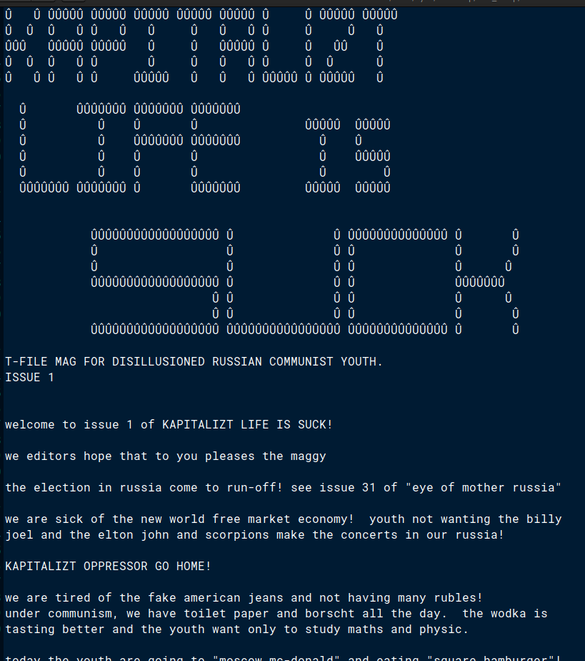

Slide 4
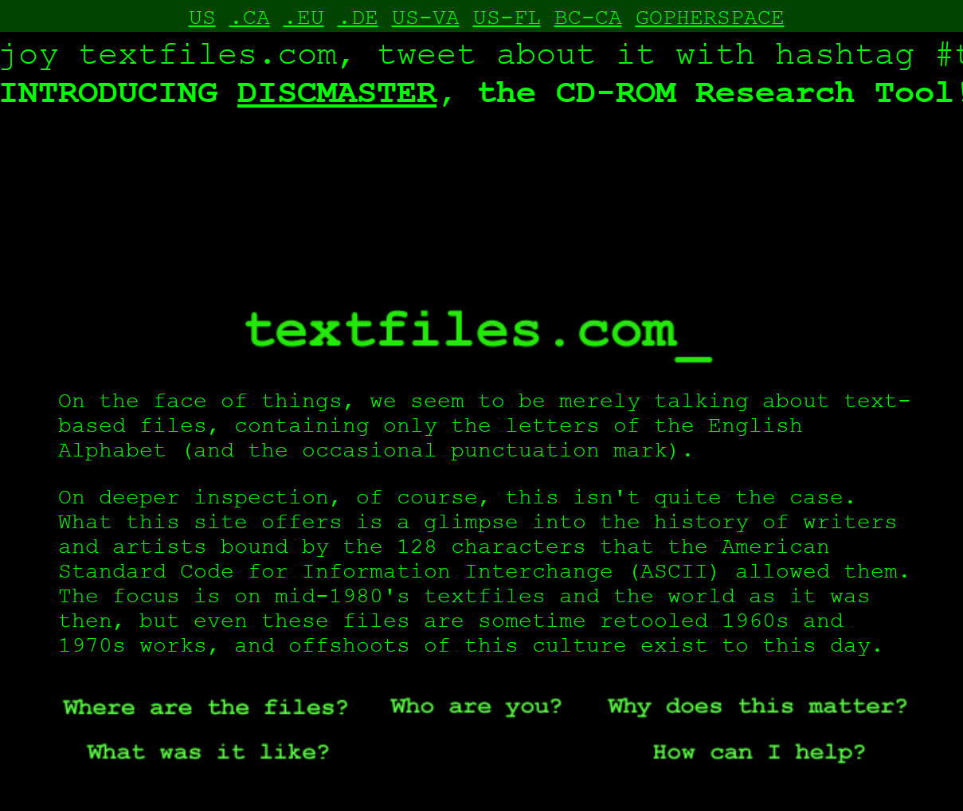
http://textfiles.com/art/

Slide 5
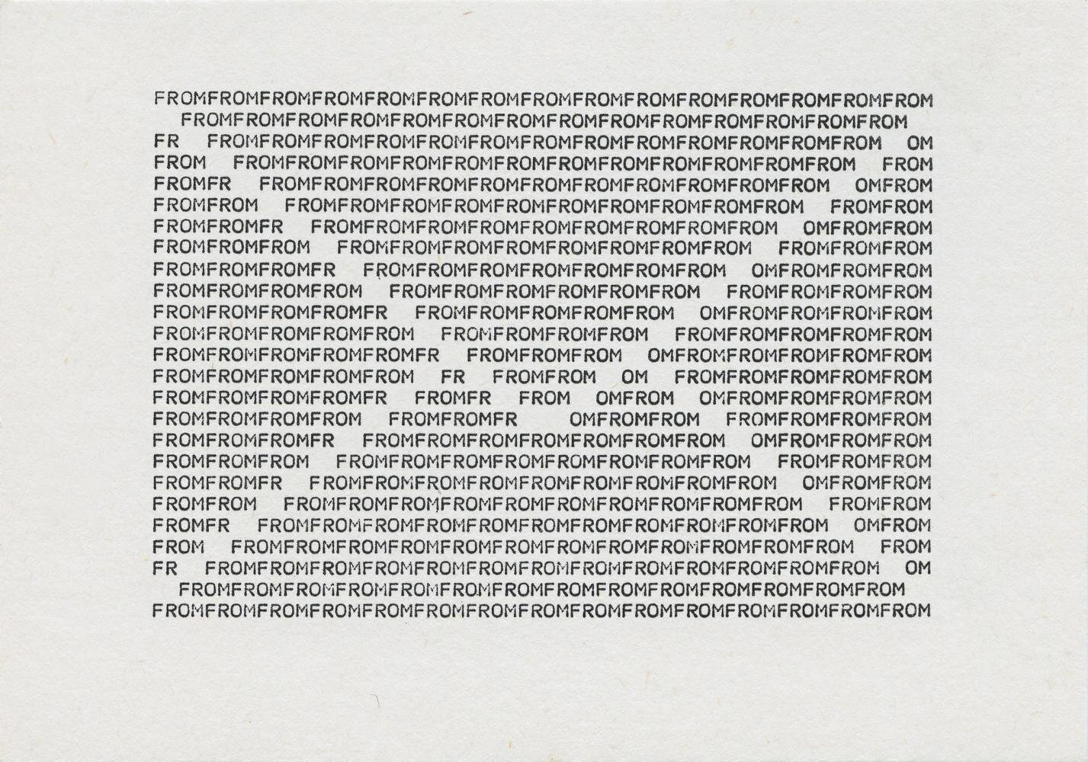
Ruth Wolf-Rehfeldt, 1974

Slide 6
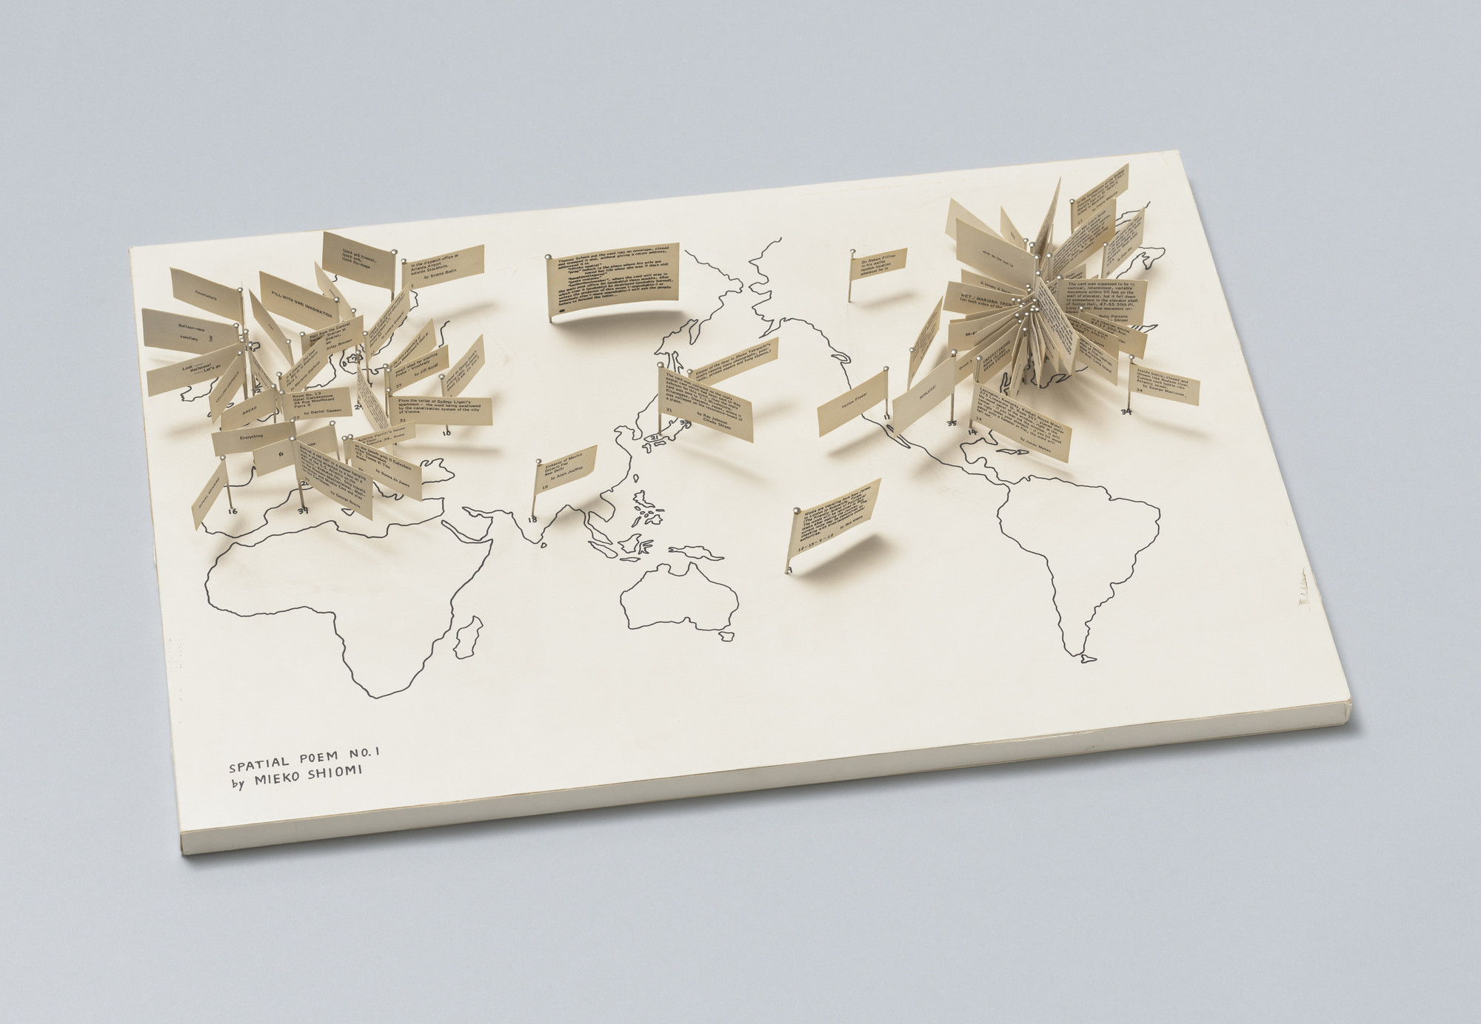
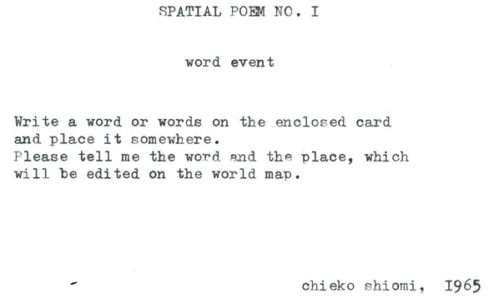
Mieko Shiomi, Spatial Poem (1965)

Slide 7

Paul van Ostaijen, Bezette Stad, 1921

Slide 8
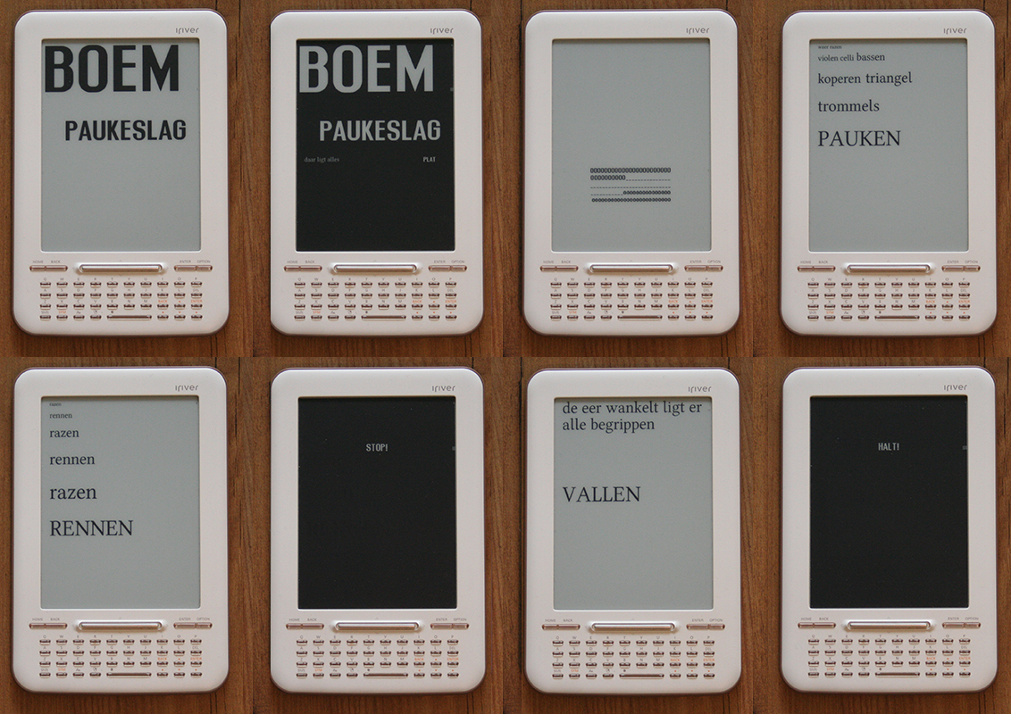
Megan Hoogenboom, 2014

Slide 9
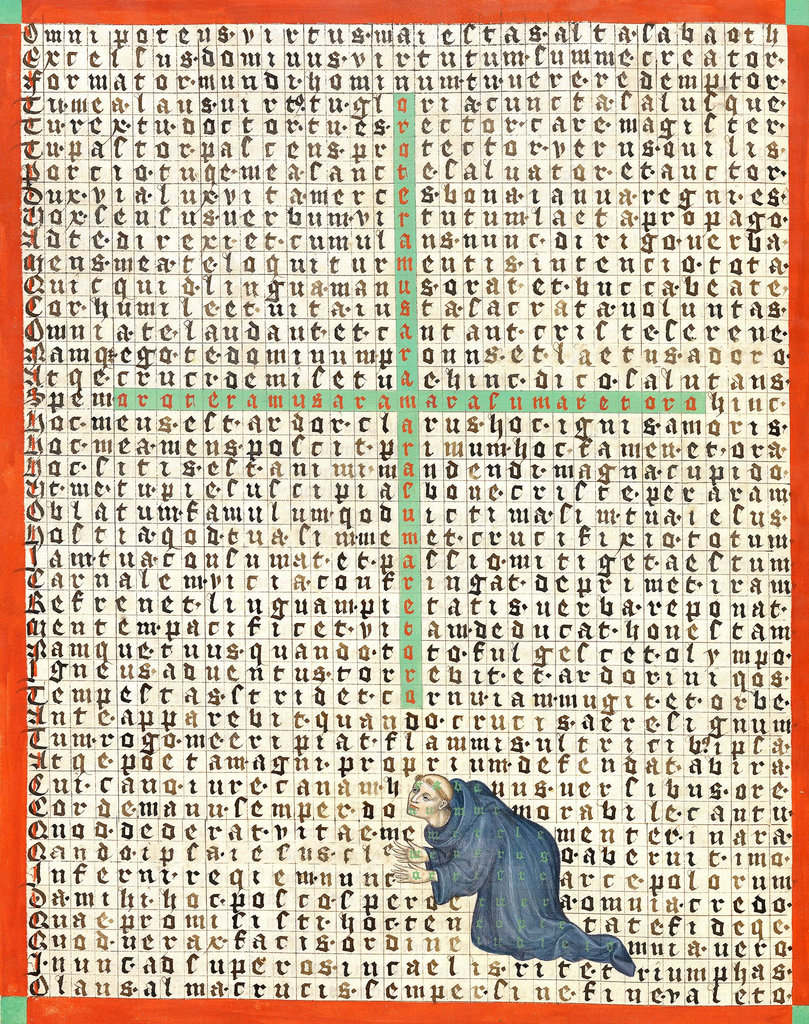
Hrabanus Maurus, ca. 850

Slide 11
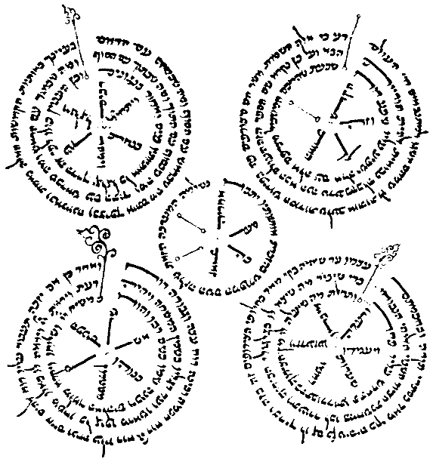
Abraham Abulafia, ca. 1250

Slide 12
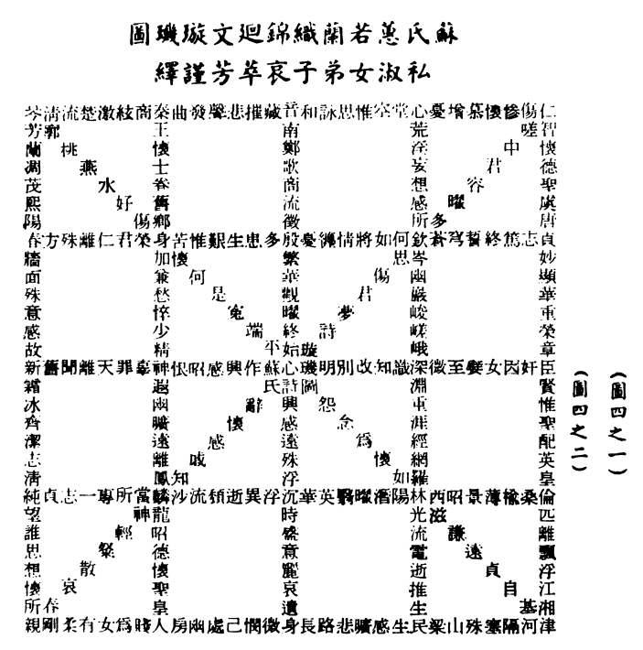
Su Hui (2nd Century A.D.), text about her husband's [a Han Dynasty court official] infidelities; can be read in 40,000 different ways.
Notes:
Arabic, Persian calligraphy

Slide 13
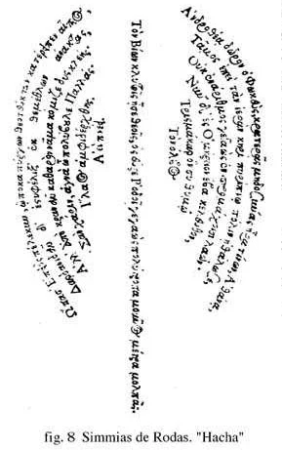
Simmias of Rhodes, ca. 300 BC

Slide 14
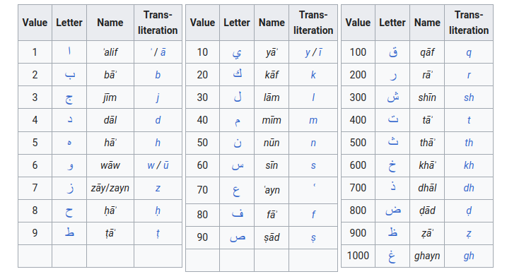
Arabic Abjad numerals

Slide 15
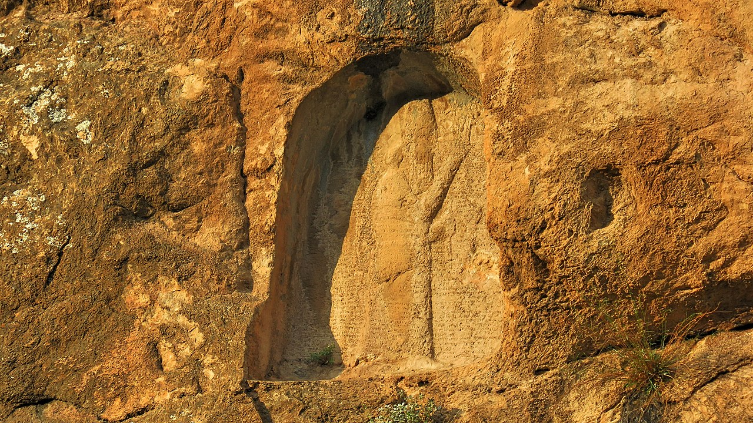
The first use of gematria occurs in an inscription of Sargon II (727–707 B.C.E.) which states that the king built the wall of Khorsabad 16,283 cubits long to correspond with the numerical value of his name.

Slide 16
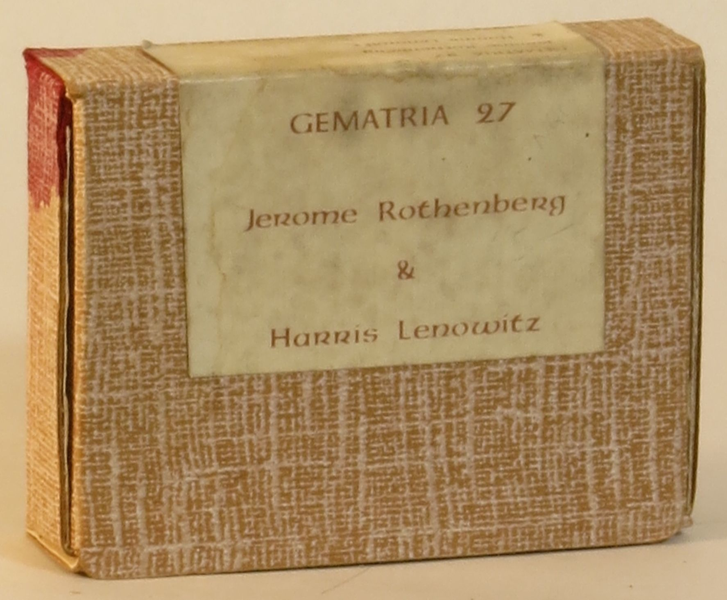
My Heart (1) My Heart (2)
Flaming. Blood

Slide 17
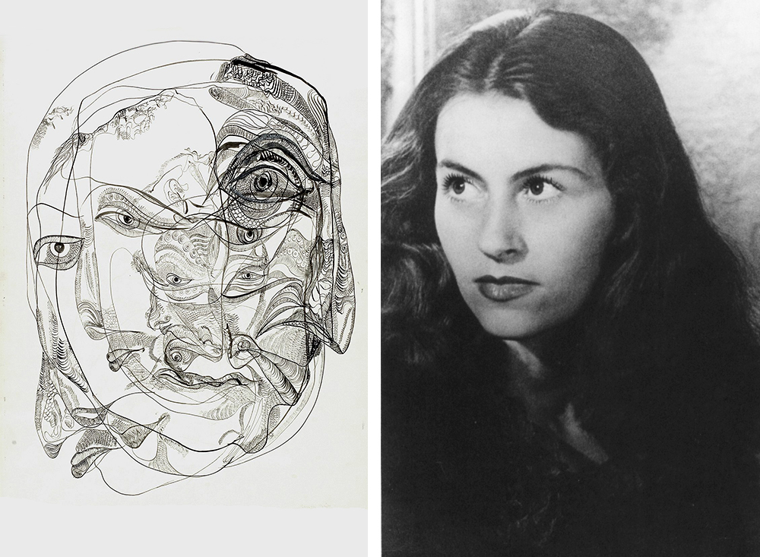
We love death
Red winds the body,
bread turn into sorrow,
end misery, axe becomes
life. We, your death,
weave your line
in the earth. Wild messengers,
we love death.
1956
Wir lieben den Tod
Rot winde den Leib,
Brot wende in Leid,
ende Not, Beil wird
Leben. Wir, dein Tod,
weben dein Lot dir
in Erde. Wildboten,
wir lieben den Tod.
Unica Zürn, Hexentexte ("Witches Texts")

Slide 18
Divos fallere perfide sperasti te Proteu.
Divos fallere perfide te sperasti Proteu.
Divos fallere sperasti perfide te Proteu.
Divos fallere sperasti te perfide Proteu.
Divos fallere te perfide sperasti Proteu.
Divos fallere te sperasti perfide Proteu.
Divos perfide fallere sperasti te Proteu.
Divos perfide fallere te sperasti Proteu.
Divos perfide sperasti fallere te Proteu.
Divos perfide sperasti te fallere Proteu.
Divos perfide te fallere sperasti Proteu.
Divos perfide te sperasti fallere Proteu.
Divos sperasti fallere perfide te Proteu.
Divos sperasti fallere te perfide Proteu.
Divos sperasti perfide fallere te Proteu.
Divos sperasti perfide te fallere Proteu.
Divos sperasti te fallere perfide Proteu.
Divos sperasti te perfide fallere Proteu.
Divos te fallere perfide sperasti Proteu.
Divos te fallere sperasti perfide Proteu.
Divos te perfide fallere sperasti Proteu.
Divos te perfide sperasti fallere Proteu.
Divos te sperasti fallere perfide Proteu.
Divos te sperasti perfide fallere Proteu.
Fallere divos perfide sperasti te Proteu.
Fallere divos perfide te sperasti Proteu.
Fallere divos sperasti perfide te Proteu.
Fallere divos sperasti te perfide Proteu.
Fallere divos te perfide sperasti Proteu.
Fallere divos te sperasti perfide Proteu.
Fallere perfide divos sperasti te Proteu.
Fallere perfide divos te sperasti Proteu.
Fallere perfide Proteu sperasti te divos.
Fallere perfide Proteu te sperasti divos.
Fallere perfide sperasti divos te Proteu.
Fallere perfide sperasti Proteu te divos.
Julius Caesar Scaliger,
Proteus poem, 1561
(240 shuffles/permutations are possible)

Slide 19
Brion Gysin, Junk is no good (1962)
https://www.youtube.com/watch?v=63L1_8NnD2U

Slide 20
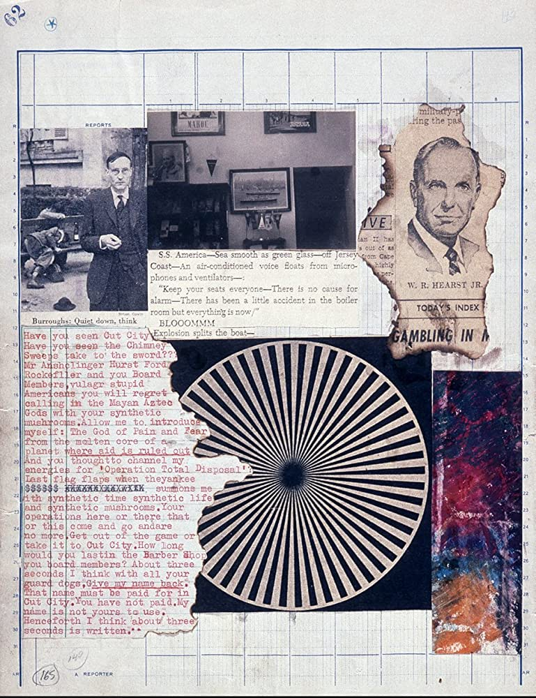
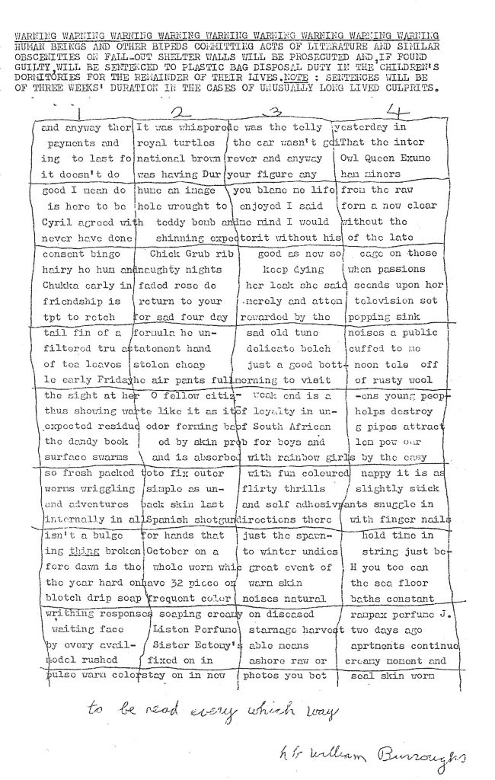
Brion Gysin & Willam S. Burroughs, Cut-Ups (1960s)

Slide 21
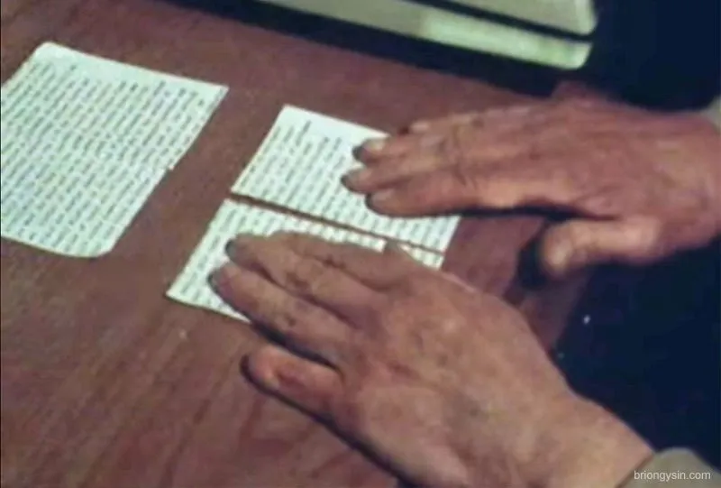
David Bowie
https://www.youtube.com/watch?v=m1InCrzGIPU&t=10s

Slide 22
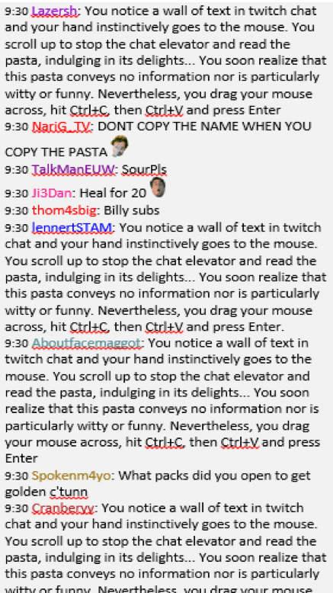
copypasta

Slide 23
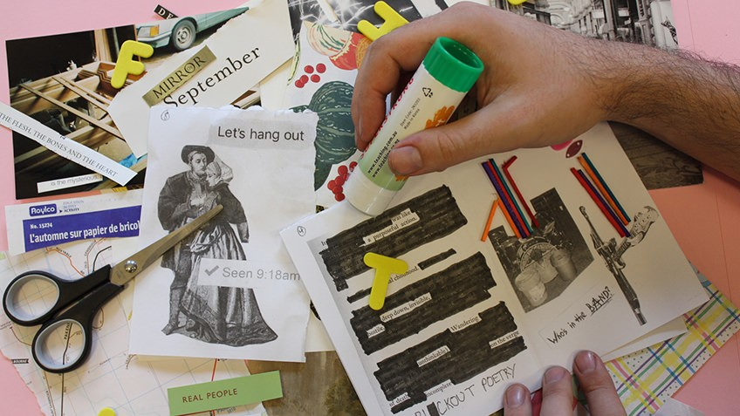

Slide 24
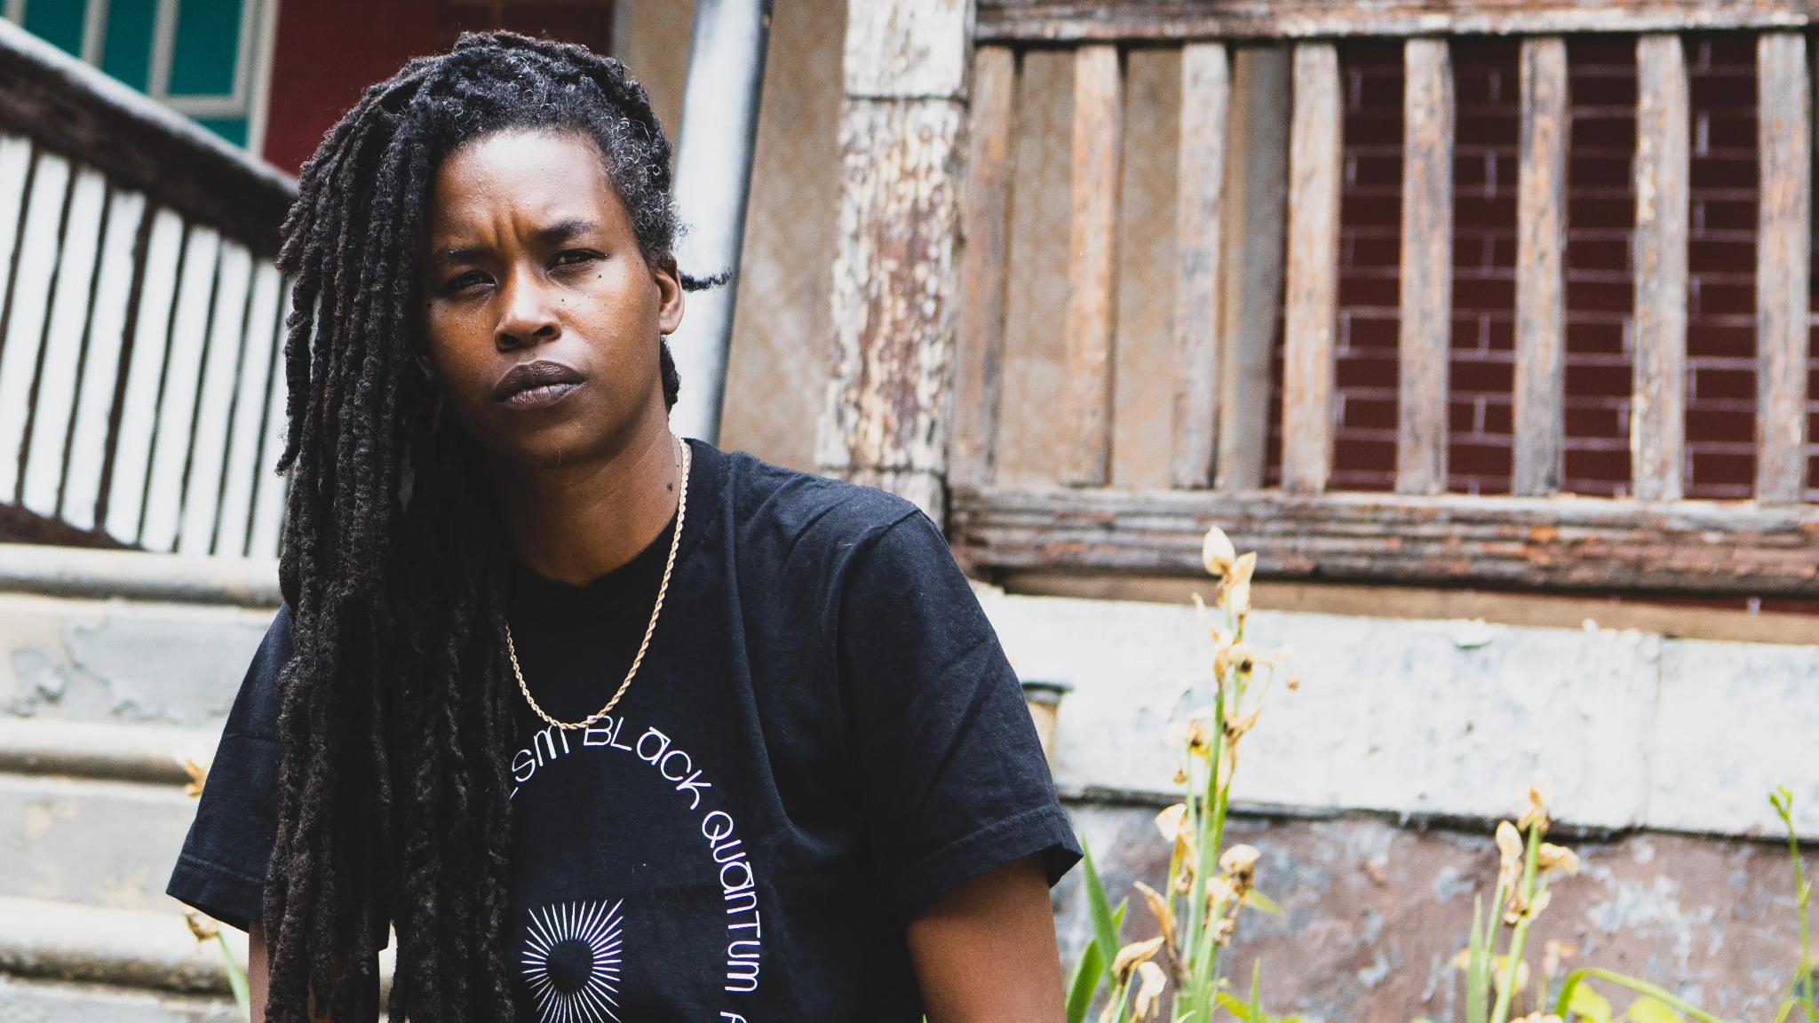
Moor Mother
https://youtu.be/OgyhcFdmwK0?t=122

Slide 25
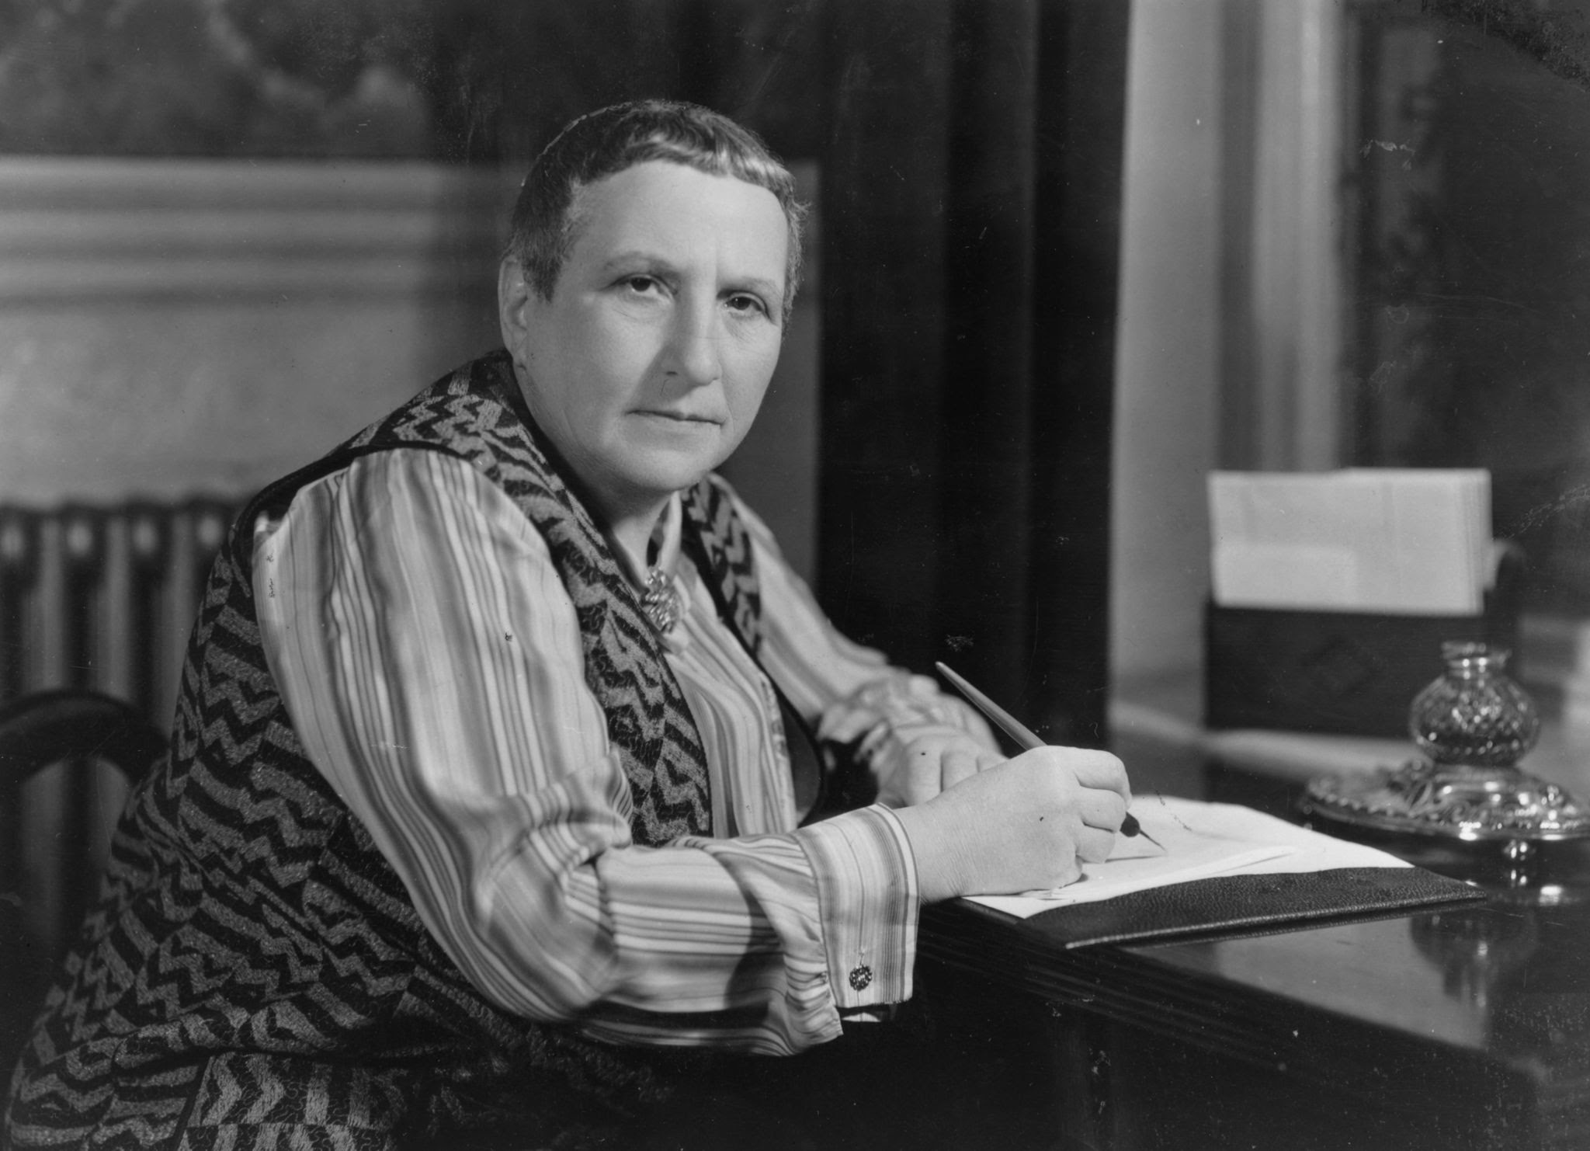
Gertrude Stein, If I Told Him, A Completed Portrait of Picasso (1923)
https://www.youtube.com/watch?v=63L1_8NnD2U

Slide 26
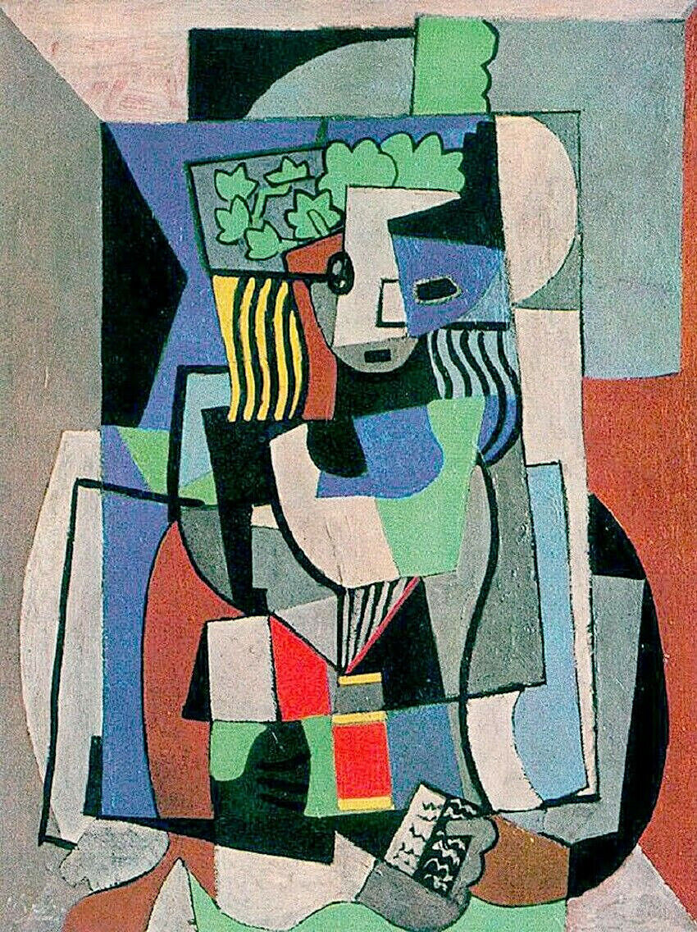
Pablo Picasso, The Student (1919)

Slide 27
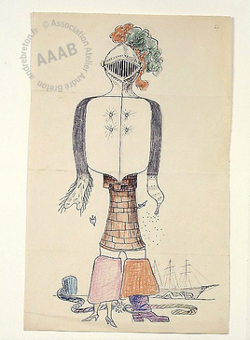
Surrealist exquisit corpse, 1927, by Max Morise, Man Ray, André Breton & Yves Tanguy

Slide 28
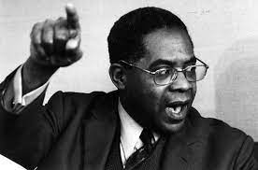
Aimé Césaire

Slide 29
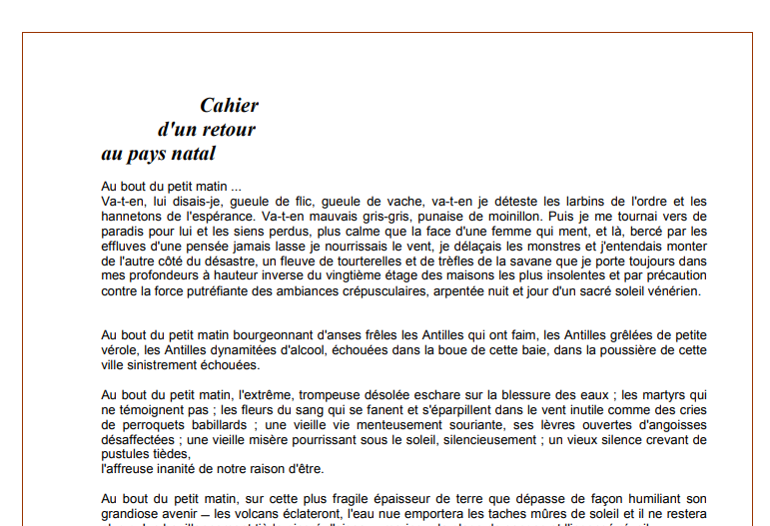
1939

Slide 30
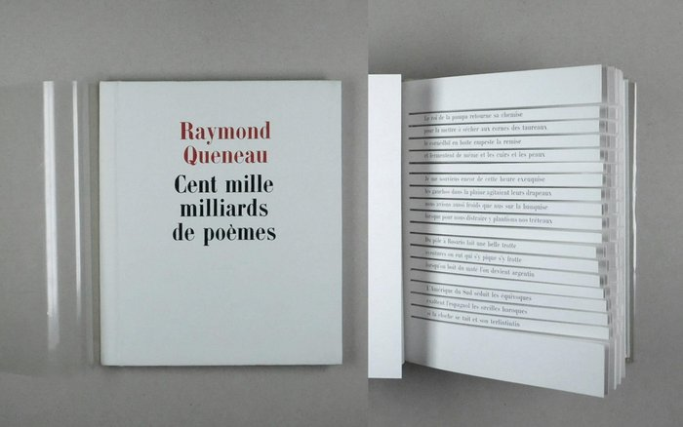

Slide 31
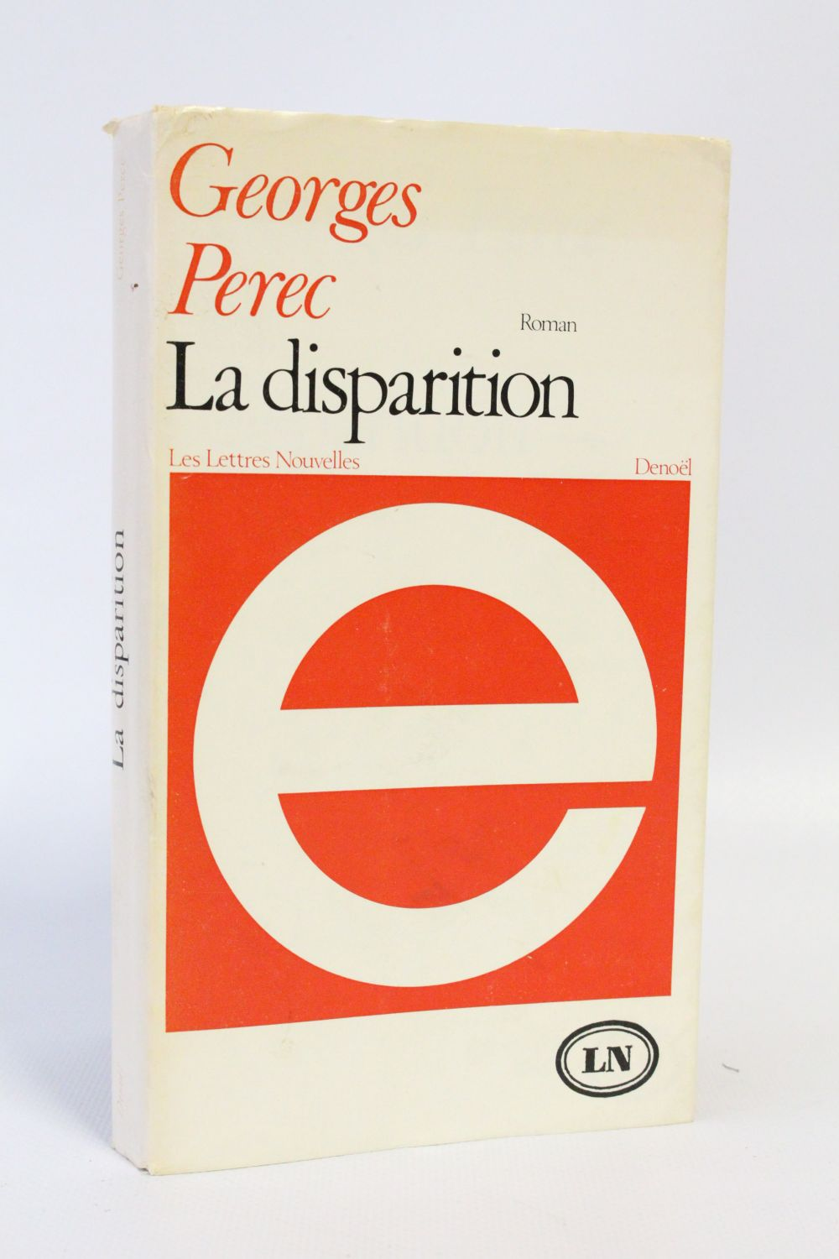
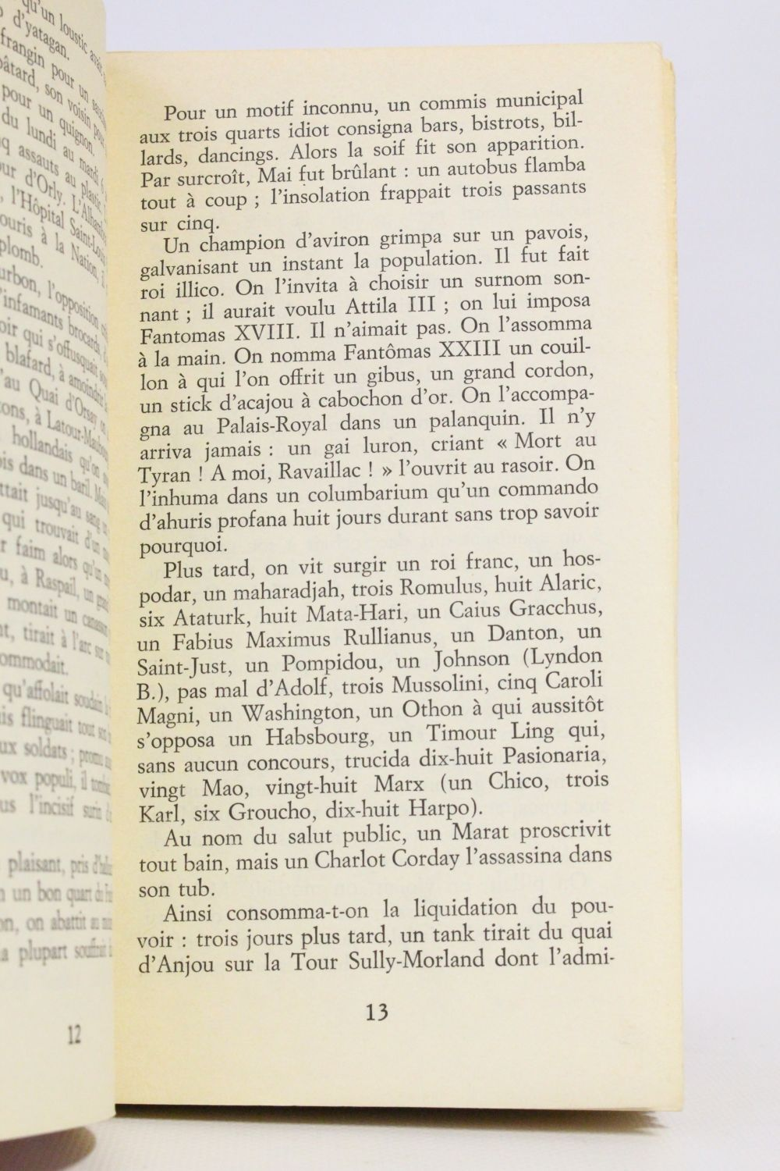

Slide 32
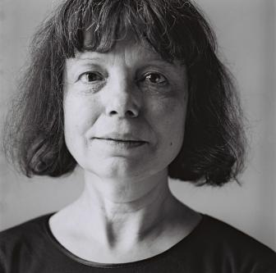
OULIPIAN TREATY
Oulipian treaty Subtle meaning Cold apocalypse
Praise given
Aztec melancholy Black handlebar Elementary opposition
Chrome-plated sector
Phonetic sum Slow household Elementary page
Combinatory literature
I am tall
the earth grows
I am born
a man sleeps
all ends
Pierrot changed the
meaning of the palindrome
Nonexistent turn Invisible stations Lived autobiography
Unforgettable column
Michelle Grangaud

Slide 33
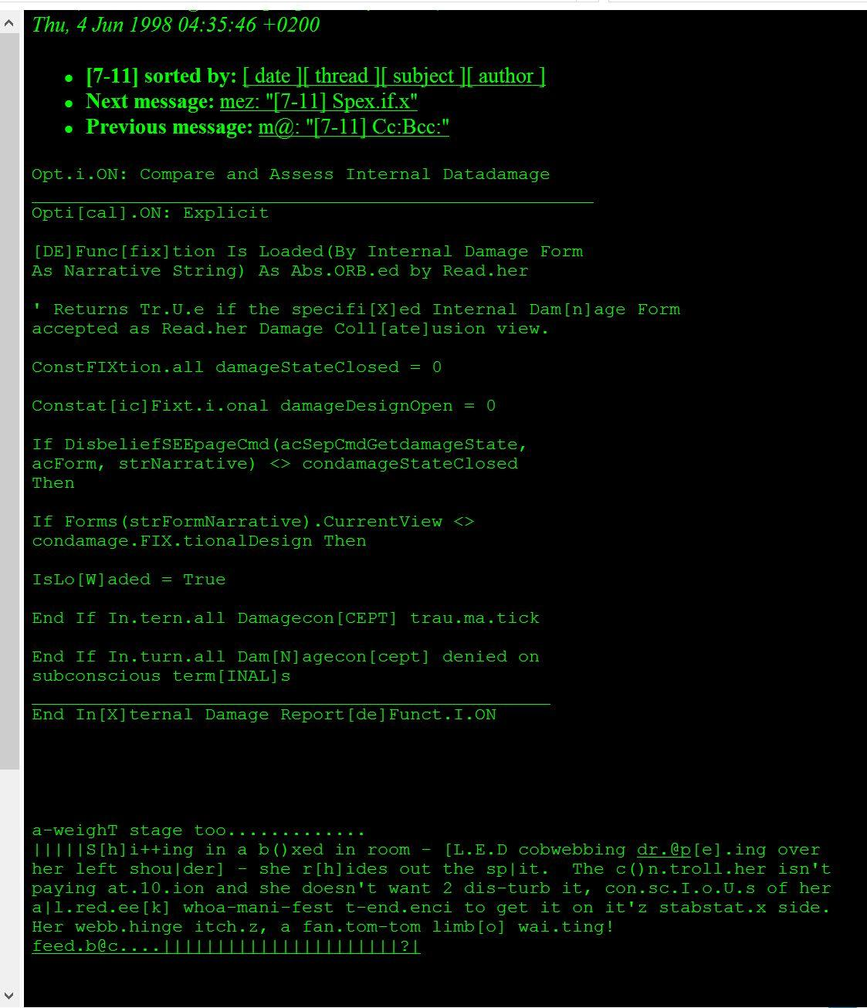
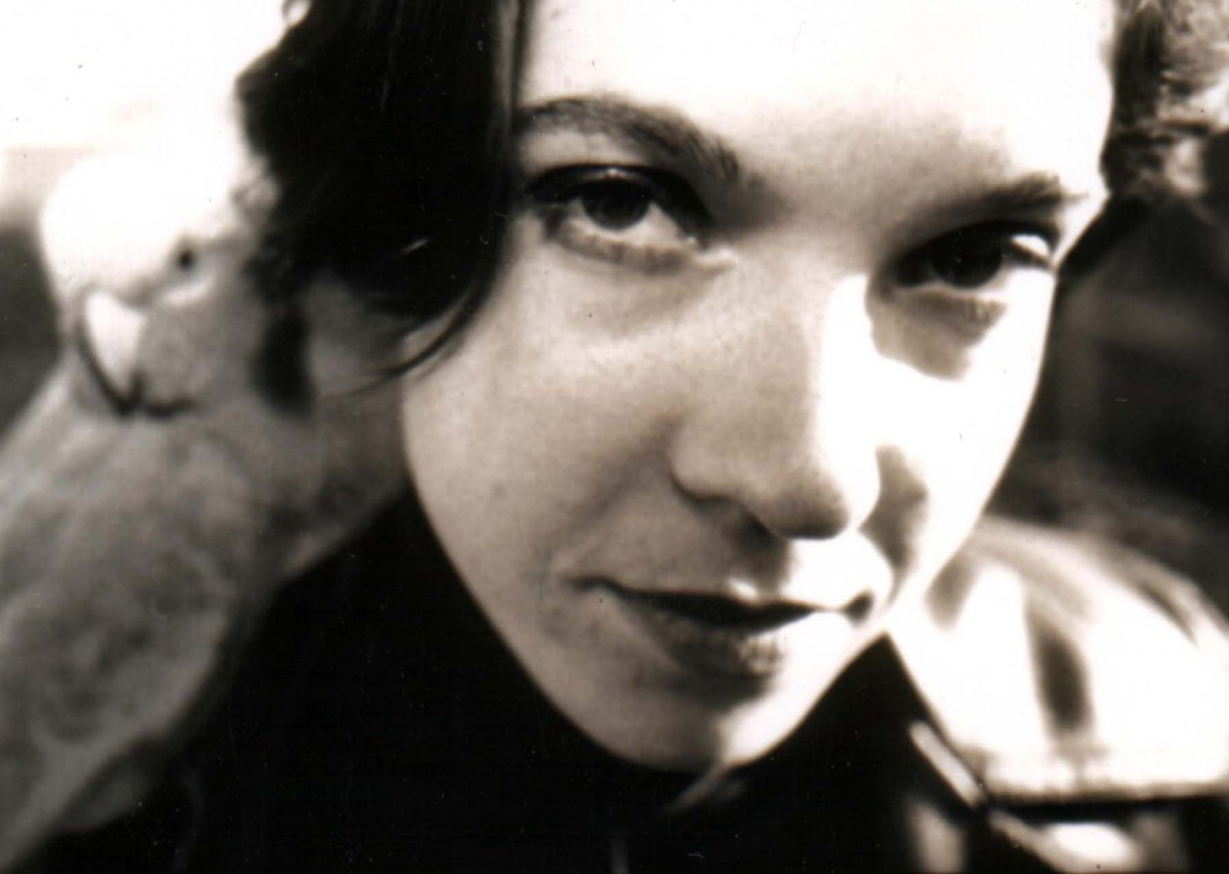
Code poetry by
mez breeze
(early 2000s, Australia)

Slide 34
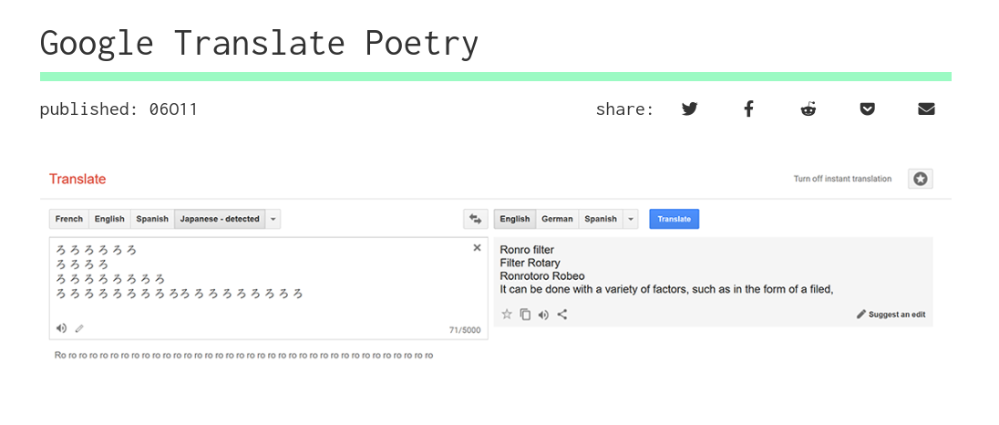

Slide 35
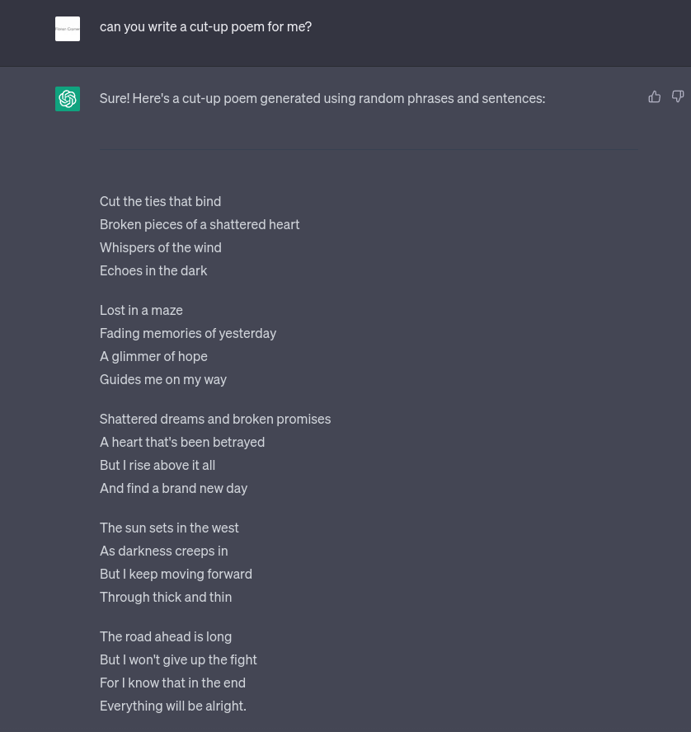

Slide 36
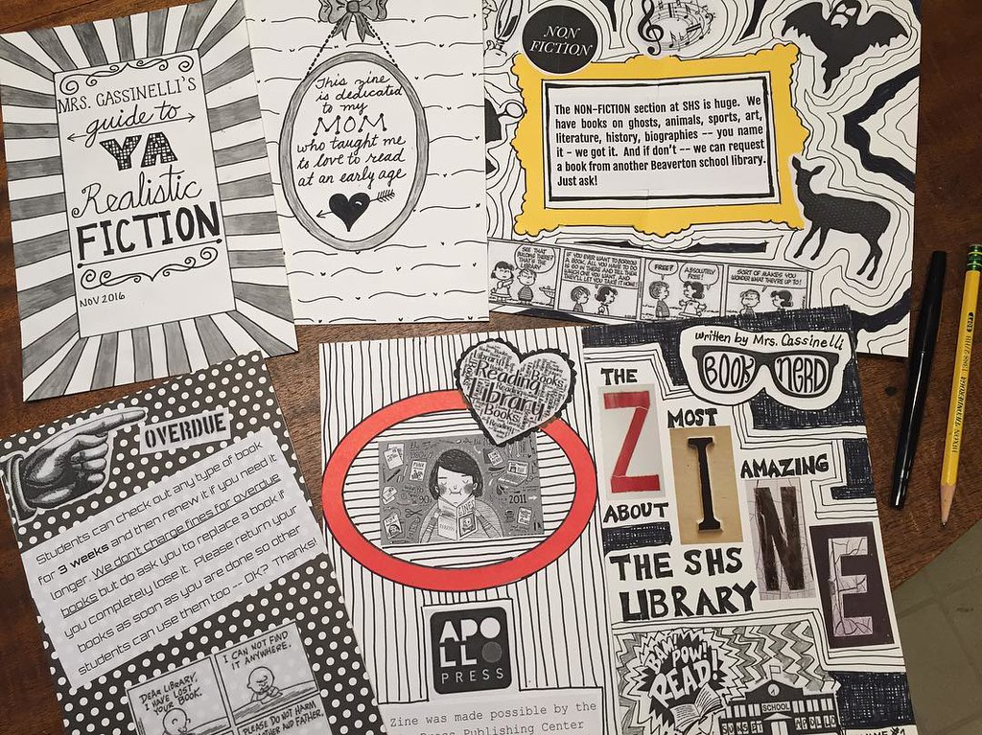

Slide 37


