Slide 1
Florian Cramer
Rotterdam University of Applied Sciences
("Fachhochschule Rotterdam" /
"Rotterdam Polytechnic")
Willem de Kooning Academy
Piet Zwart Institute

Slide 2
Dutch art education:
"hogescholen"/polytechnic/Fachhochschule
no university status, mostly Bachelors programs + small Masters programs
(WdKA: 2000 Bachelor + 100 Masters students; less than 100 in Fine Art)
non-university-equivalent degrees (in NL)
Notes:
Actually, a bit lower than German Fachhochschule: even "Berufsausbildungen"/vocational trainings such as nurse and physiotherapist are part of Dutch polytechnical education.

Slide 3
before 2000: no professors
since 2000: "lectoren"
(readers / akademische Räte / Juniorprofessoren) as "practice-oriented research professors"
at WdKA: 3 research professorships (2 FTE)
Notes:
The job names of our teachers are factually "höherer Berufsschullehrer", "teachers in higher vocational training".

Slide 4
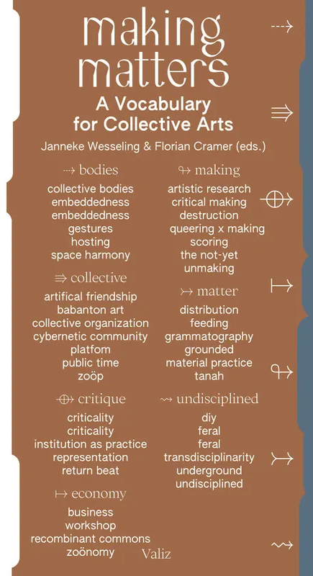
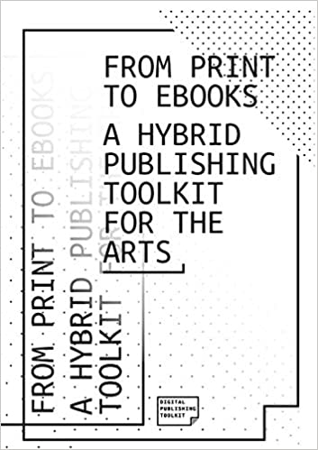
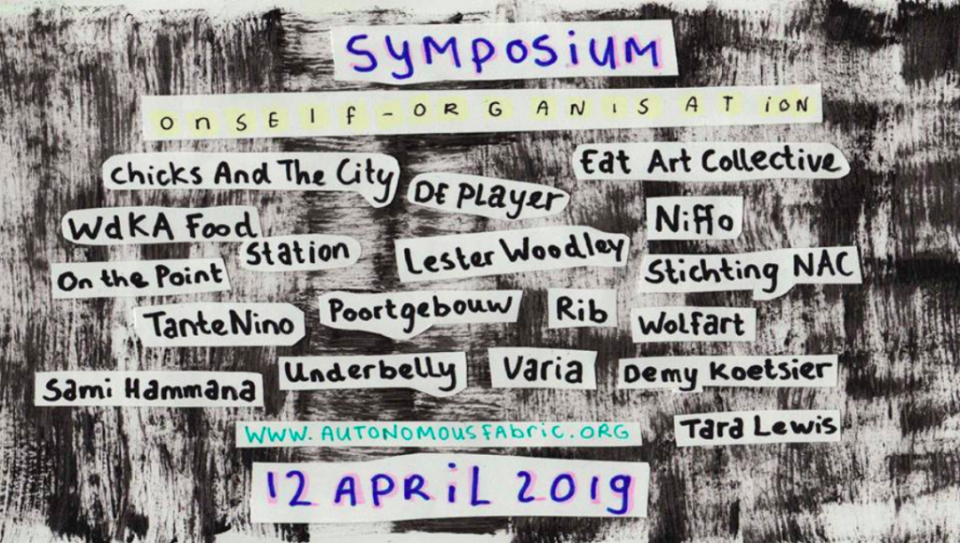
Notes:
Lector since 2008, before that wissenschaftlicher Mitarbeiter/lecturer at Freie Universität Berlin in Comparative Literature; in a faculty where there was a lot of collaboration and overlap between art theory and art practice.

Slide 5
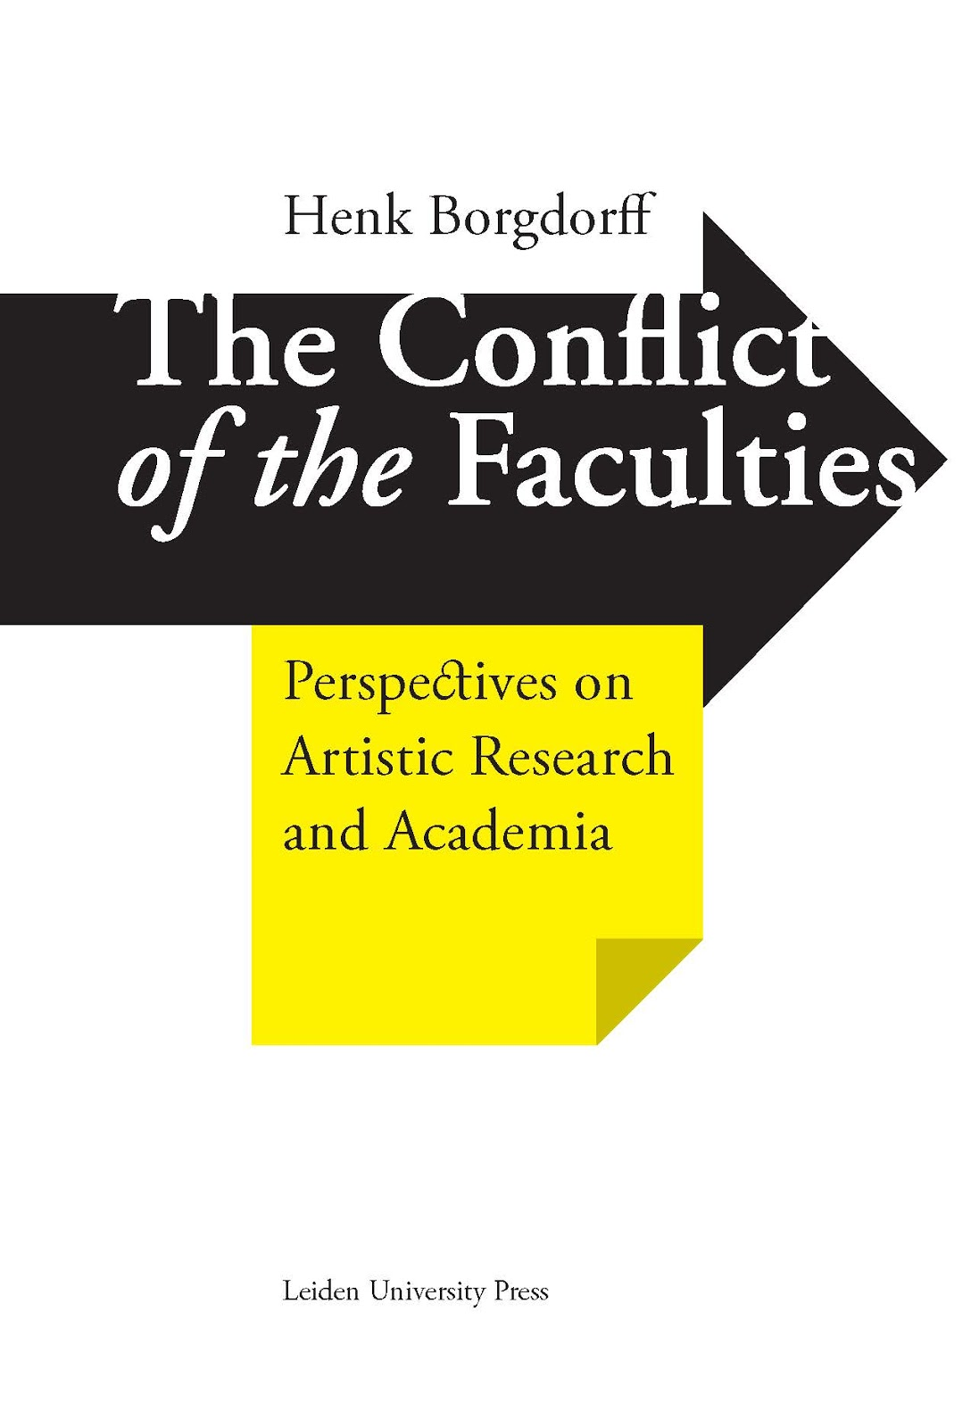
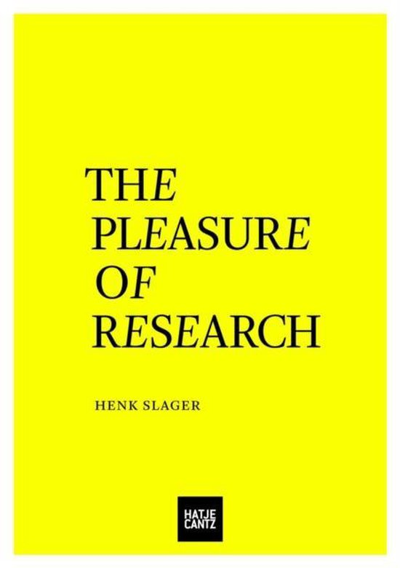
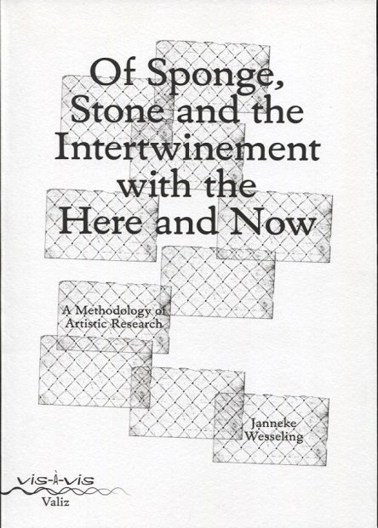
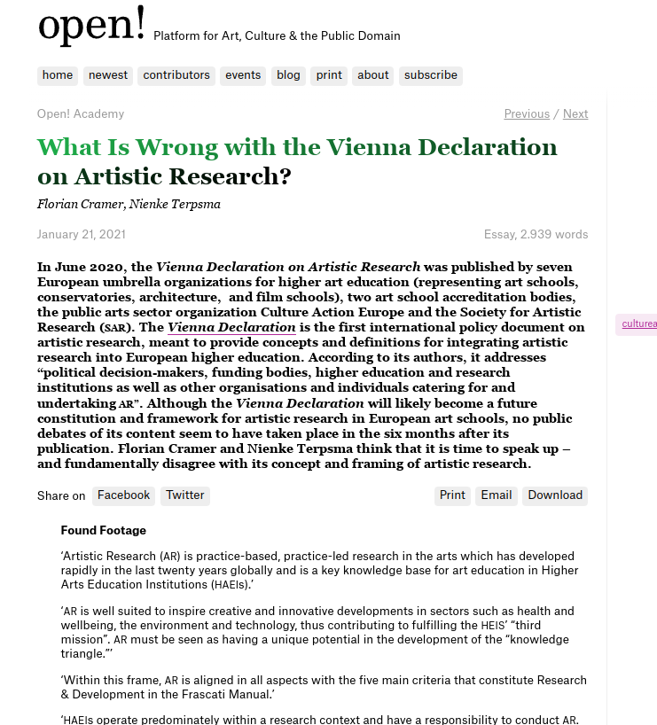
Notes:
Next to Scandinavia and Germany, the Netherlands are among the main producers of literature on artistic research. But I would argue that most of it is simply born out of the restrictions of the Dutch higher educational system, where art schools do not have research institutional status, but are factually trade schools.

Slide 6
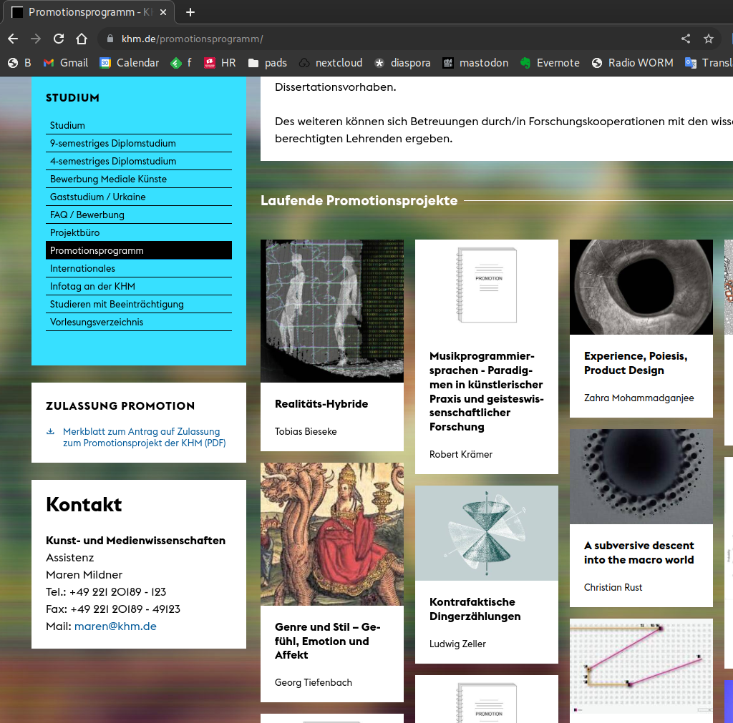
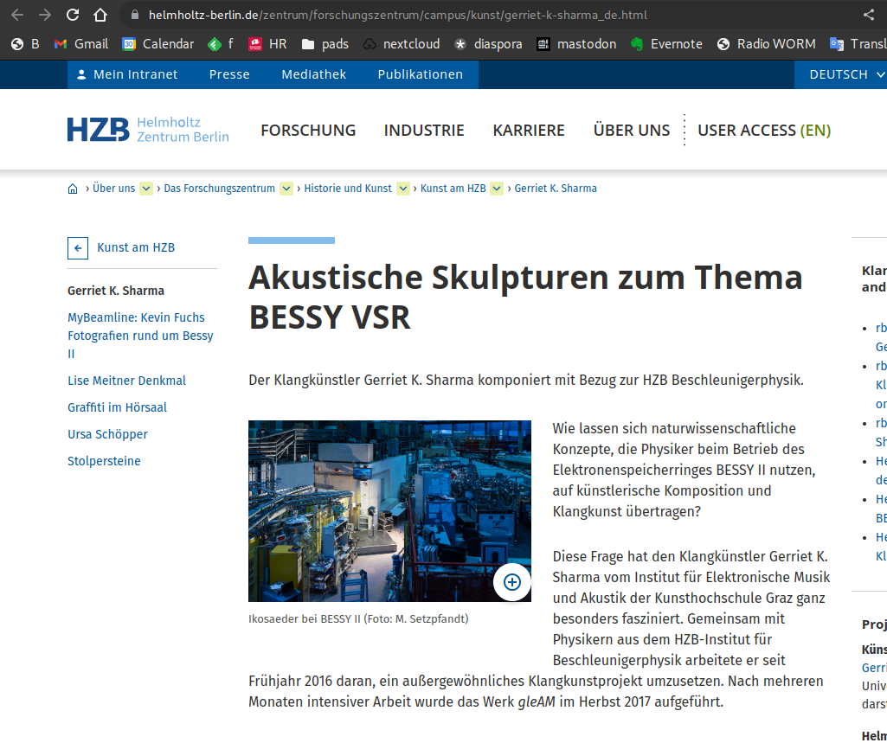
Notes:
None of this exists or is currently possible in the Netherlands. Doesn't Germany already have "artistic research"/"künstlerische Forschung" since a long time, and as a well-institutionalized practice?

Slide 7
J.J.F.Cramer@hr.nl

