Slide 1
The Schemastism of Conceptual Art
From the Analytic Proposition to the Culture Industry
Stephen Zepke

Slide 2
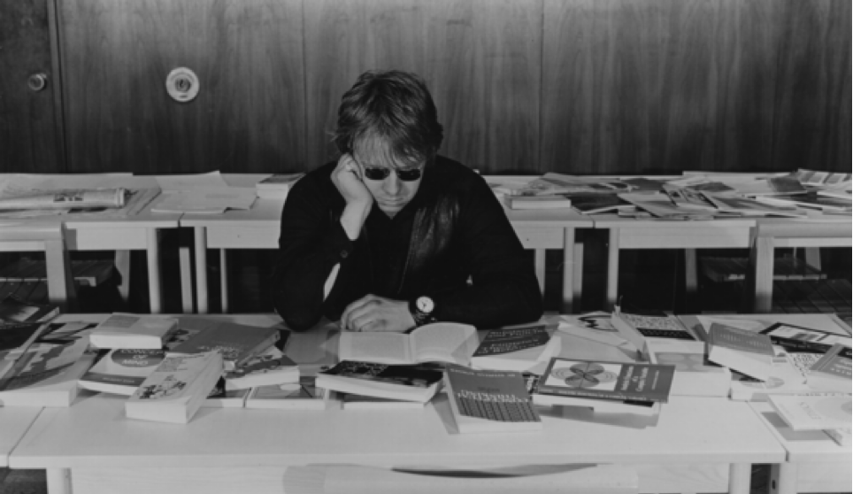
Joseph Kosuth, Information Room, 1970. New York Cultural Center.

Slide 3
‘The validity of artistic propositions is not dependent on any empirical, much less any aesthetic, presupposition about the nature of things. For the artist, as an analyst, is not directly concerned with the physical properties of things. He is concerned only with the way (1) in which art is capable of conceptual growth and (2) how his propositions are capable of logically following that growth. In other words, the propositions of art are not factual, but linguistic in character – that is, they do not describe the behaviour of physics or even mental objects; they express definitions of art, or the formal consequences of definitions of art. Accordingly, we can say that art operates on a logic. […] it is concerned with the formal consequences of our definitions (of art) and not with questions of empirical fact.’
Joseph Kosuth, ’Art After Philosophy’, p. 20-1

Slide 4
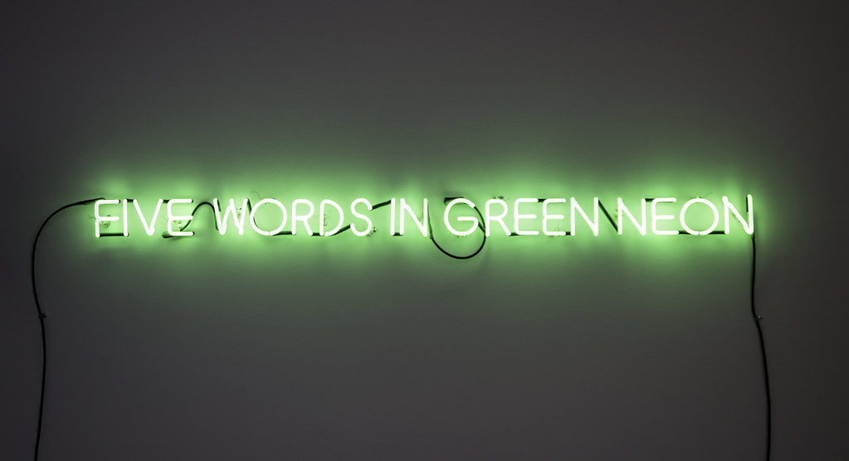
Joseph Kosuth, Five Words in Green Neon, 1965.

Slide 5
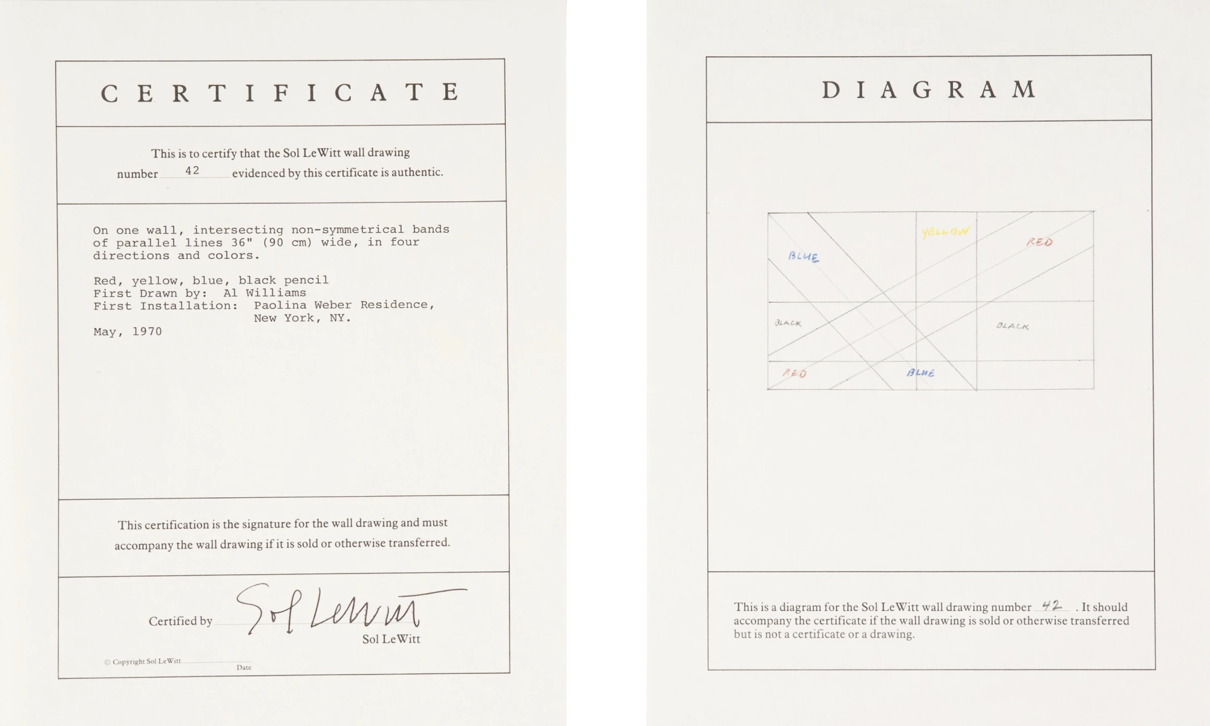

Slide 6
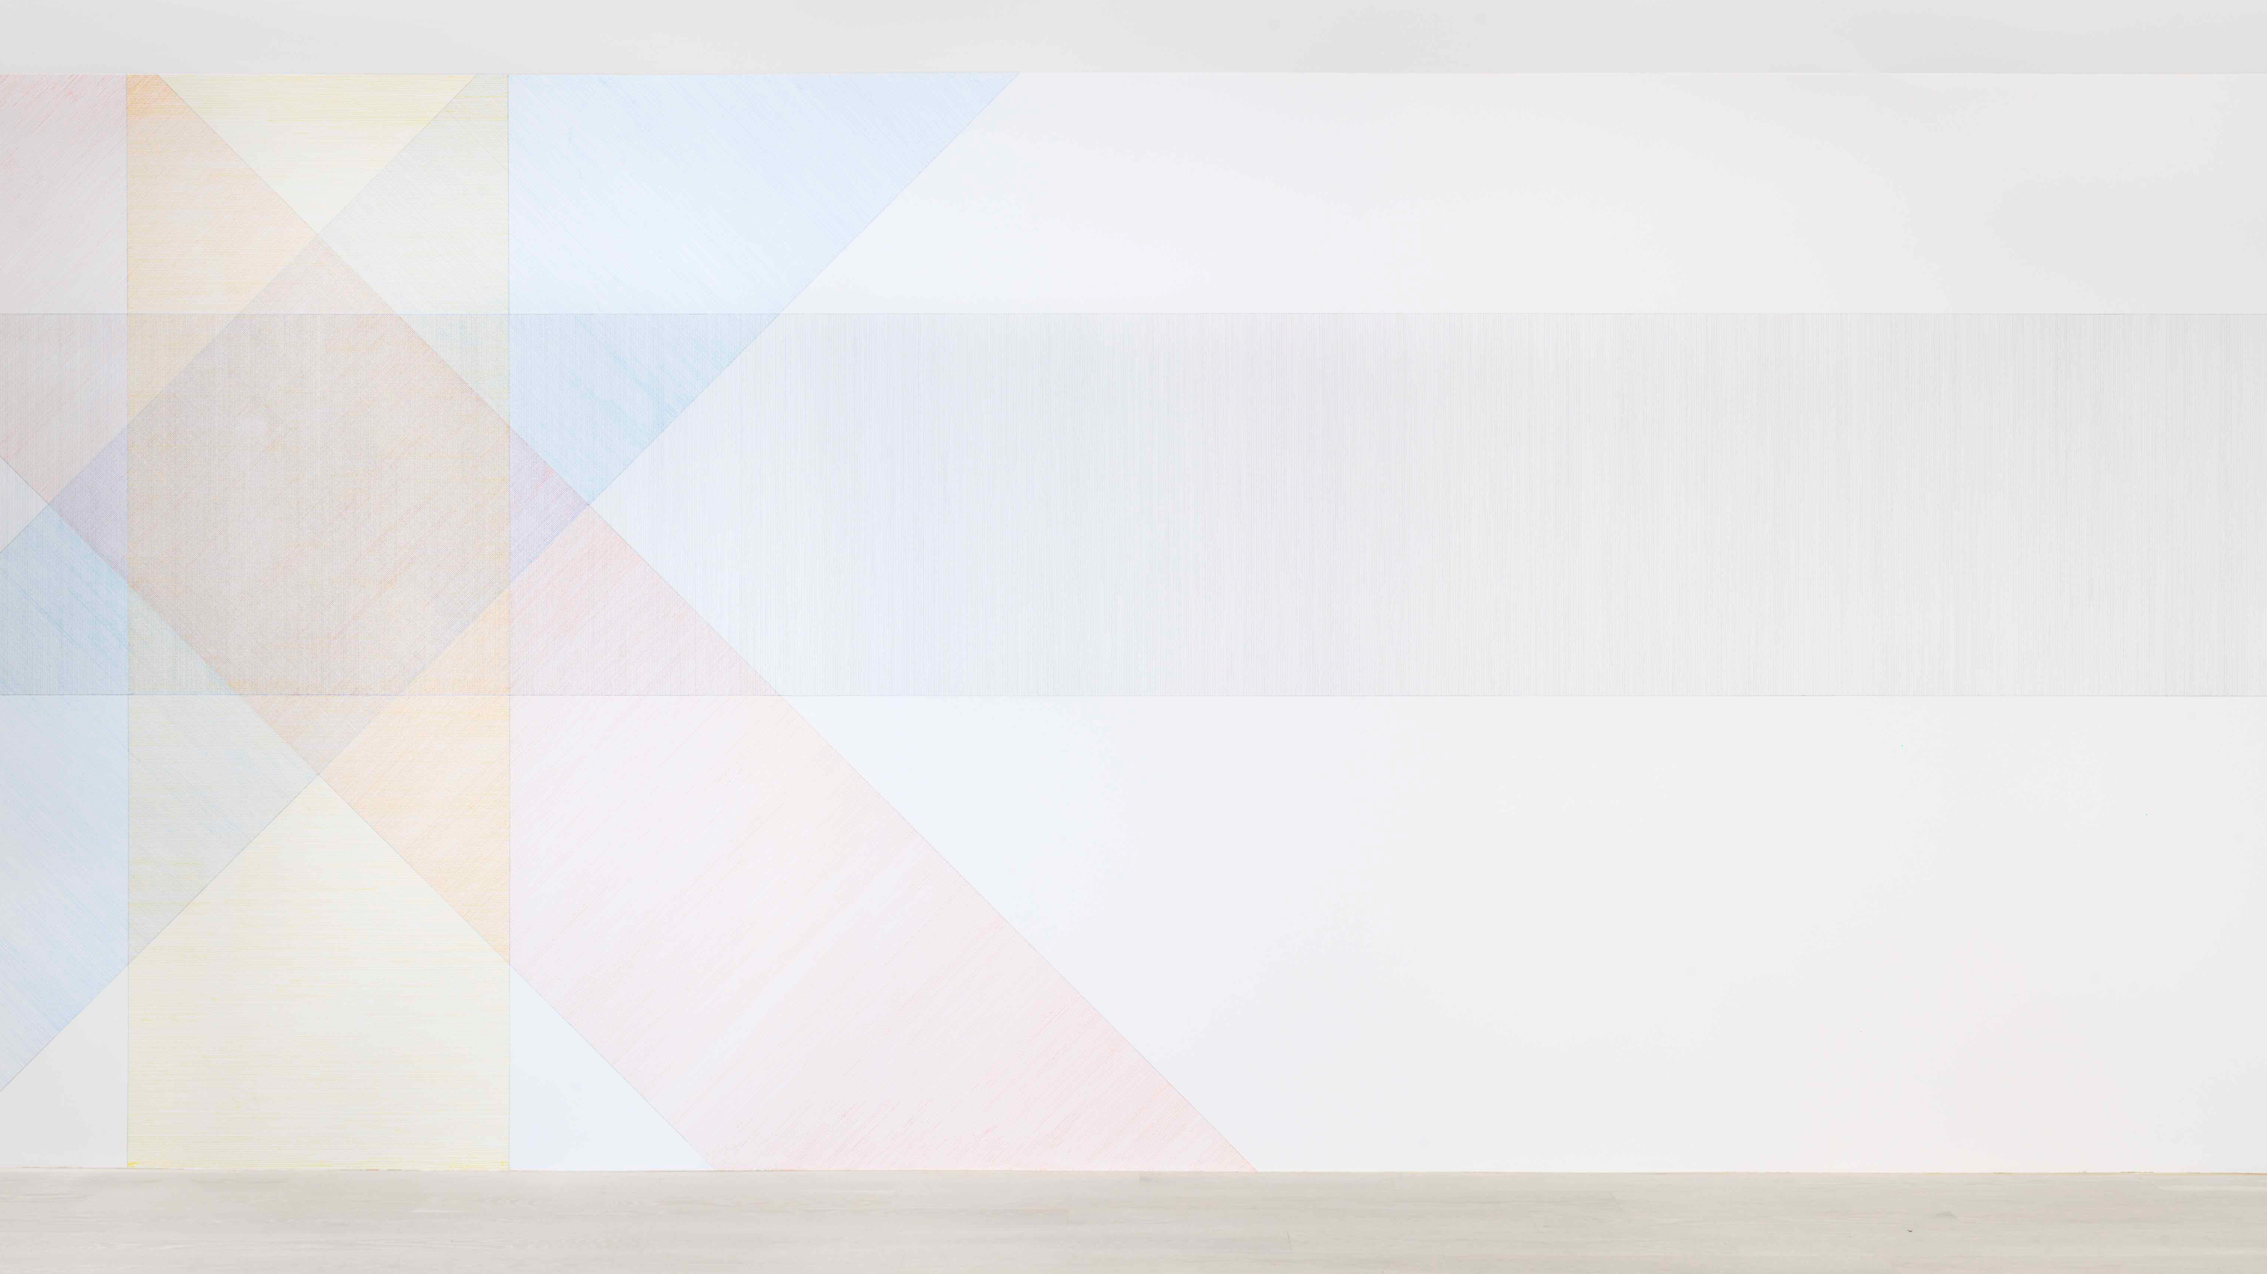
Sol Le Witt, Wall Drawing #42, 1970

Slide 7
‘It is time as given a priori which in advance bestows upon the horizon of transcendence the character of the perceivable offer. […] This single and pure ontological horizon is the condition for the possibility that the being given within it can have this or than particular revealed, indeed notice horizon.’
Heidegger, Kant and the Problem of Metaphysics, p. 76.

Slide 8
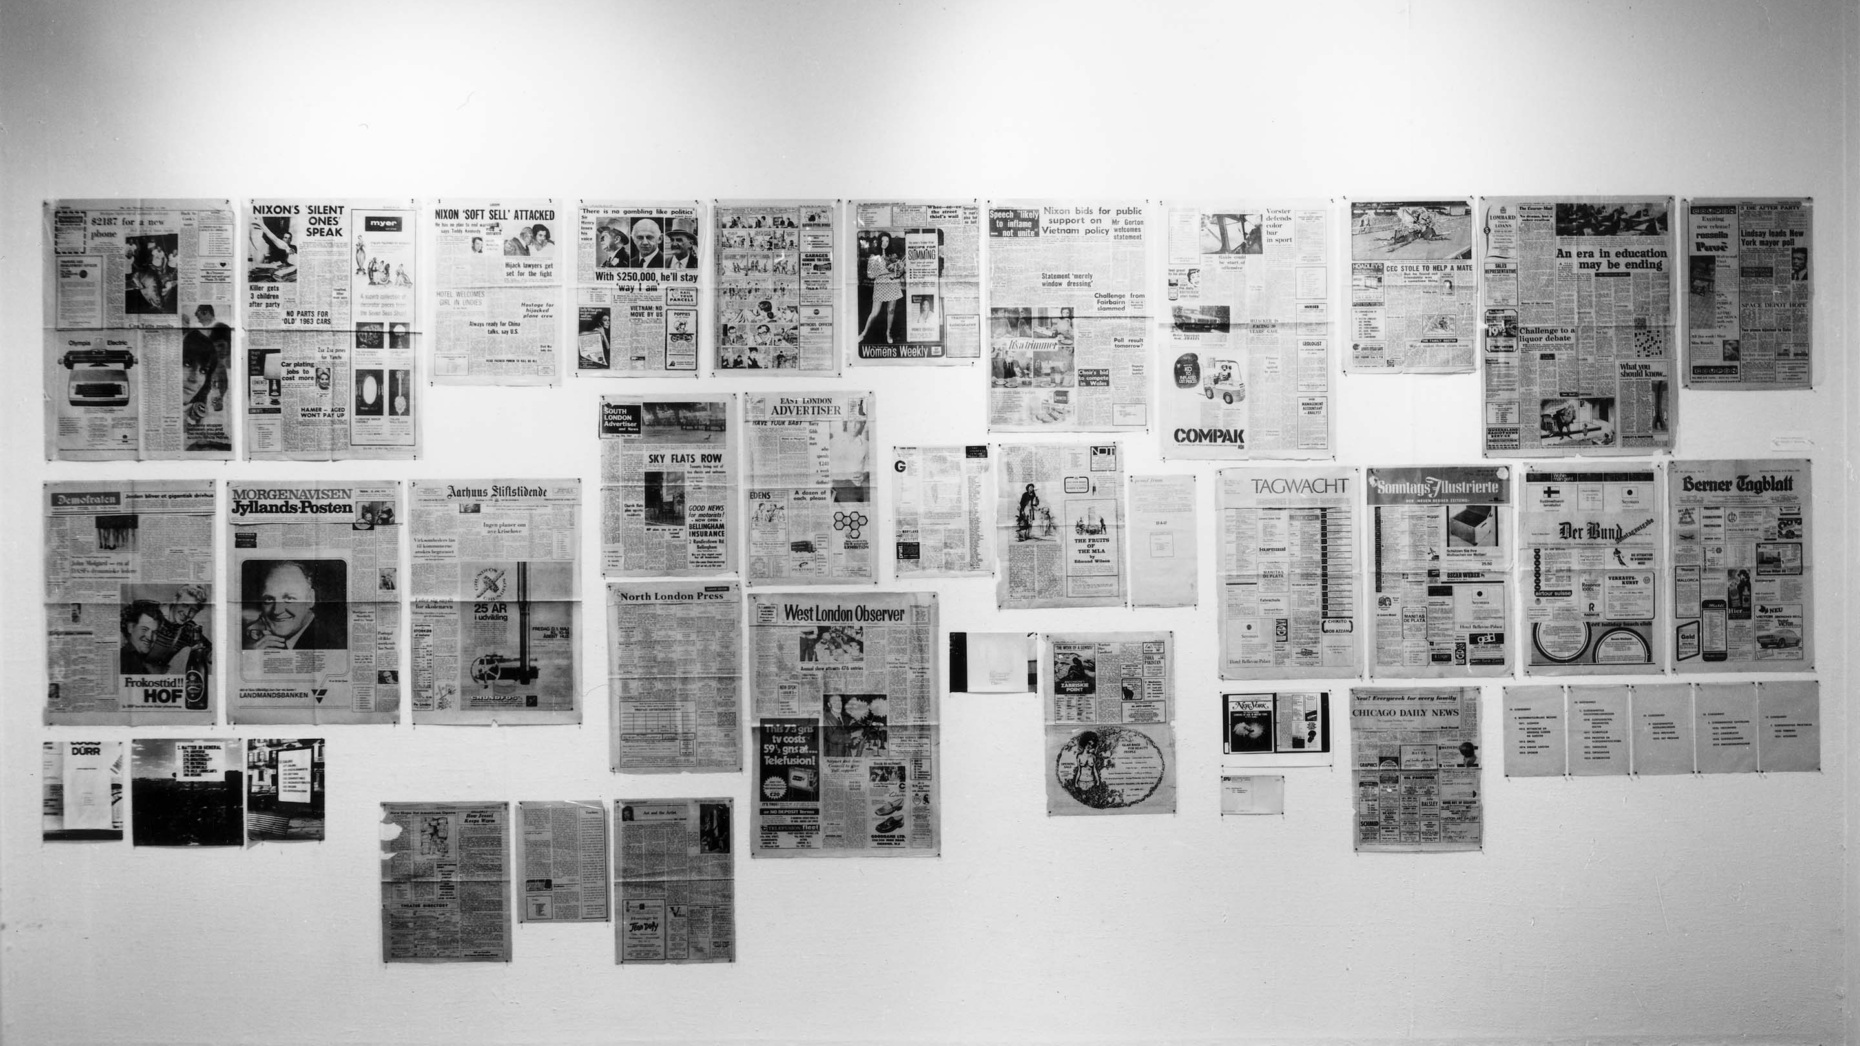
Joseph Kosuth, Second Investigation, 1968–74
Title

