Slide 1
artistic research – dead on arrival?

Slide 2
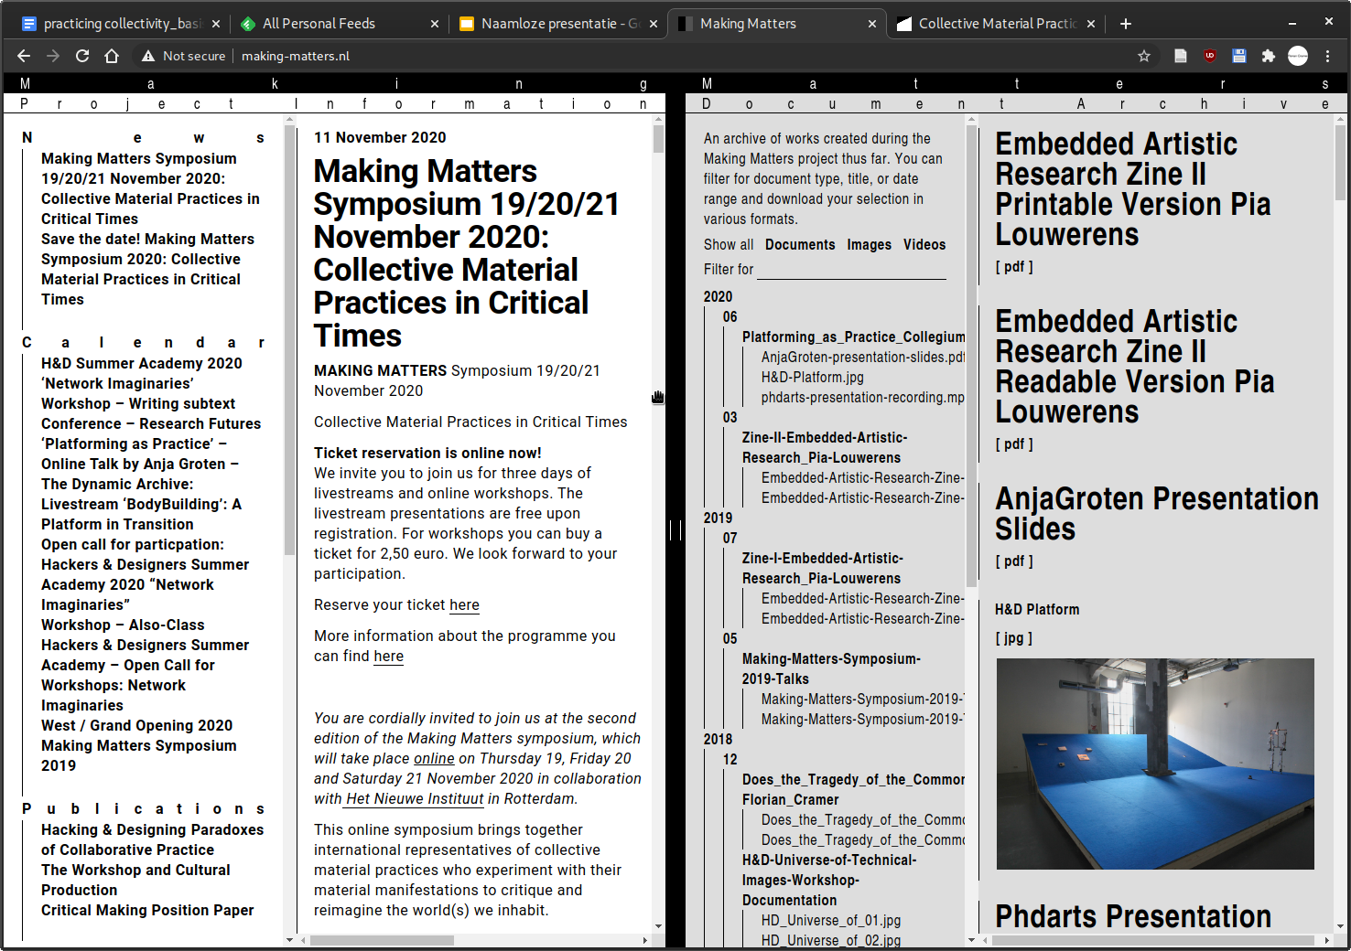

Slide 3
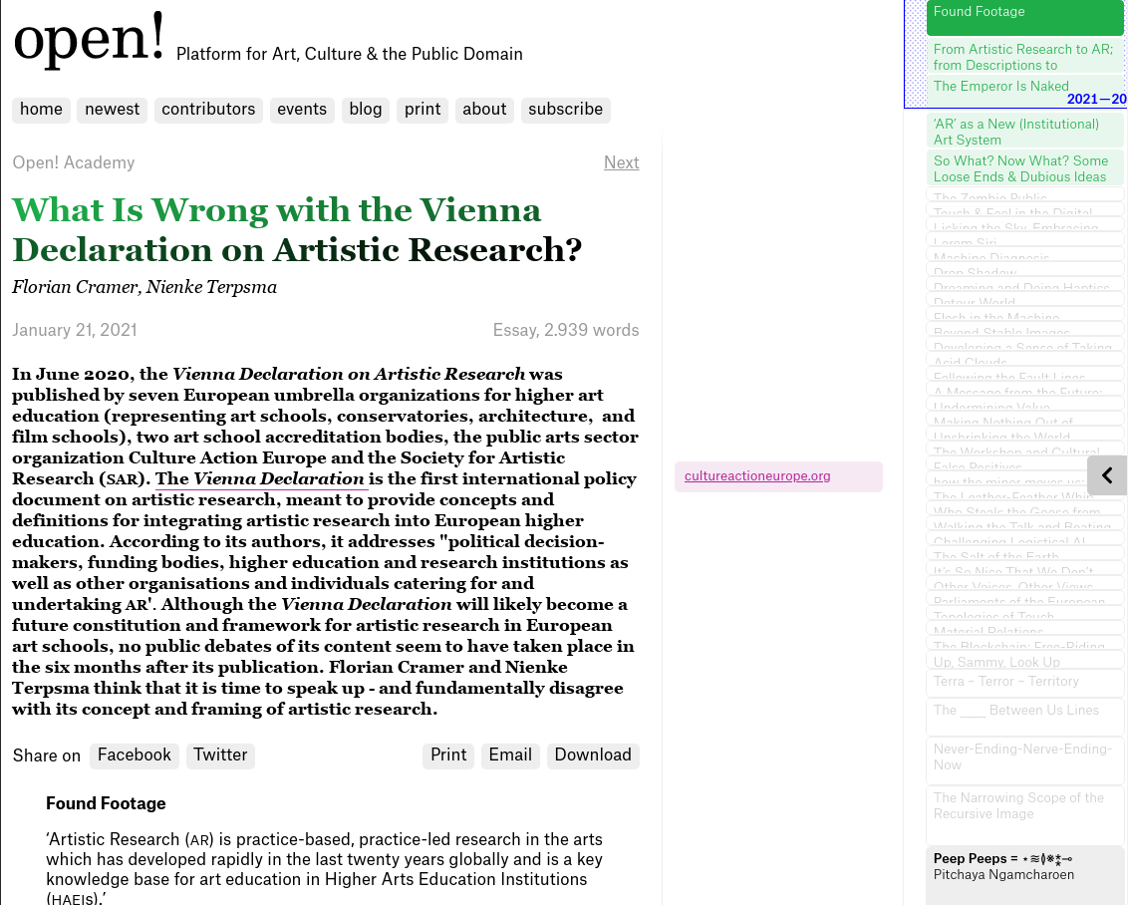

Slide 4
research / Forschung / onderzoek

Slide 5
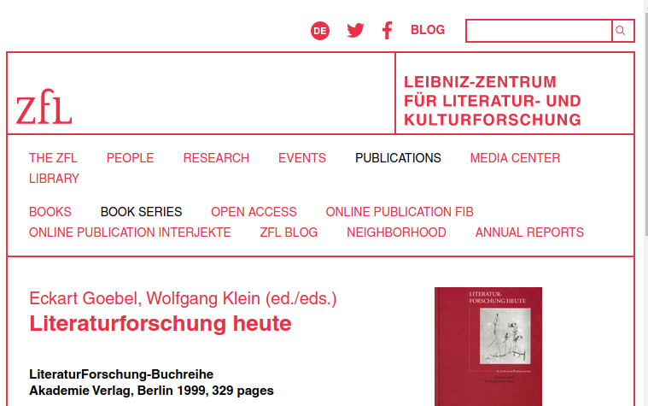

Slide 6
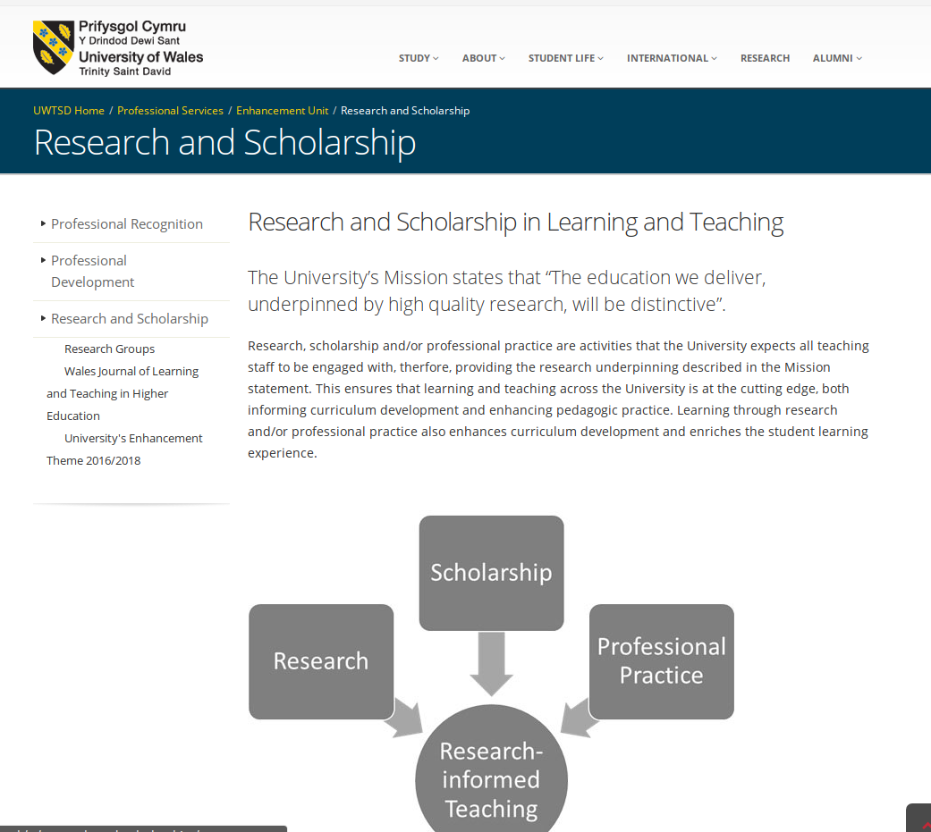

Slide 7
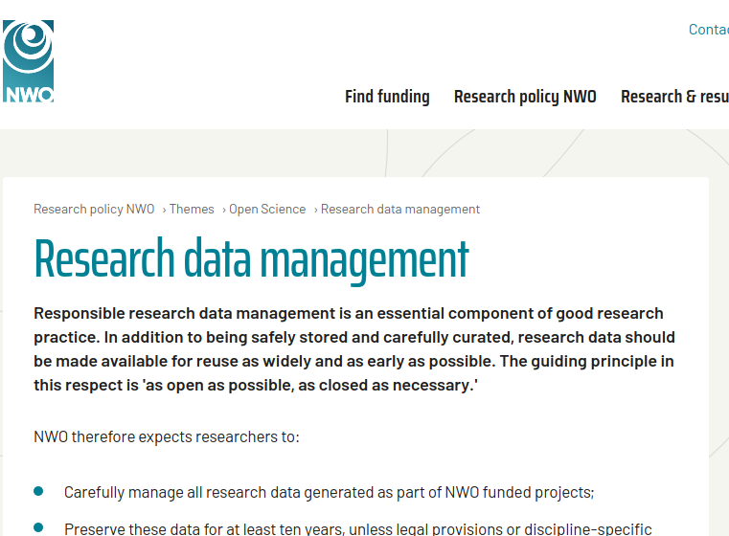

Slide 8
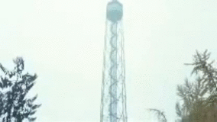
Milano Calibro 9, 1972

Slide 9
“Artistic research is identical to ‘human science,’ [humanities] which for us means ‘concerned’ [engaged] science, not purely historical science. This research should be carried out by artists with the assistance of scientists.”
Asger Jorn, Notes on the Formation of an Imaginist Bauhaus (1957)

Slide 10
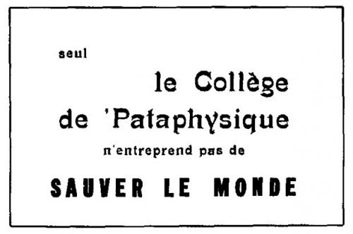

Slide 11
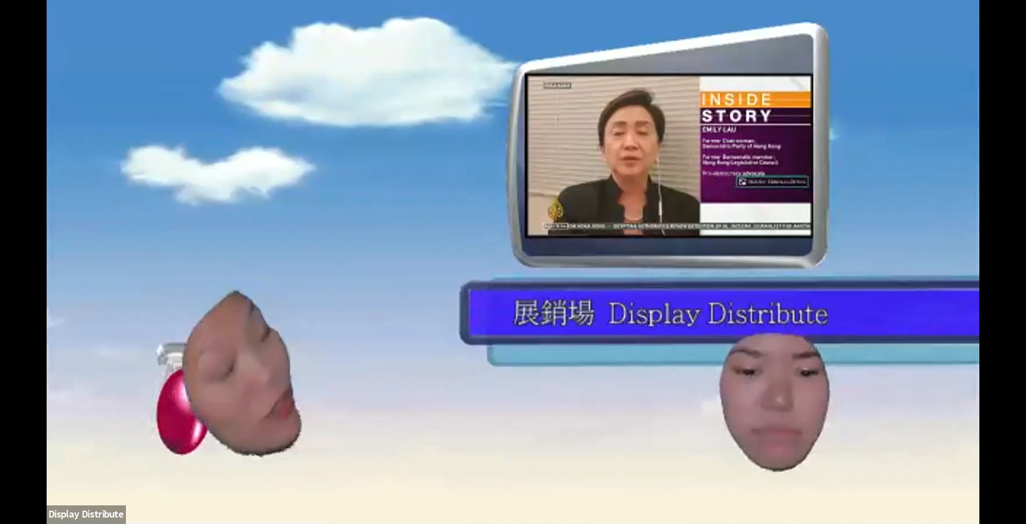


Slide 12
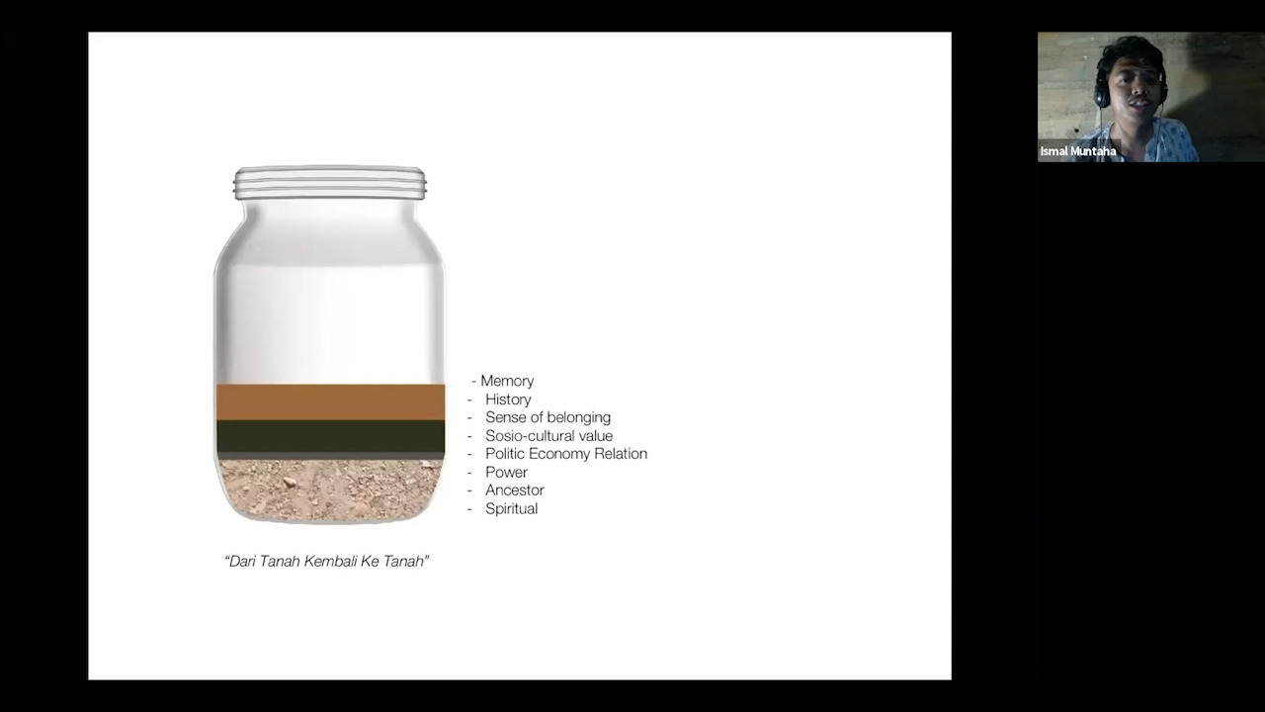

Slide 13
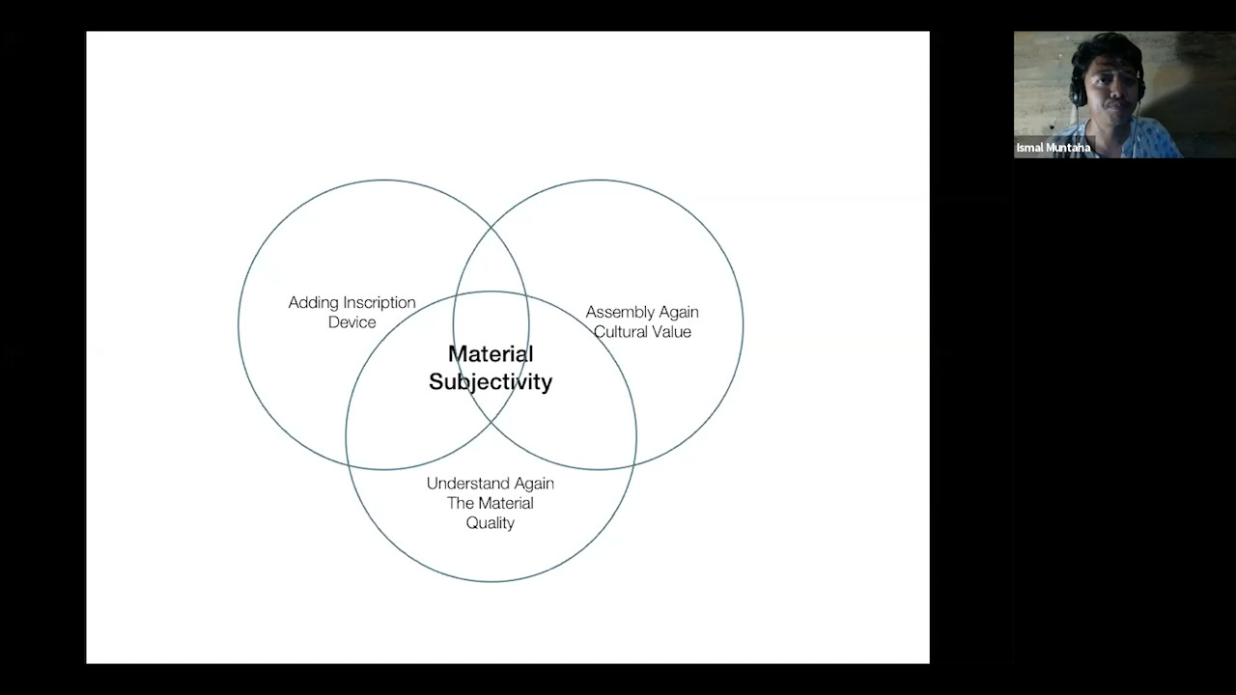

Slide 14
[ video ]

Slide 15
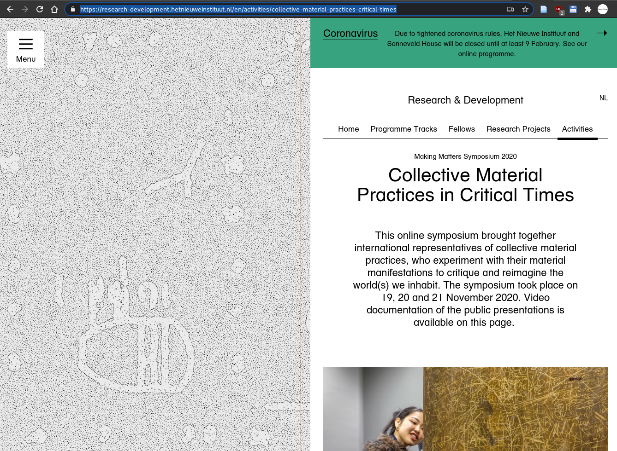
https://research-development.hetnieuweinstituut.nl/en/activities/collective-material-practices-critical-times

Slide 16
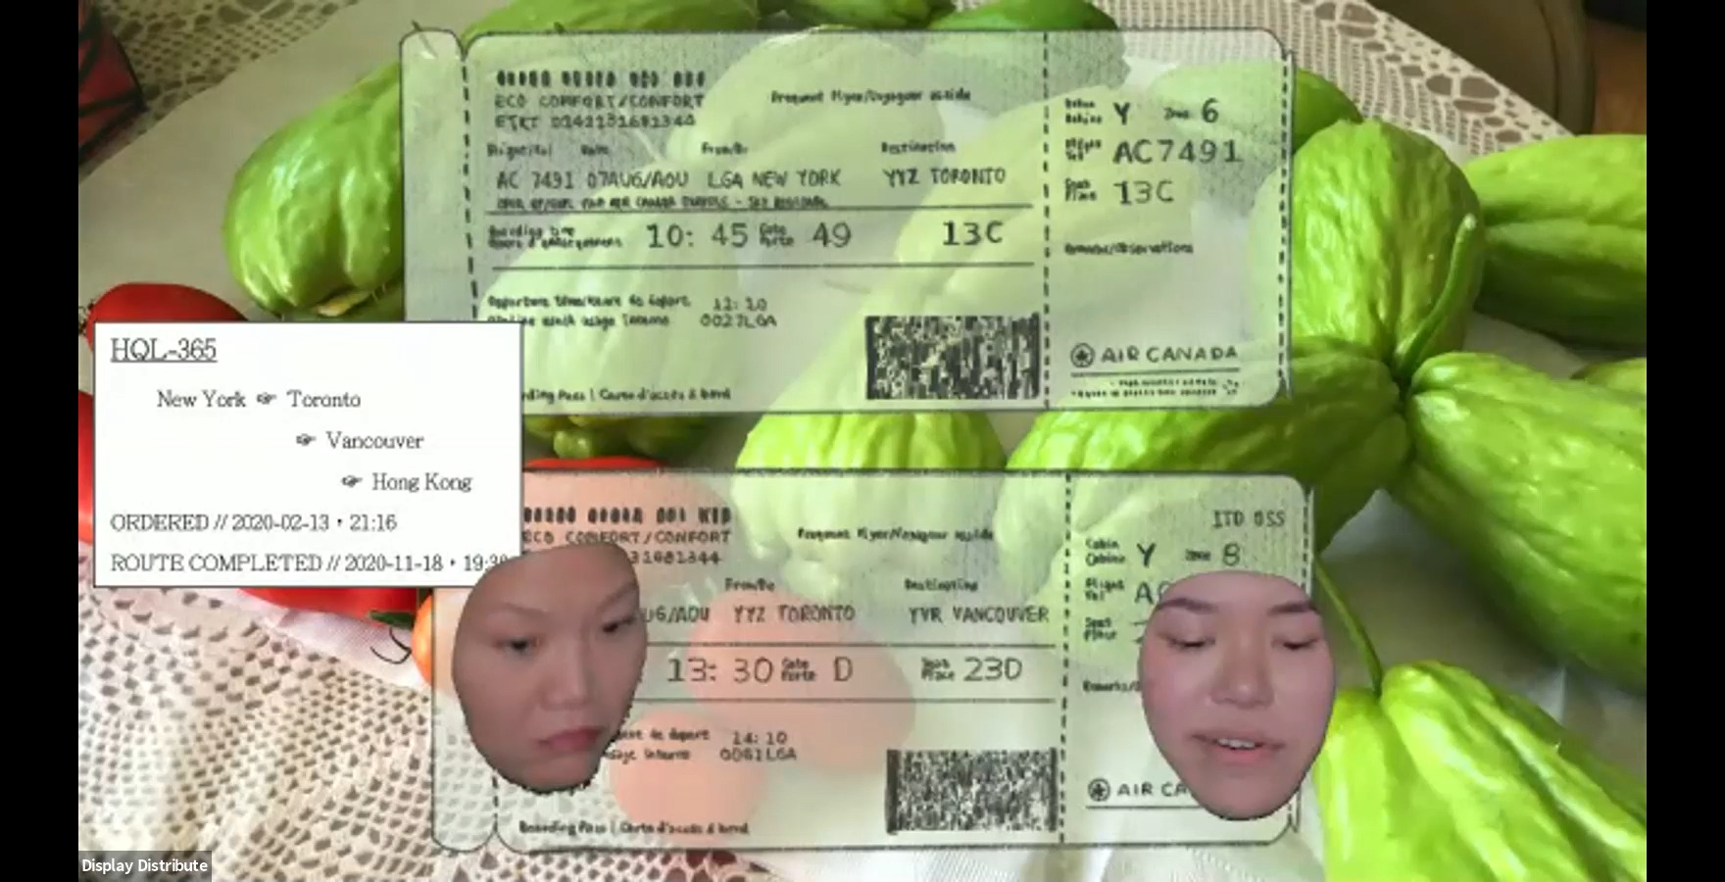

Slide 17
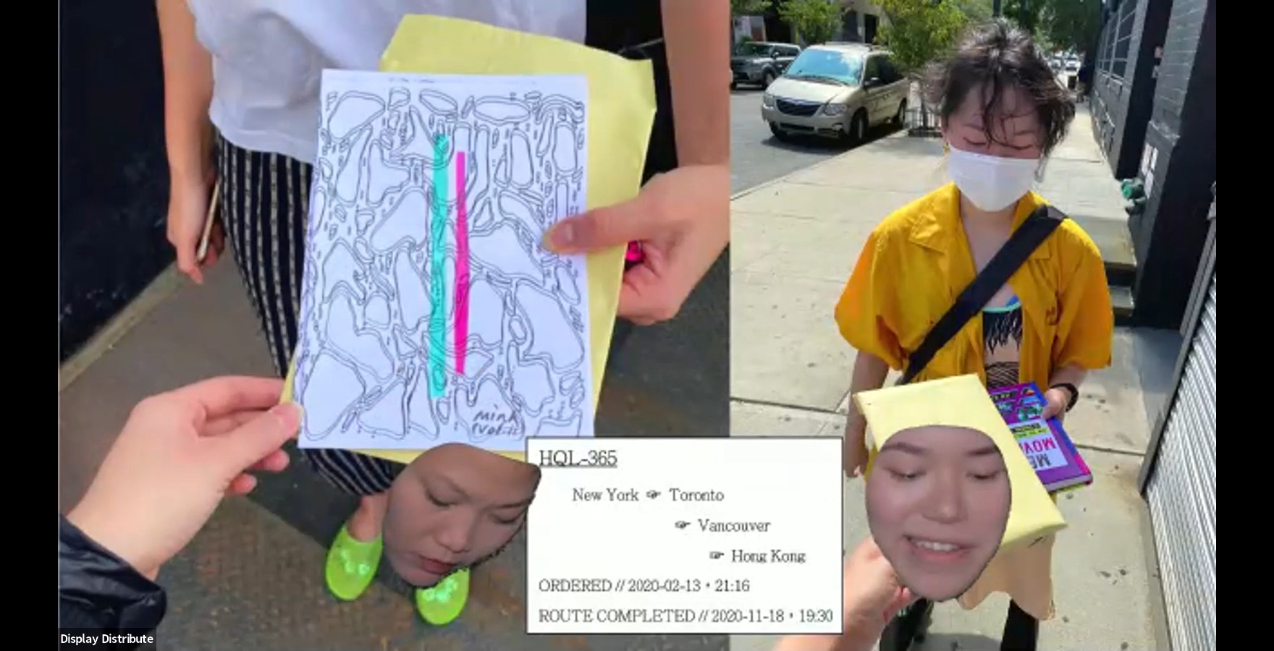

Slide 18
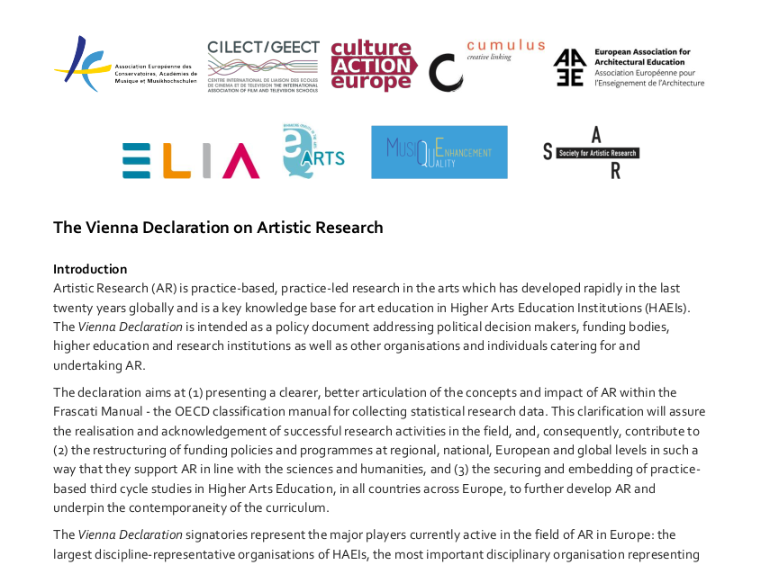

Slide 19
“Artistic Research (AR) [...] has developed rapidly in the last twenty years globally and is a key knowledge base for art education in Higher Arts Education Institutions (HAEIs)."
“AR is well suited to inspire creative and innovative developments in sectors such as health and wellbeing, the environment and technology, thus contributing to fulfilling the HEIs’ ‘third mission’. AR must be seen as having a unique potential in the development of the ‘knowledge triangle.’”
“Within this frame, AR is aligned in all aspects with the five main criteria that constitute Research & Development in the Frascati Manual.”
“HAEIs operate predominately within a research context and have a responsibility to conduct AR. It is also common for HAEIs to interact with related enterprise Research & Development, and to contribute directly to the creation of intellectual property in arts, entertainment and media through research practice.”
"This environment requires funding for: educating the next generation of researchers through doctoral programmes; [...] building links with business and enterprise in order to stimulate the impact of research."
“AR is validated through peer review covering the range of disciplinary competences addressed by the work. Quality assurance is undertaken by recognised independent, international QA bodies and assures the standards described in the European Standards and Guidelines (ESG 2015) for Quality Assurance in the European Higher Education Area.”
"[T]he establishment of AR as an independent category within the Frascati Manual, establishing the opportunity for harvesting research data and statistics from the AR field".

Slide 20

https://www.onlineopen.org/what-is-wrong-with-the-vienna-declaration-on-artistic-research

Slide 21
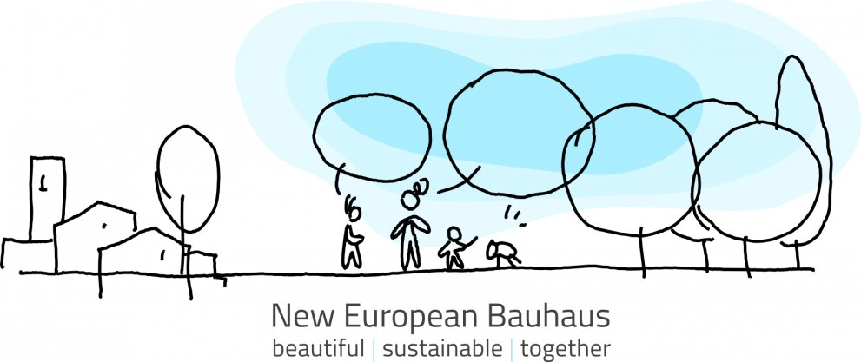

Slide 22
post-research?

