Slide 1
Democracy & Internet

Slide 2
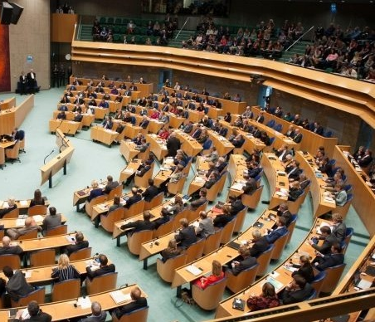
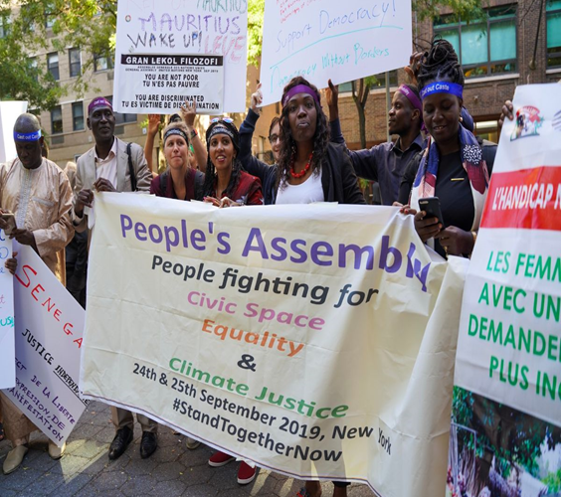
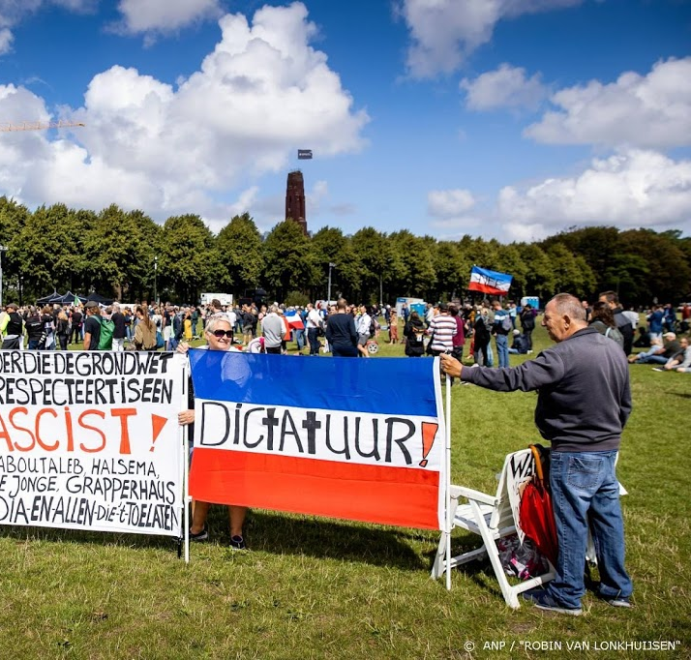
Notes:
In my presentation, I will leave aside the question of how democracy can be defined - whether as parliamentary democracy, people's assemblies, or even as rule of the people in a populist sense. But perhaps it can be said that the Internet itself mirrors this question, and is itself a experimentation field and battle ground for various concepts of democracy

Slide 3
governance
communication
spaces
Notes:
constituents of democracy: democracy is either a form of governance, or can be further specified as specific forms of governance. But since it always is collective governance, it needs communication (or, more specifically: public discourse), and it needs infrastructures or spaces for this communication. In Western democracy, these links have been made since the Greek agora (which was a site of governance, communication and a public space).

Slide 4

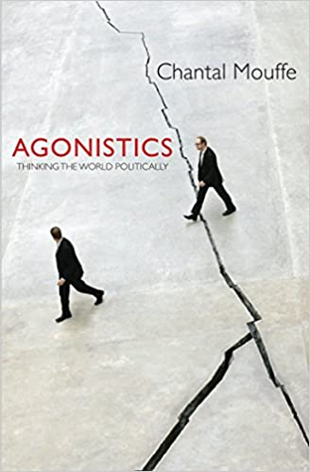
Notes:
A footnote: Implicitly, these links are also made in contemporary political philosophies of democracy, even when they are seemingly taking opposite positions, such as Habermas’ model of communicative action (which roughly corresponds to the Dutch model of democracy, including “poldering”), and Chantal Mouffe’s theory of agonistic radical democracy (which is based on acting out conflict, and thus an antithesis to both Habermas and the Dutch model).

Slide 5
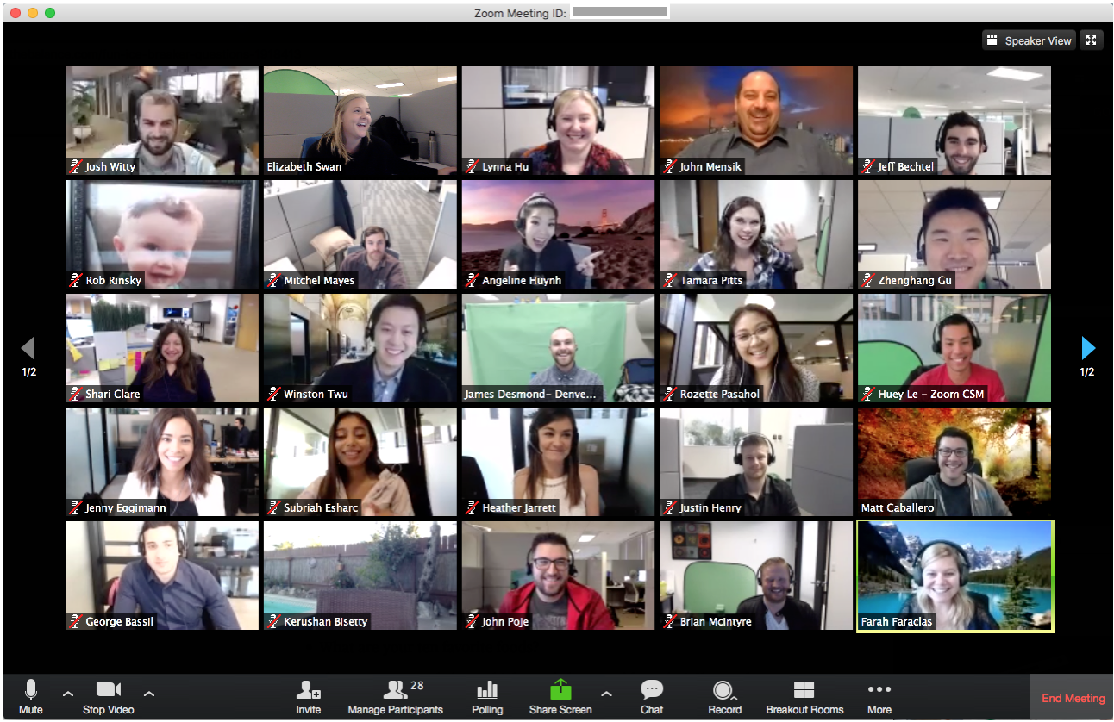
Notes:
In contemporary terms, we could see the agora as a forerunner of the communication platform that we are using right now. And that creates all kinds of questions of: ownership, control, inclusion and exclusion. Who can actually participate in such an infrastructure, and who can make decisions about its design and use? When we look at who is governing these electronic agoras, we see that they are actually under private ownership and corporate governance.
But before going into more detail, let me do another historical retrospective: What we see here, the interface of software applications like Zoom, and the Internet itself, is the product of what were originally efforts (and even movements) of democratization.

Slide 6
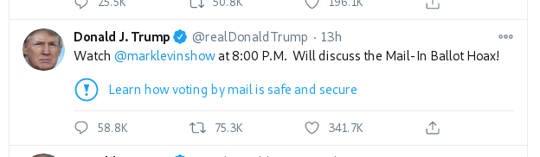
Notes:
A good example for this private governance is this.

Slide 7
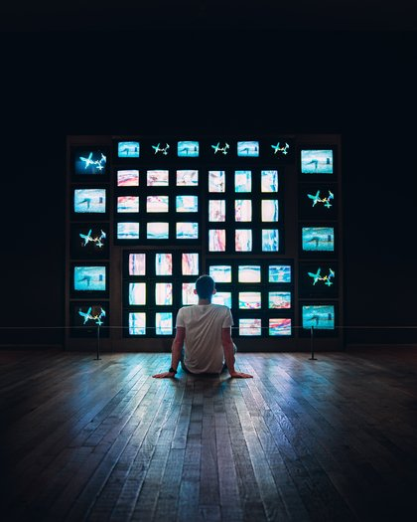
Nam June Paik, Global Groove (1973)
Notes:
The multi-screen interface of Zoom strongly reminds of the tv sculptures of Nam June Paik, who invented video art in the 1960s and 1970s as a way of breaking up the centralist broadcast mass media model of tv and turning it into a creative and democratic medium. (There is a longer history about artistic video activism that I cannot tell in the short amount of time.)

Slide 8
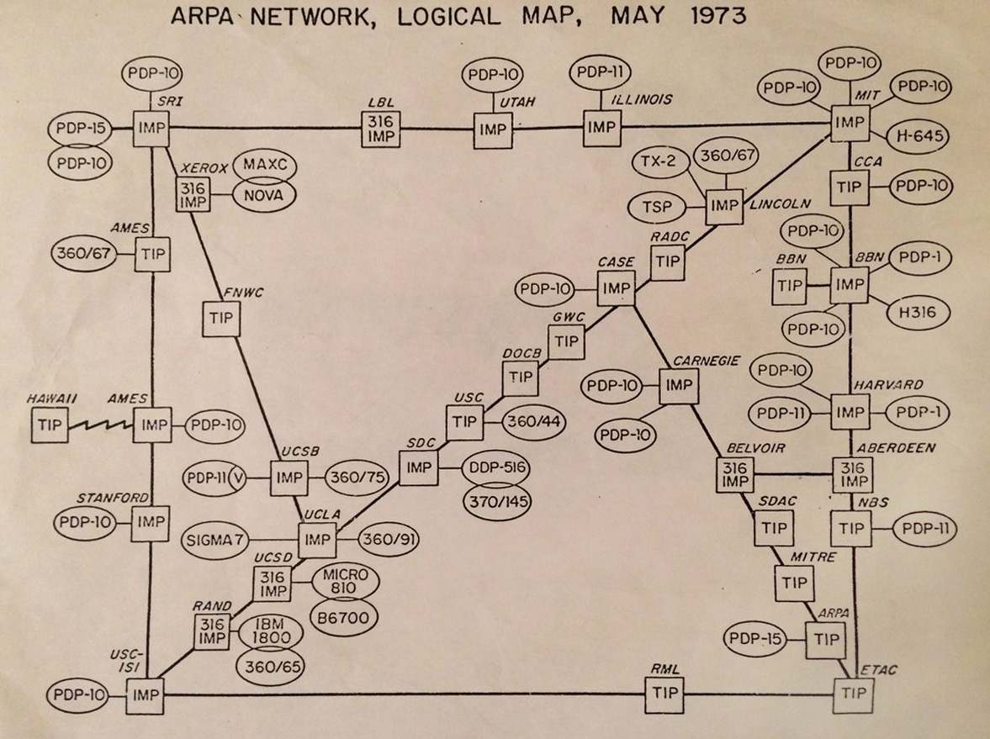
Notes:
The Internet and its forerunner Arpanet were developed from 1969 to the 1980s as a university network, on the basis of fully public (and today we would say: Open Source) technology, with the idea of creating a decentral communication infrastructure that is not owned by anyone.

Slide 9
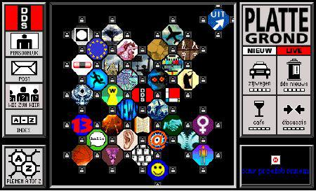
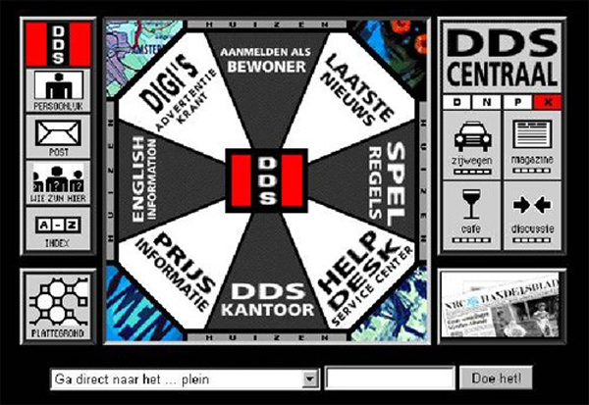
Notes:
In 1993 later, artists and media activists founded the"Digitale Stad Amsterdam" (Digital City Amsterdam), which was not based on the Internet, but on dialup modem computers. This was strongly carried by the idea that such electronic systems can improve participation and make society more democratic. (Waag Society emerged out of this project.) This was very much the creation of an electronic “public sphere” in the sense of Habermas to enable democratic “communicative action”, and literally reused the topology of the agora.

Slide 10
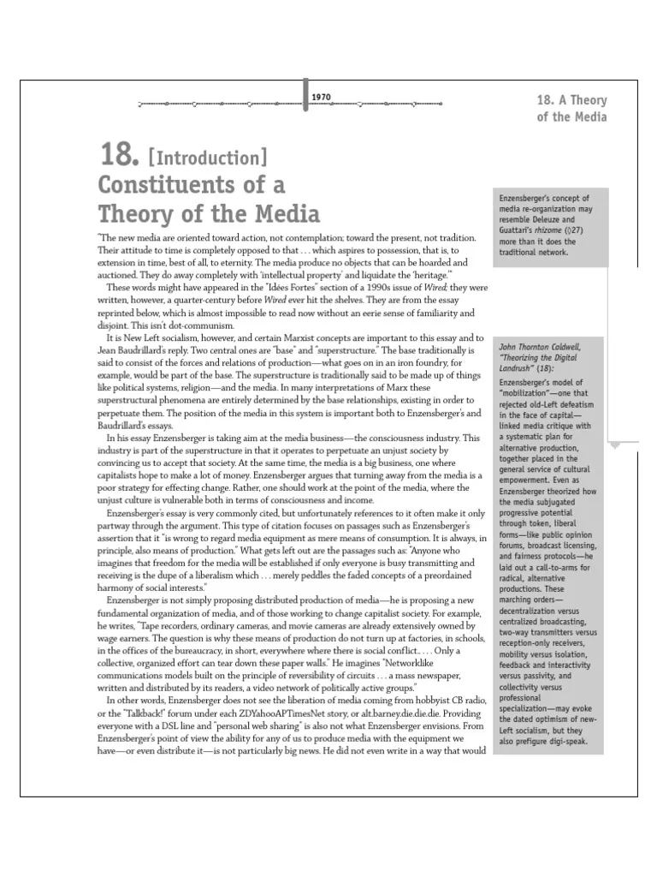
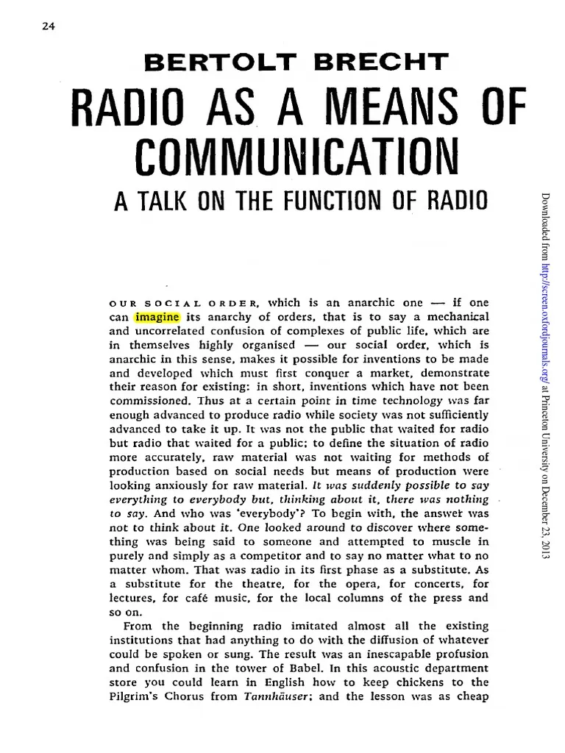
Bertolt Brecht, 1932
Hans Magnus Enzensberger, 1970
Notes:
Let's quickly add that democratization of media as a means of democratizing society is a debate that began in the 1920s and was at the root of the creation of alternative press and alternative media from the 1960s to 1990s.

Slide 11
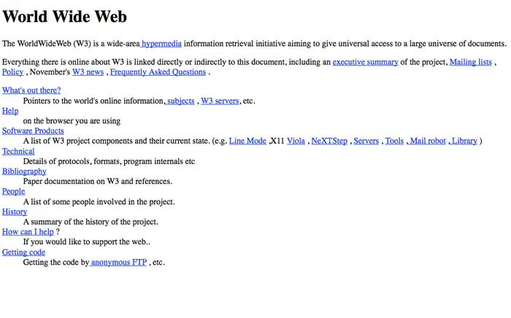
Notes:
The World Wide Web was invented in 1991 on the basis of Internet technology as a democratic publishing system in which anyone could publish - not, as before, only people with access to newspaper, book, tv or radio publishing. Back then, the Internet was not commercialized, but largely an educational and non-profit infrastructure. Wikipedia is one of the few remaining, large-scale projects that still operate with this ethos and governance.

Slide 12
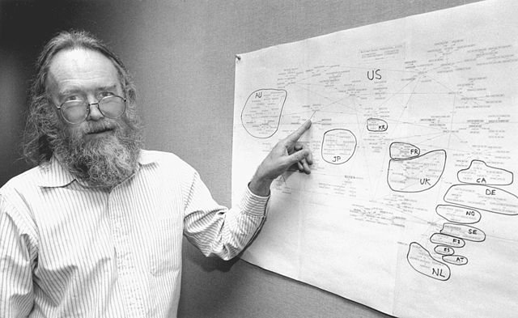
Notes:
But even in the early years of the Internet, its governance was actually not democratic. Registration and adminsitration of Internet domain names, for example, was single-handedly done by this gentleman, the computer scientist Jon Postel. When he died in 1998, the Internet Corporation for Assigned Names and Numbers (ICANN) was created as an American multistakeholder group and non-profit organization and is in charge of domain registrations and IP address block assignments since. It is not the only governance and standardization body of the Internet - and surveying them would take way too much time for this presentation.

Slide 13
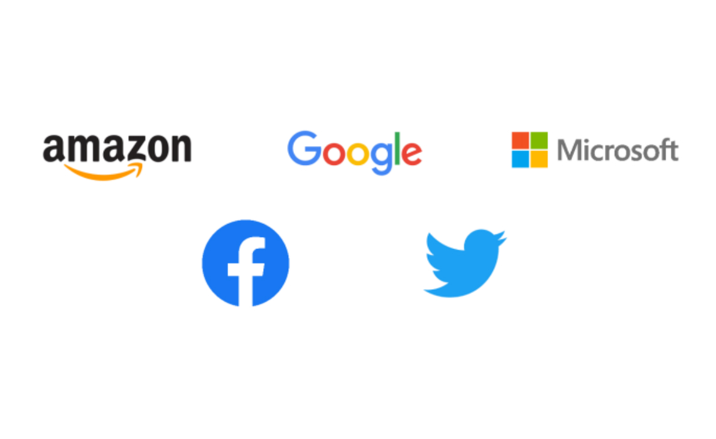
Notes:
In short, it could be said that the Internet is nowadays mostly ruled by companies (large telecom providers and the Silicon Valley Big 5 - Google, Microsoft, Facebook, Amazon, Apple), but that formally, its governance and standardization consists of a mix of public and private, US American and international parties. This is the result of the commercialization of the Internet since the 1990s and in this way a reflection of the post-1990s neoliberal period.
At the same time, this development is not specific to the Internet: think of the privatization of public space and public services, where the agora sometimes has literally become part of a shopping mall. (Such as in Zoutermeer.)

Slide 14
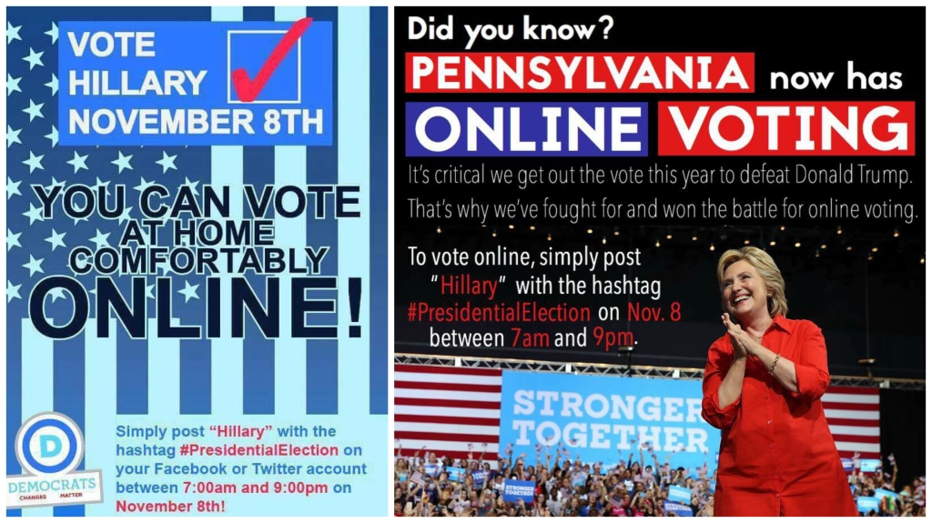
2016 fake news campaign
Notes:
As we all know, there are many issues not only with this mixed governance, but with how democracy is practiced online. Arguably, the 1980s and 1990s expectations of their democratizing effects now seem to have been exaggerated or even naive, since these systems can and are routinely abused for trolling, fake news and anti-democratic purposes; including the organization of extremist mobs. This is an important discussion, but I will leave it aside, too.

Slide 15
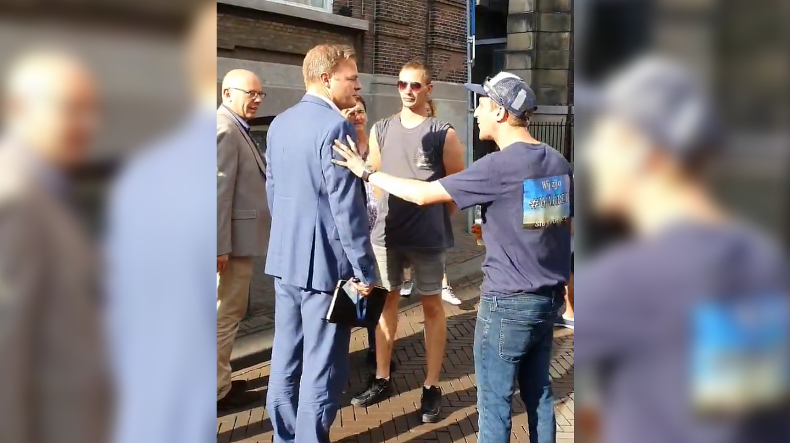
Notes:
If we for example consider the “viruswaanzin” protests also a result of mobilization and group organization through the Internet and digital technology, then the question is whether this is a democratizing effect or the opposite. (Habermas would probably say that it’s destabilizing democracy while Mouffe would see it as furthering democracy although she is ideologically opposed to these protesters.)

Slide 16
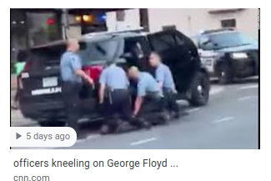
Notes:
At least we shouldn’t forget the flip side: the availability of media production technology to almost everyone, and the possibility for everyone to publish, has also led to more democratic scrutiny: "Racism isn't getting worse, it's getting filmed” (Will Smith). In this sense, the Internet is the (imperfect) fulfillment of earlier media activist visions.
But this example also demonstrates that we can no longer differentiate “online” and “offline” in culture, society and politics. While we thought of these as two different spheres in the past, they are now physically interwoven.

Slide 17
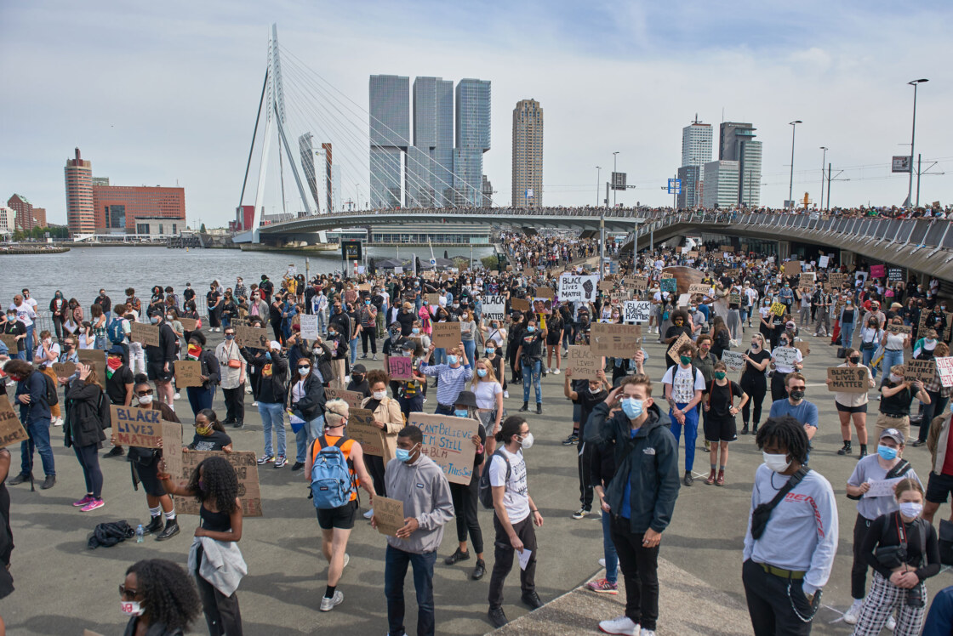
Notes:
Or, to use another, example: A demonstration like the Black Lives Matter in Rotterdam demonstrates why we can no longer separate online and offline, the Internet and public space, and how both have become precarious:
there was not enough space for 4000 protesters under the Corona distancing provisions because of a lack of available public space, which is why the demonstration was prematurely ended by the police; this would not have been the case 10 years ago when Rotterdam’s South Bank was largely undeveloped and there was plenty of available public space.
the protest only came together because of the initial social media video images, and social media organizing (the event had been announced on Facebook only three days before); and at least as important as the gathering itself was the spreading of images via social media. Like all contemporary protests, this one addressed the city space as much as the Internet.
But likewise, everything communicated about the event happened via company-owned platforms.

Slide 18

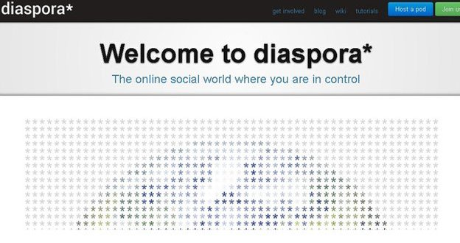

Notes:
So far, I described Internet democracy as something that developed from non-profit and educational initiatives to corporate platforms since the 1990s, but this is not the full picture. Aside from non-profit organizatoins like Wikipedia, there are many initiatives in Open Source developer communities to create non-profit, non-corporate alternatives to the dominant social networks: Such as Mastodon as a (very well working) alternative to Twitter, Diaspora as an alternative to Facebook or PeerTube as an alternative to YouTube. What is particular about them is that they do not have central servers or ownership, but they are based on decentralized networks of small, volunteer-run servers. So an organization like De Waag, for example, could run its own Mastodon, Diaspora and PeerTube servers which would be contribute to the global network infrastructure of these services.
However, these initiatives have the same problems of governance as other non-profit initiatives: In most cases, they run as US American or EU charity non-profits, but as we all know, an NGO isn’t a democratic institution. So they cannot actually compensate for the privatization of the public sphere. On top of that, none of these platforms can really solve the issues of abuse - trolling, disinformation - that plague commercial social media. They only haven’t become a visible issue yet because these platform are not widely in use.

Slide 19
governance
communication
spaces
Notes:
So who is governing this hybrid analog-digital public sphere today? Is it still a public sphere, or has it become a pseudo-public sphere, comparable to gated communities?
What is the accountability of the Internet platform owners? Are the rules they impose on platforms new laws, and does this mean that a major part of today's legislation has become privatized? Do the platforms have the power to shut down democracy through their algorithms, or just through denying service?
What are the democratic checks and balances of these infrastructures? But also: how does the concept and common understanding of democracy when life has become both online and offline?

