Slide 1
Democracy & Internet

Slide 2
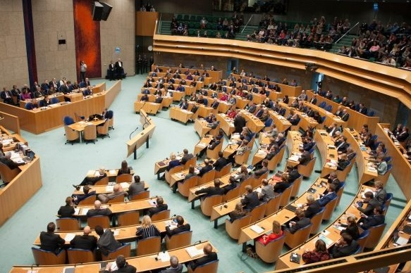
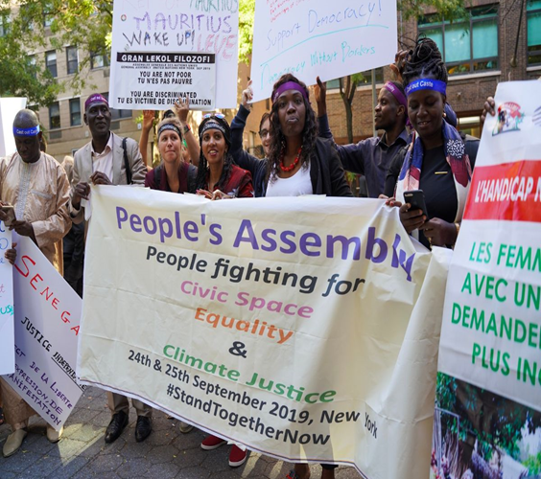
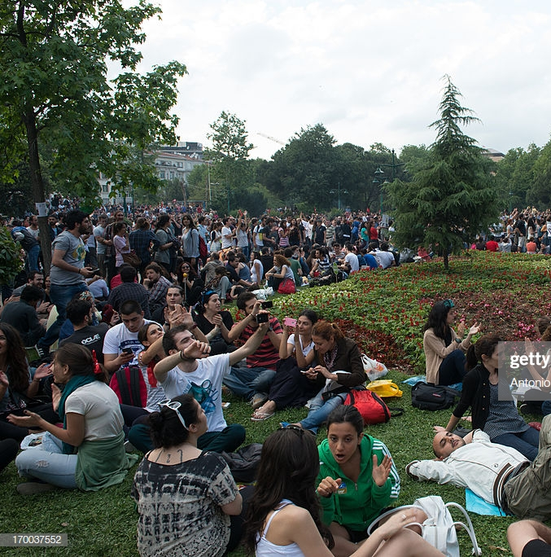
Notes:
In my presentation, I will leave aside the question of what democracy is and how it could be defined - whether as parliamentary democracy, people's assemblies, common (as in the third picture which is from the occupation of Gezi Park in Istanbul in 2013), but talk about in the most generic forms possible.

Slide 3
governance
communication
spaces
Notes:
constituents of democracy: democracy is either a form of governance, or can be further specified as specific forms of governance. But since it always is collective governance, it needs communication (or, more specifically: public discourse), and it needs infrastructures or spaces for this communication.

Slide 4

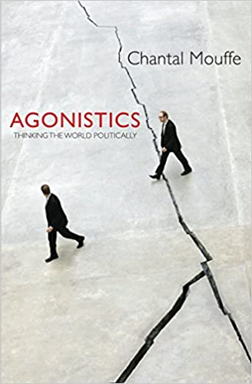
Notes:
A footnote: If we look at only two influential contemporary theories of democracy, which occupy opposite positions in many respects, such as Habermas' and Mouffe's, there is a common denominator that they both stress discourse as the essence of democracy.

Slide 5
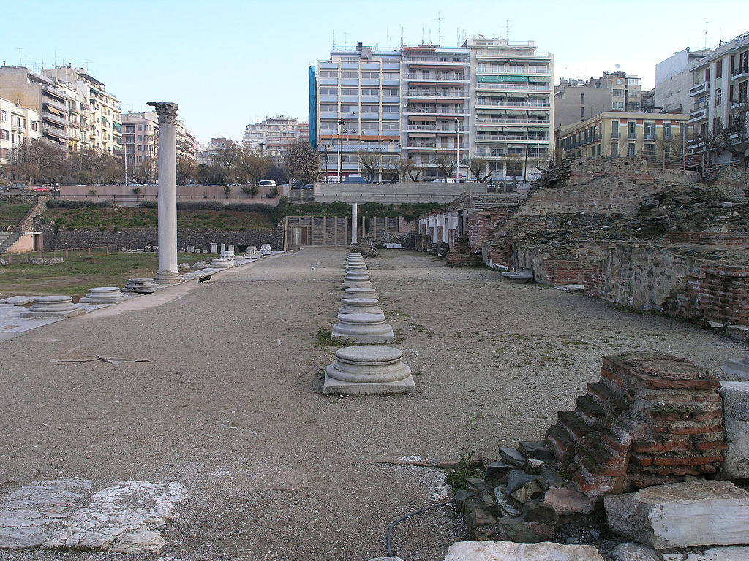
Notes:
The mythical space of that space, and that communication, in Western culture is the Greek agora. Here we see the historical agora of Thessalonii. I call it mythical because it could be questioned in many ways: By today's standards, the Attic democracy was not a democracy but an oligarchy of a few upper class men. Nevertheless, it points out the necessity of public space, and a public infrastructure, for collective governance.

Slide 6
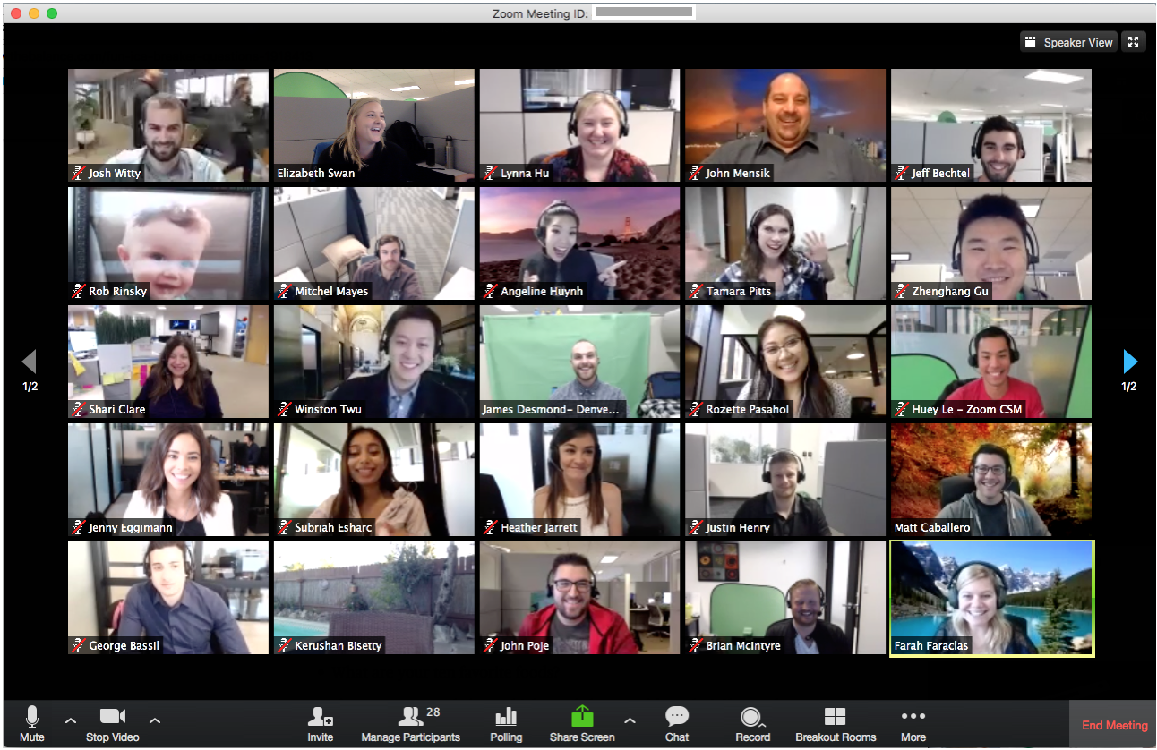
Notes:
In contemporary terms, we could see the agora as a forerunner of the communication platform that we are using right now. And that creates all kinds of questions of: ownership, control, inclusion and exclusion. Who can actually participate in such an infrastructure, and who can make decisions about its design and use? But before going into more detail, let me do another historical retrospective: What we see here, the interface of software applications like Zoom, and the Internet itself, is the product of what were originally efforts (and even movements) of democratization.

Slide 7
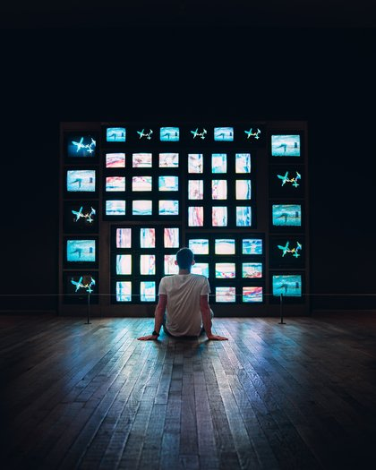
Nam June Paik, Global Groove (1973)
Notes:
The multi-screen interface of Zoom strongly reminds of the tv sculptures of Nam June Paik, who invented video art in the 1960s and 1970s as a way of breaking up the centralist broadcast mass media model of tv and turning it into a creative and democratic medium. (There is a longer history about artistic video activism that I cannot tell in the short amount of time.)

Slide 8
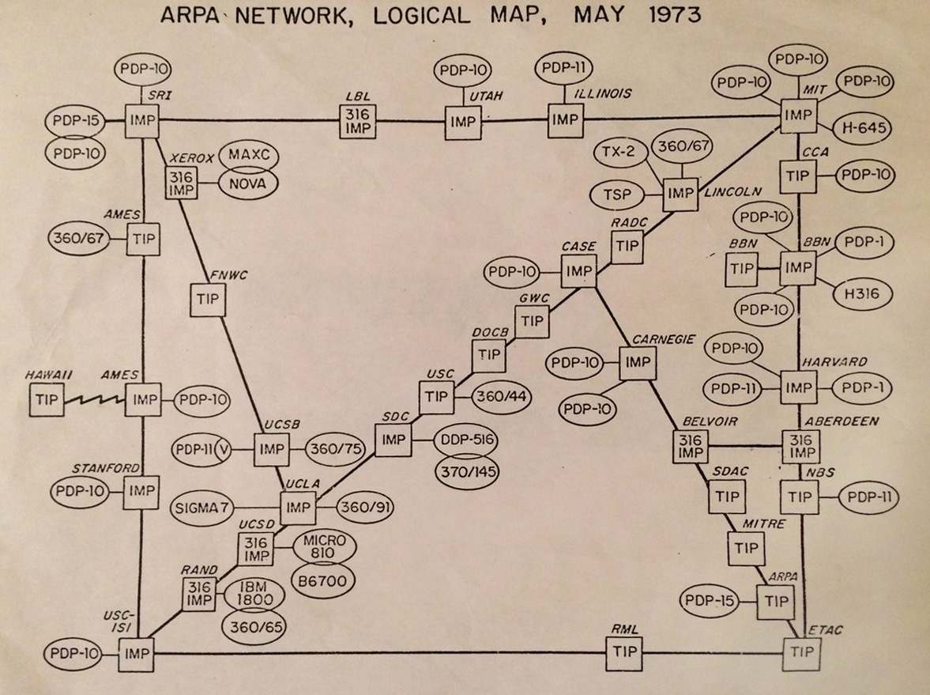
Notes:
The Internet and its forerunner Arpanet were developed from 1969 to the 1980s as a university network, on the basis of fully public (and today we would say: Open Source) technology, with the idea of creating a decentral communication infrastructure that is not owned by anyone.

Slide 9
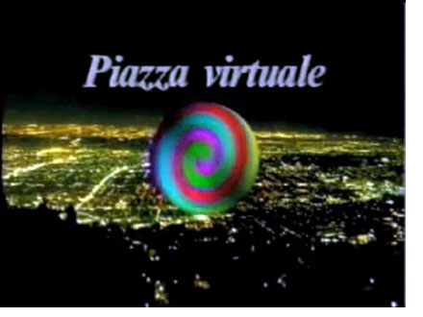
https://www.youtube.com/watch?v=Cx9XIhfmPZY
Notes:
In parallel, artists and media activists created participatory media such as "Piazza Virtuale" by Van Gogh TV collective which ran during the Documenta contemporary art exhibition in 1992 - and retrospectively looks like a perfect anticipation of the chat and teleconferencing systems we use today.

Slide 10
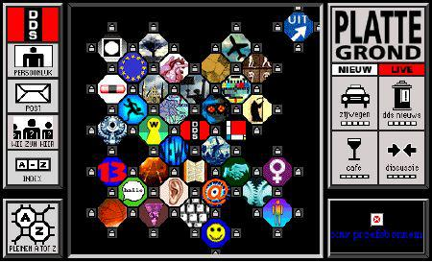
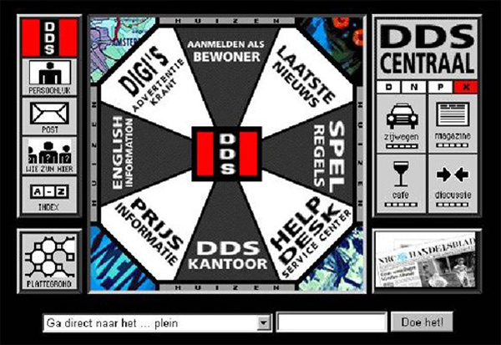
Notes:
Two years later, artists and media activists founded the"Digitale Stad Amsterdam" (Digital City Amsterdam), which was not based on the Internet, but on dialup modem computers.
This was strongly carried by the idea that such electronic systems can improve participation and make society more democratic. (Waag Society emerged out of this project.)

Slide 11
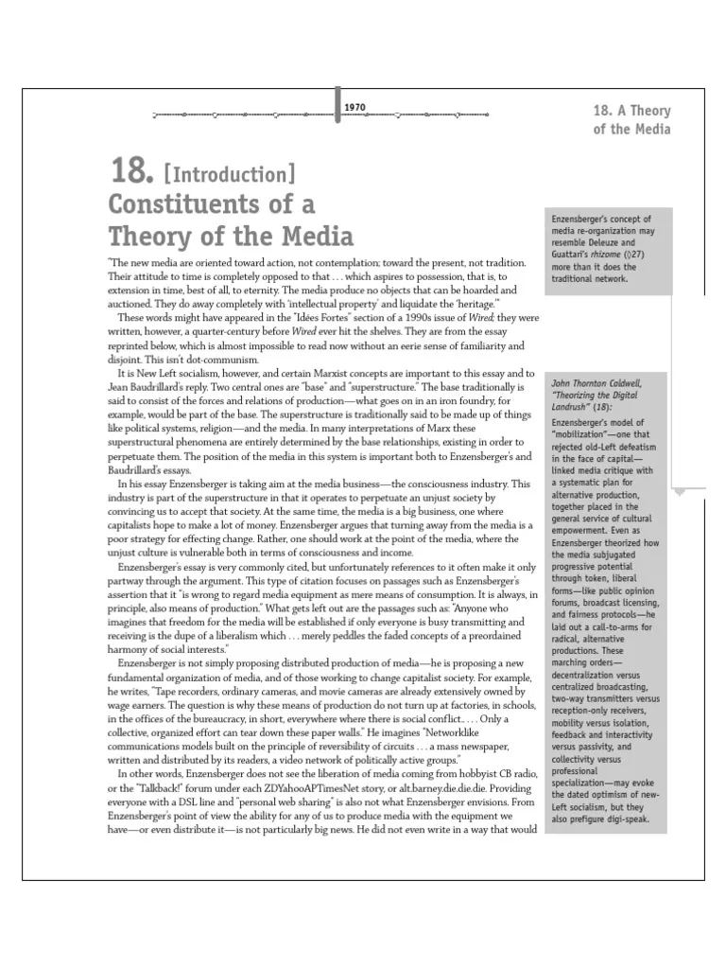
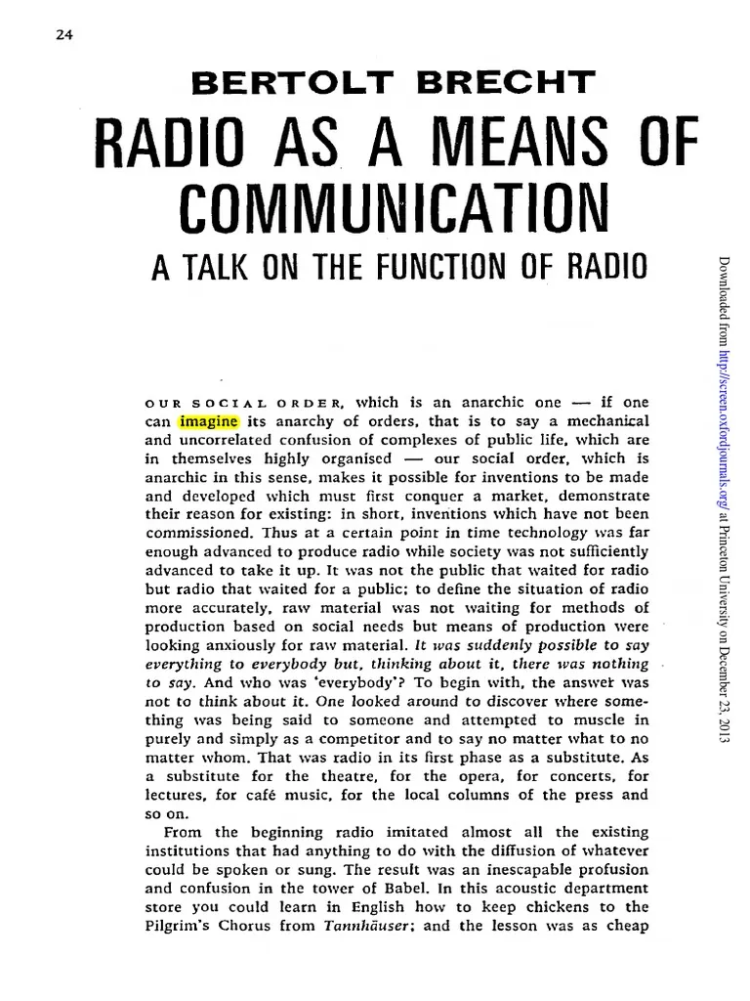
Bertolt Brecht, 1932
Hans Magnus Enzensberger, 1970
Notes:
Let's quickly add that democratization of media as a means of democratizing society is a debate that began in the 1920s and was at the root of the creation of alternative press and alternative media from the 1960s to 1990s.

Slide 12
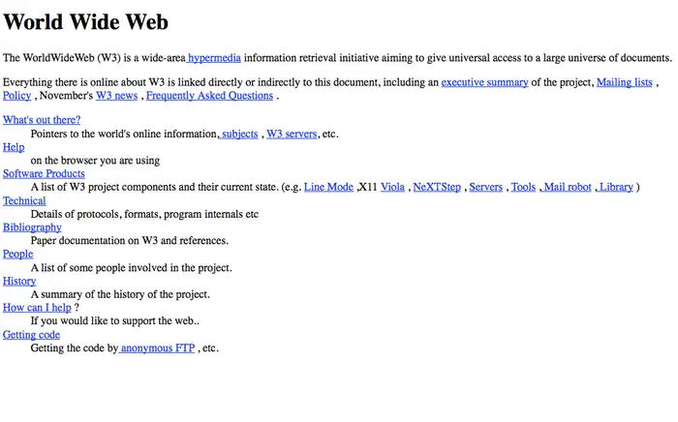
Notes:
The World Wide Web was invented in 199 on the basis of Internet technology as a democratic publishing system in which anyone could publish - not, as before, only people with access to newspaper, book, tv or radio publishing.

Slide 13
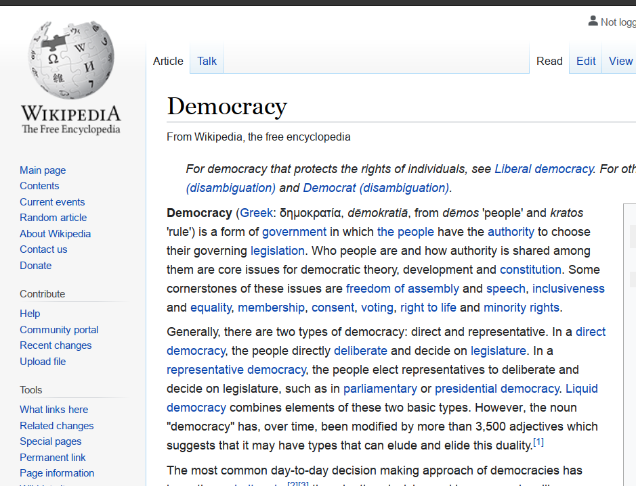
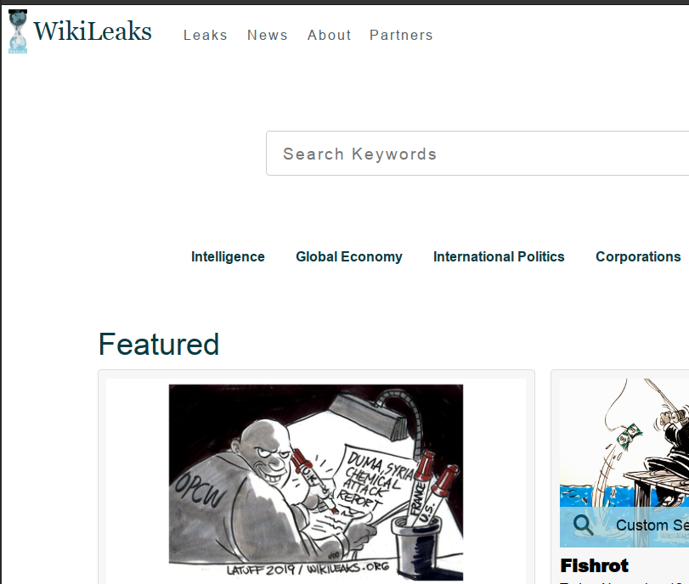
2016 fake news campaign
Notes:
Similar projects followed: Wikipedia for example, is a project of democratizing knowledge, and even authorship of knowledge media; WikiLeaks a project of democratizing political information

Slide 14
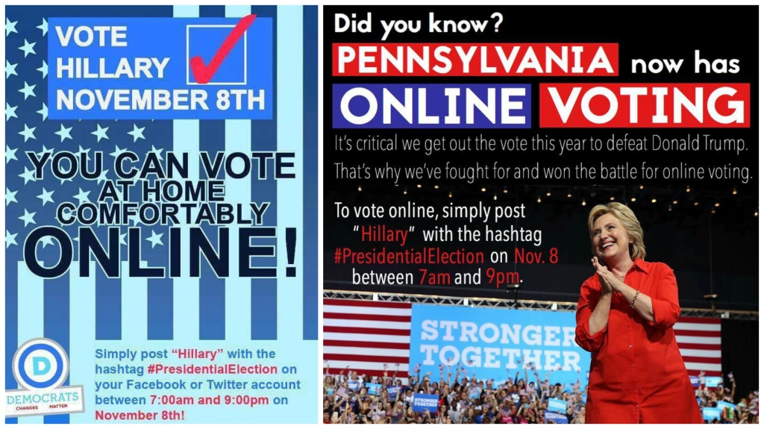
2016 fake news campaign
Notes:
You can argue that there are many issues with any of theses systems; that the exceptions of their democratizing effects may have been exaggerated or even naive, and that these systems can and are routinely abused for trolling, fake news and anti-democratic purposes. This is an important discussion, but I will leave it aside,too.

Slide 15
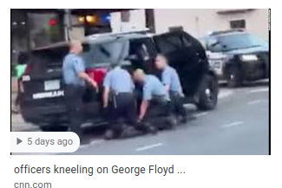
Notes:
But to also cover the flip side: the availability of media production technology to almost everyone, and the possibility for everyone to publish, has also led to more democratic scrutiny: "Racism isn't getting worse, it's getting filmed” (Will Smith).

Slide 16
Notes:
But to go back to the initial question: What is the "agora", or the public space, where the communication and negotiation of politics and governance happens?
Since the 1990s, it is no longer an infrastructure run by universities and research institutes. And opposed to the 1990s, non-profit organizations and Open Source/Open Access initiatives play only a small role in online communications and publishing - Wikipedia being one of the few big exceptions.

Slide 17
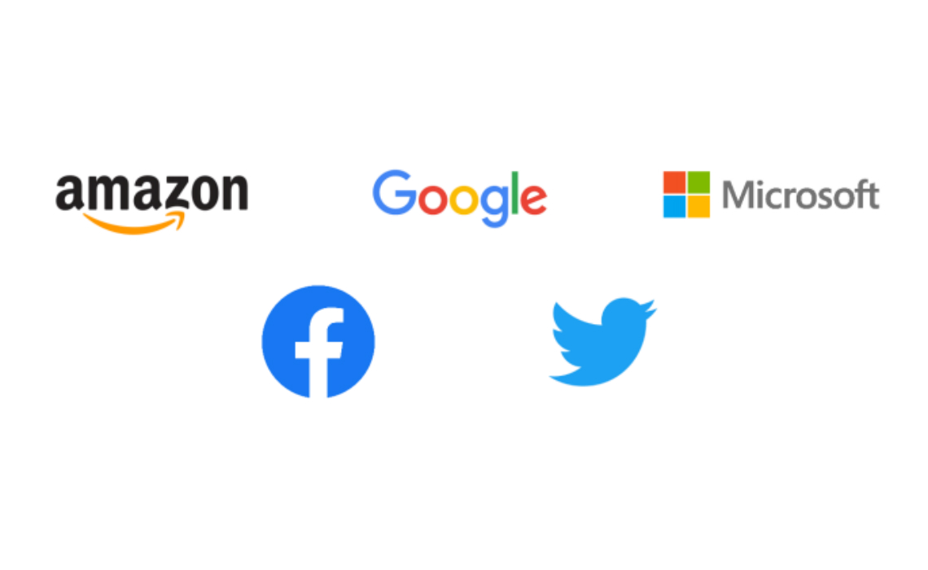
Notes:
As opposed to the 1980s, when commercial entities were even banned from the Internet, the Internet today is largely privatized. In the last two decades, most communication and interaction happens through platforms, and these are controlled by only a few big companies.
So, with the George Floyd video being uploaded to YouTube, it means that YouTube's mother company Google/Alphabet has the actual control over its distribution. It could use its platform ownership to block or censor the video, or in a more subtle way, it could use its search and ranking algorithms to make it virtually invisible.
This is the exact equivalent of the agora having become turned from public space into a private space - or the city hall turned into a shopping mall while still serving its original function.

Slide 18
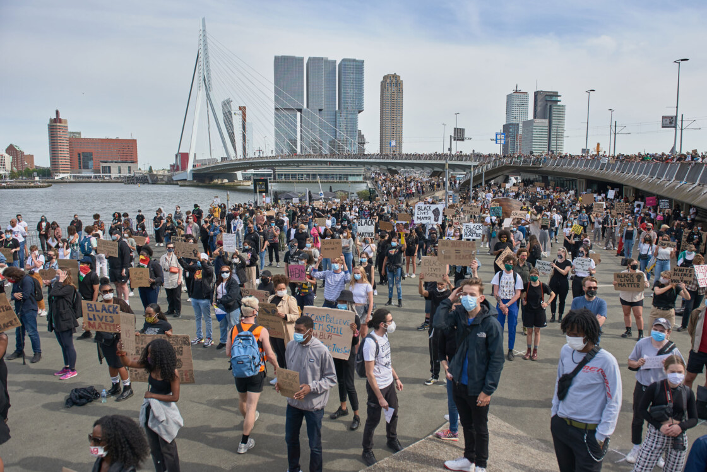
Notes:
Or, to use another, example: A demonstration like the one against racism in Rotterdam yesterday demonstrates why we can no longer separate online and offline, the Internet and public space, and why both have become precarious:
there was not enough space for 4000 protesters under the Corona distancing provisions because of a lack of available public space, which is why the demonstration was prematurely ended by the police; this would not have been the case 10 years ago when the South Bank was largely undeveloped and there was plenty of public space.
the protest only came together because of the initial social media video images, and social media organizing (the event had been announced on Facebook only three days before); and at least as important as the gathering itself was the spreading of images via social media. Like all contemporary protests, this one addressed the city space as much as the Internet.
But likewise, everything communicated about the event happened via company-owned platforms.

Slide 19
governance
communication
spaces
Notes:
So who is governing this hybrid analog-digital public sphere today? Is it still a public sphere, or has it become a pseudo-public sphere, comparable to gated communities?
What is the accountability of the Internet platform owners? Are the rules they impose on platforms new laws, and does this mean that a major part of today's legislation has become privatized? Do the platforms have the power to shut down democracy through their algorithms, or just through denying service?
What are the democratic checks and balances of these platforms?

