Slide 1
a[r/c]tivism 1971/2003/2012

Slide 2
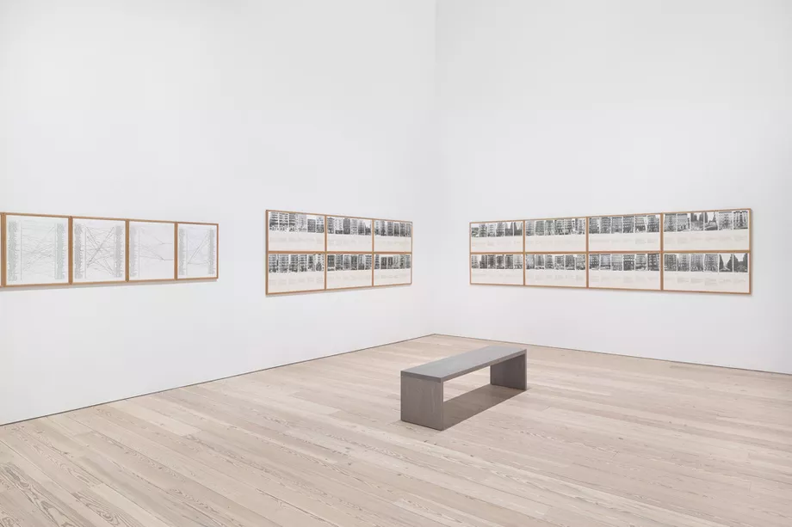
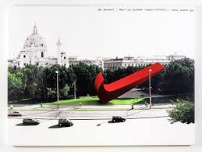
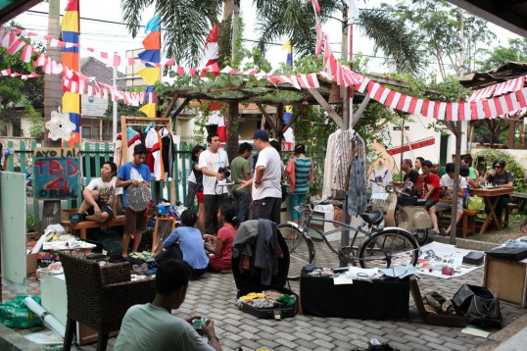

Slide 3
1971 Hans Haacke
2003 Nike Ground
2012 ruang rupa

Slide 4
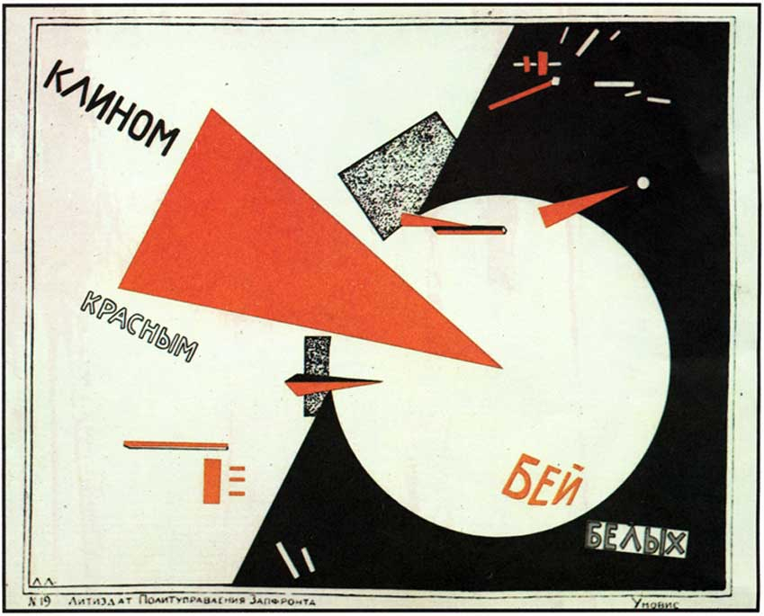
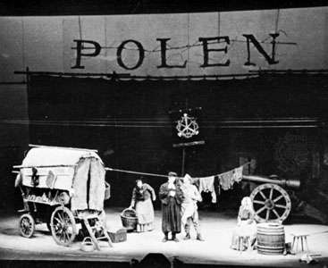
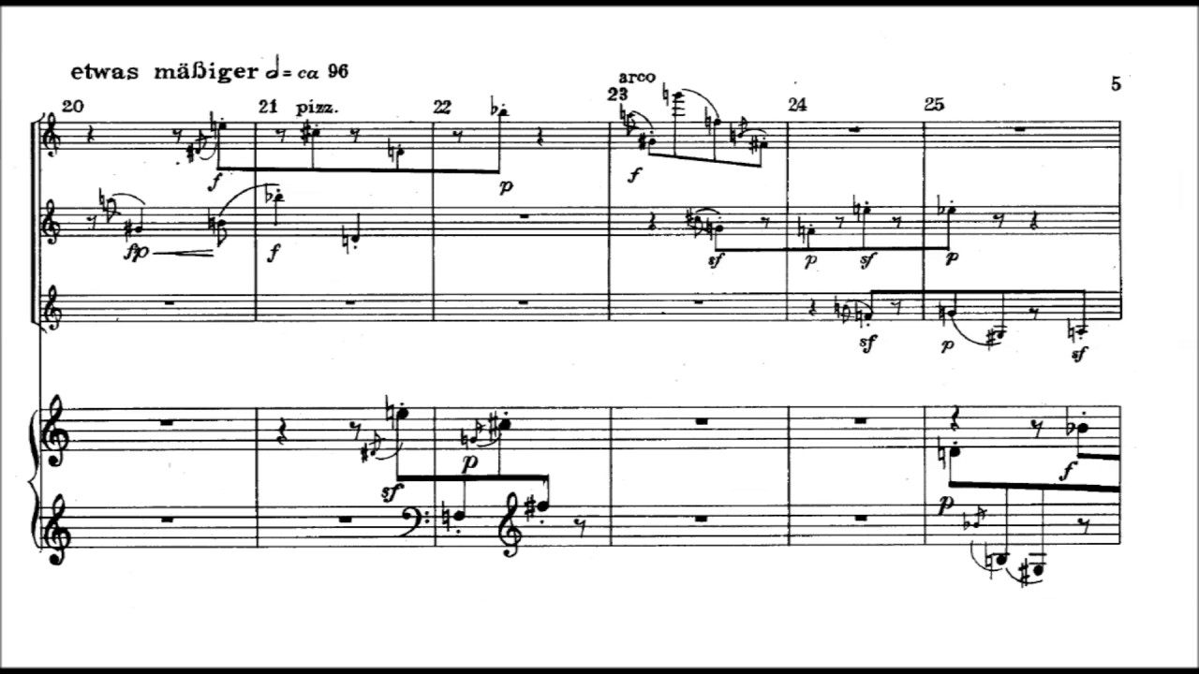
El Lissitzky, propaganda poster (1919)
Bertolt Brecht, epic theater (1930s)
Anton Webern, quartet op 22 (1930)

Slide 5
Lenin: proletkult
Walter Benjamin: “functional transformation”
Theodor Adorno: “social antithesis to society”

Slide 6
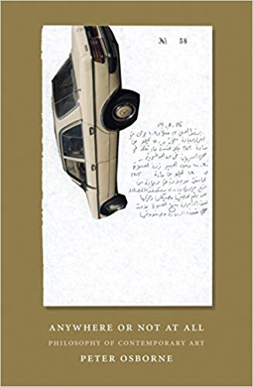
Theodor Adorno: “social antithesis to society”

Slide 7
Hans Haacke, Shapolsky et al. Manhattan Real Estate Holdings, a Real-Time Social System, as of May 1, 1971

Slide 9
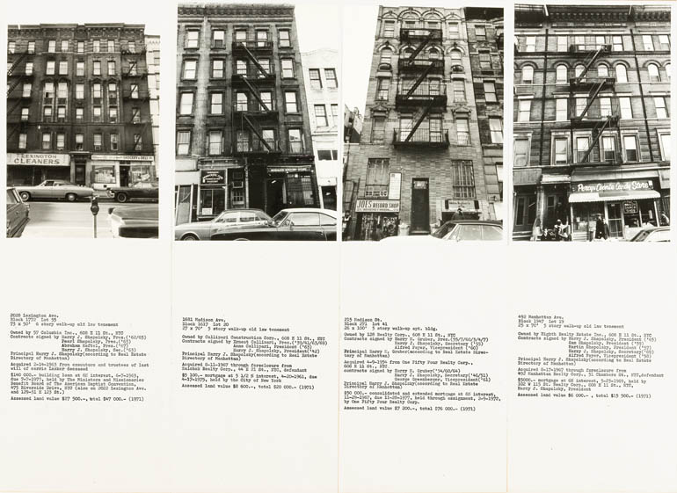

Slide 10
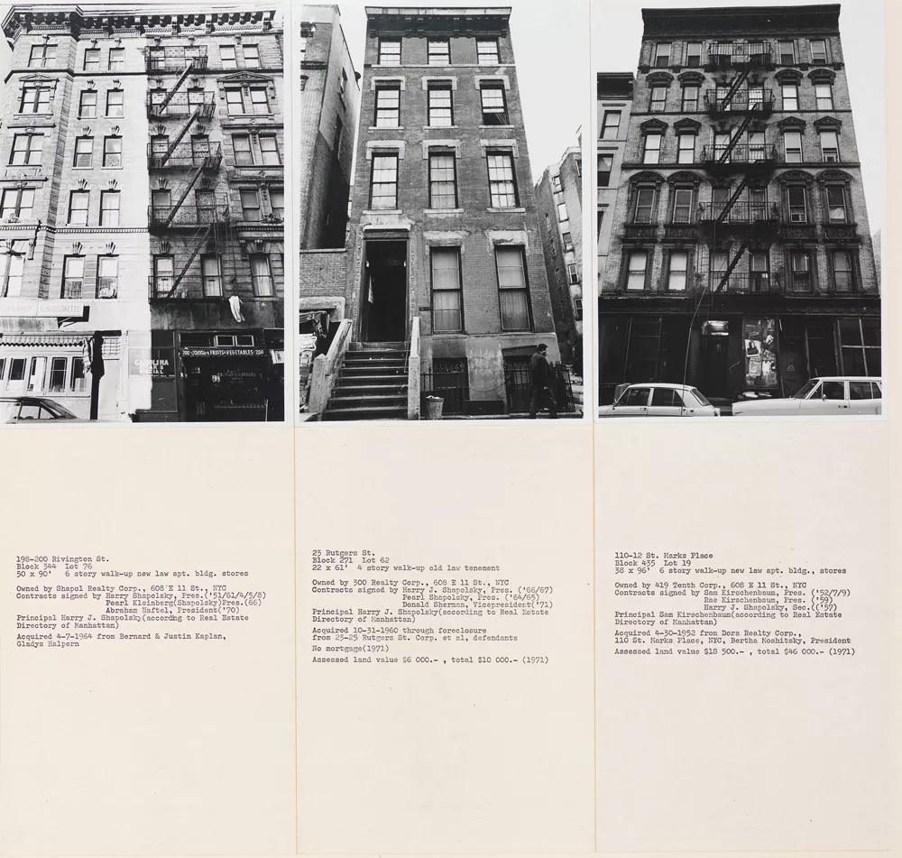

Slide 12
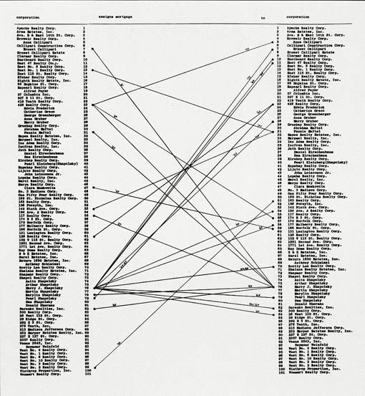

Slide 13
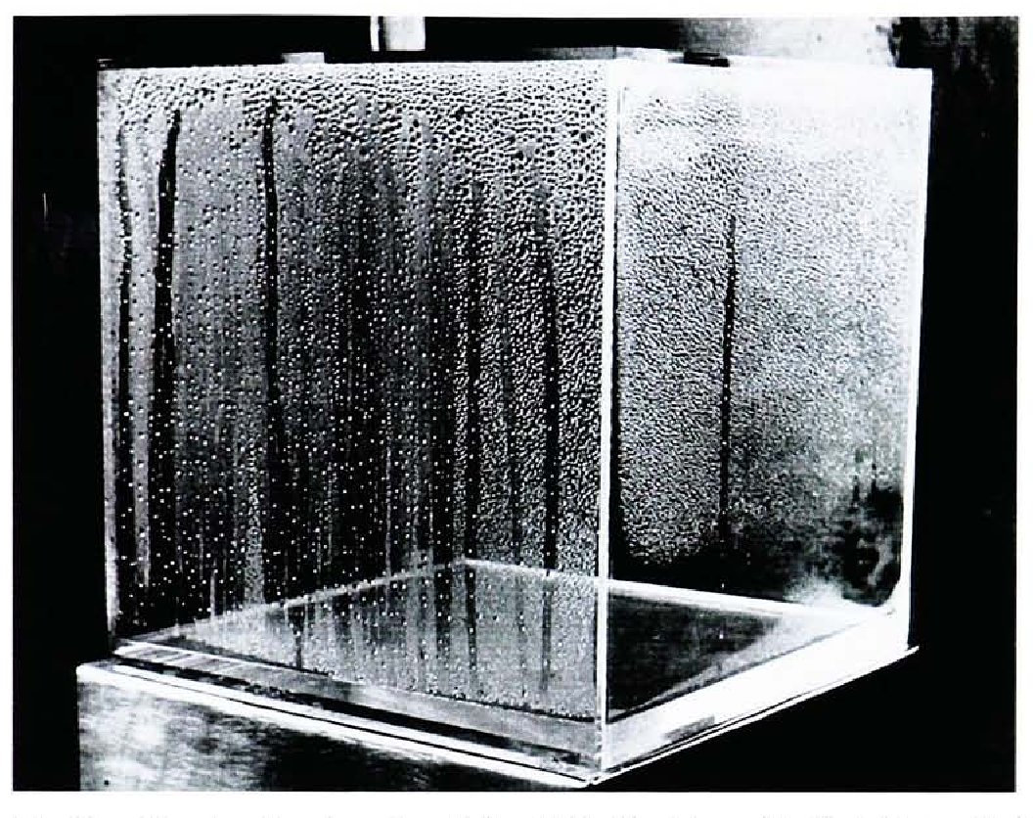
Condensation Cube, 1964

Slide 14
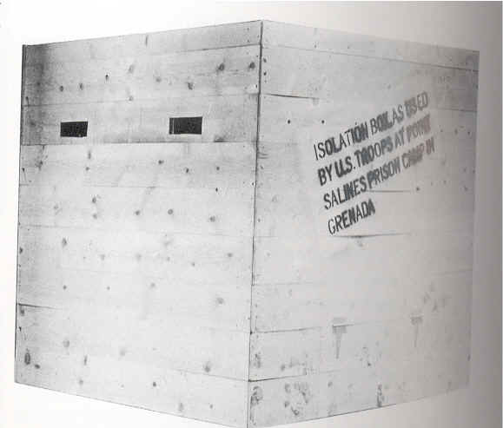
Isolation Box, 1983

Slide 15
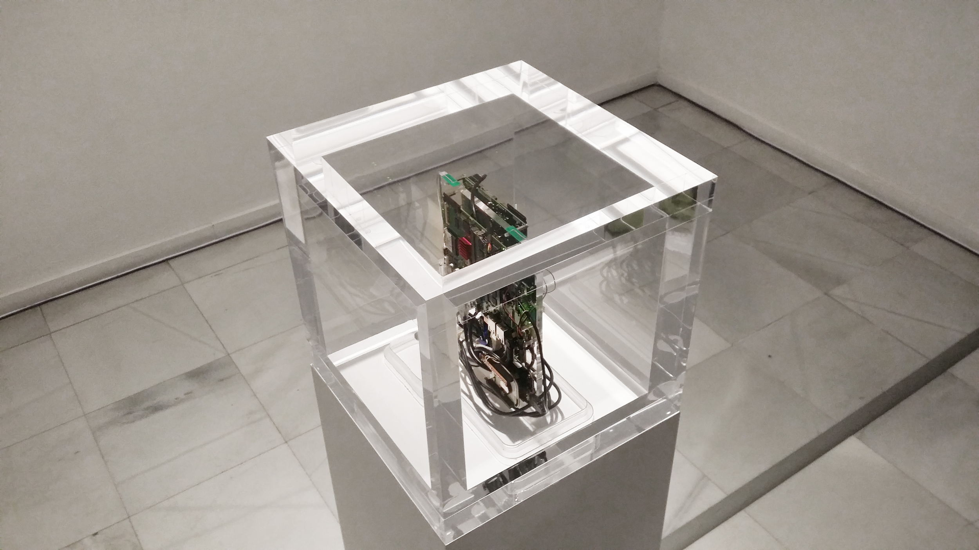
Trevor Paglen & Jacob Appelbaum, Autonomy Cube

Slide 16
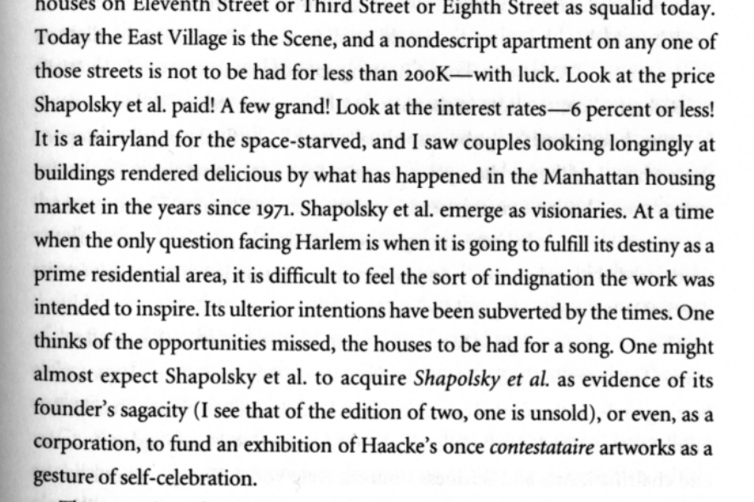
Arthur C. Danto, Hans Haacke and the Industry of Art, 1987

Slide 17

Eva & Franco Mattes (0100101110101101.org), Nike Ground, 2003

Slide 18
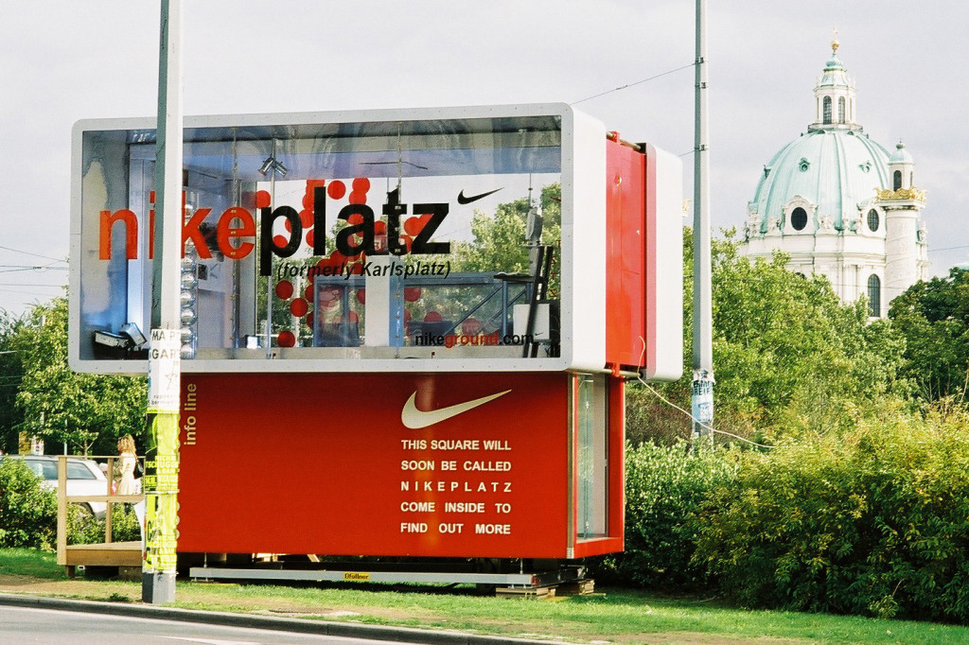

Slide 19
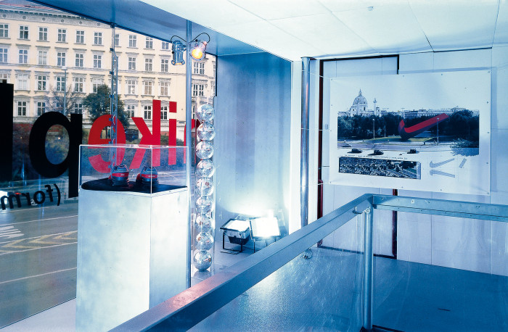

Slide 20

https://youtu.be/eICpSJzdclk?t=120

Slide 21
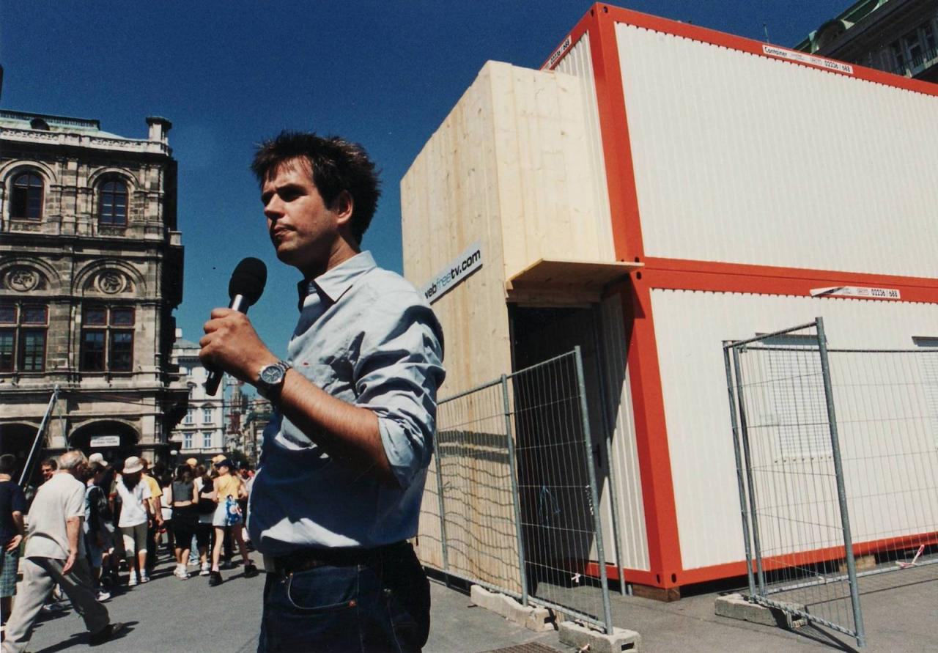
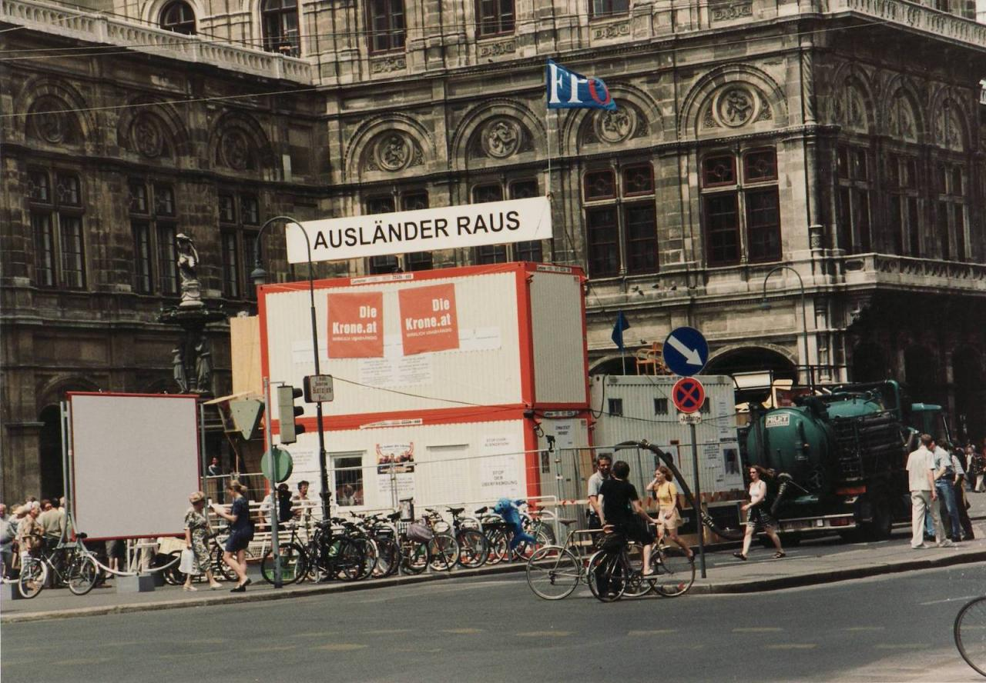
Christoph Schlingensief, Foreigners Out! (2000)

Slide 22
ruang rupa, Jakarta, 2012

Slide 23
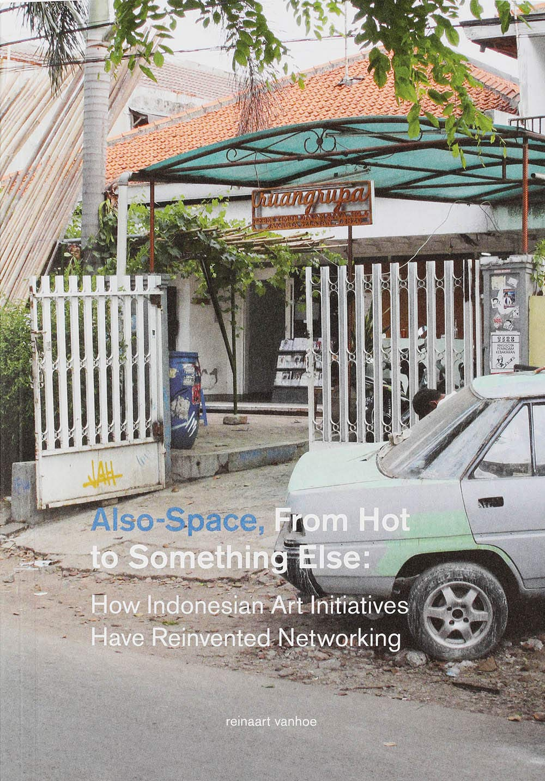
reinaart vanhoe, Also-Space, 2017

Slide 25
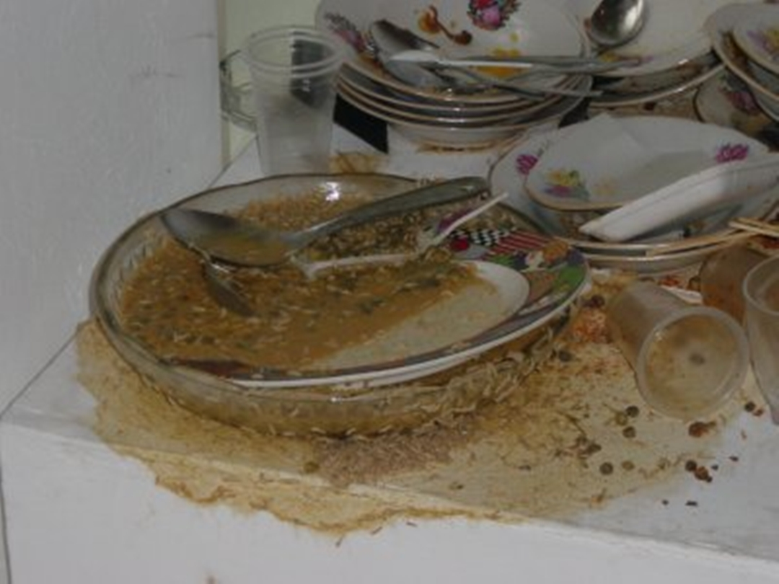
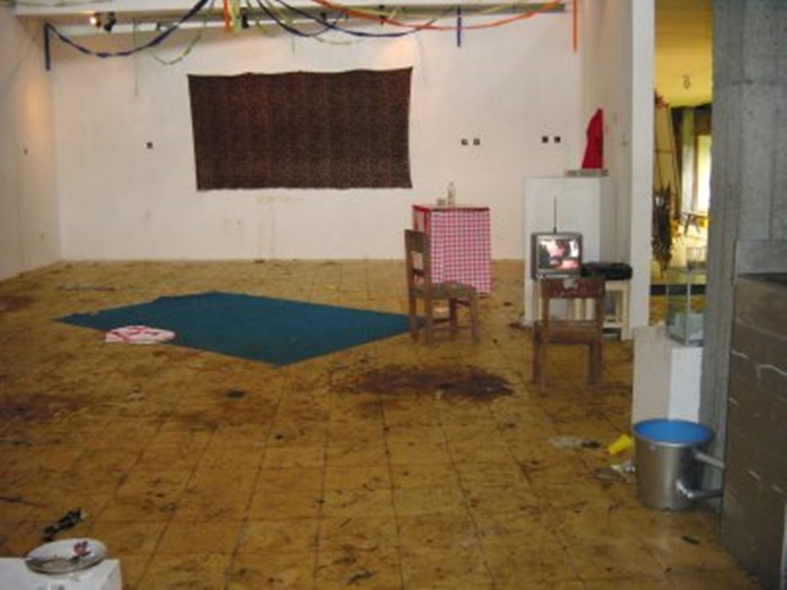
ruang rupa, Lekker eten zonder betalen, Yogyakarta, 2013

Slide 26
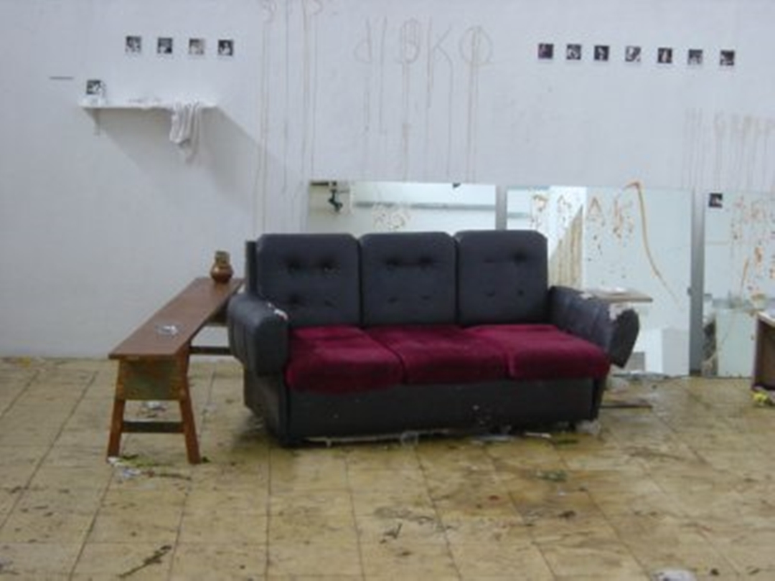
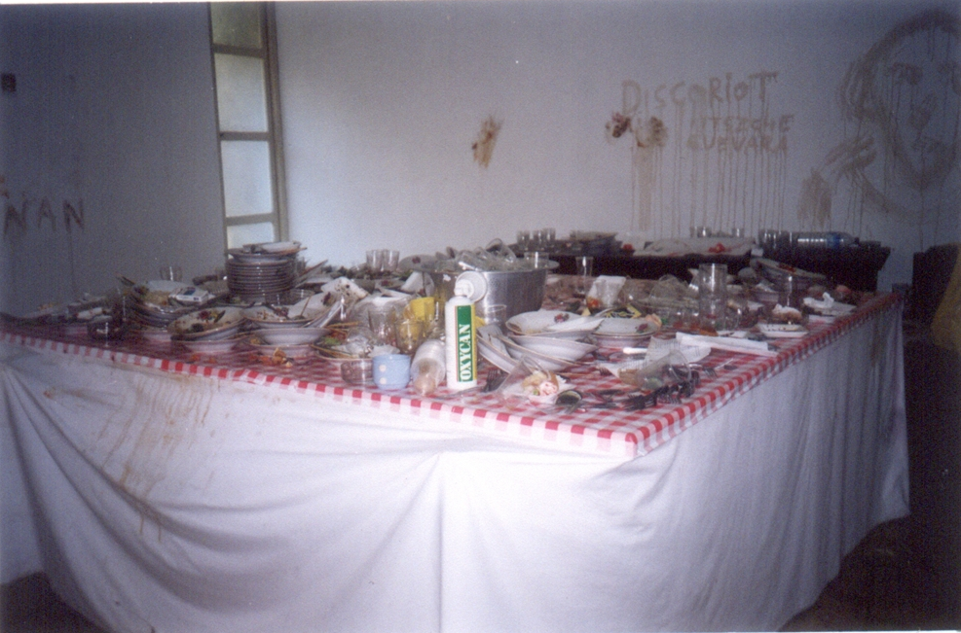

Slide 27
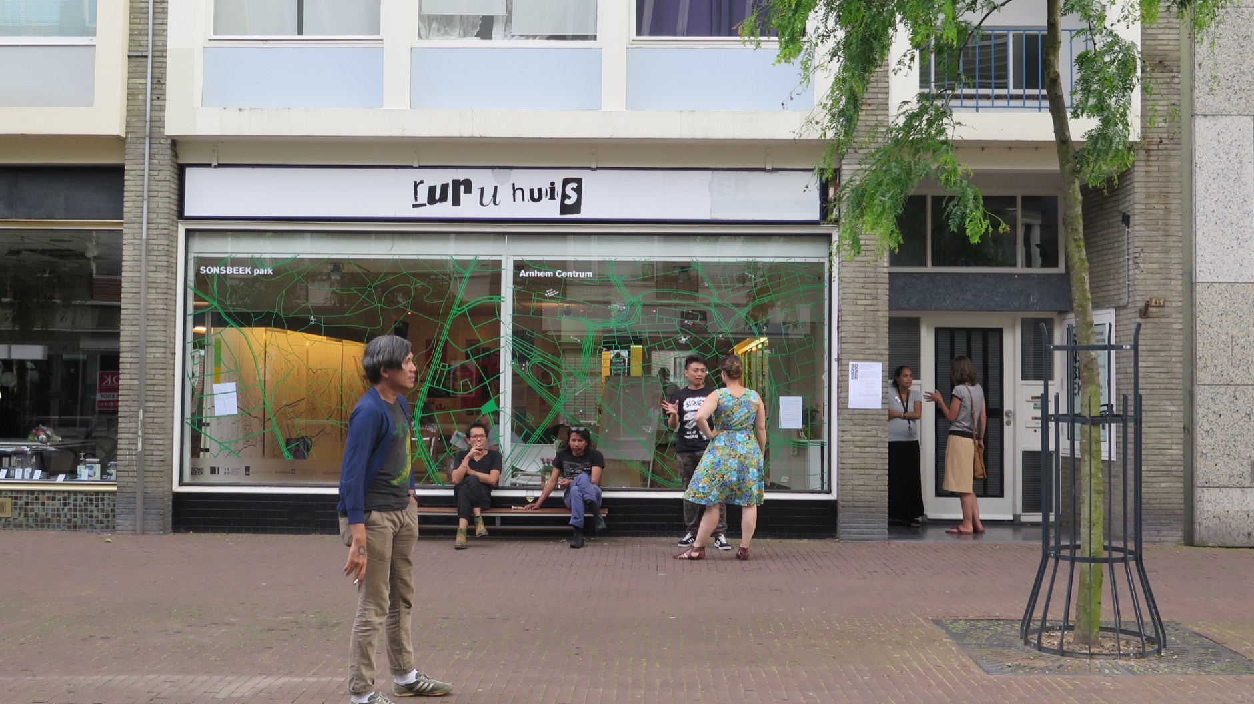

Slide 28
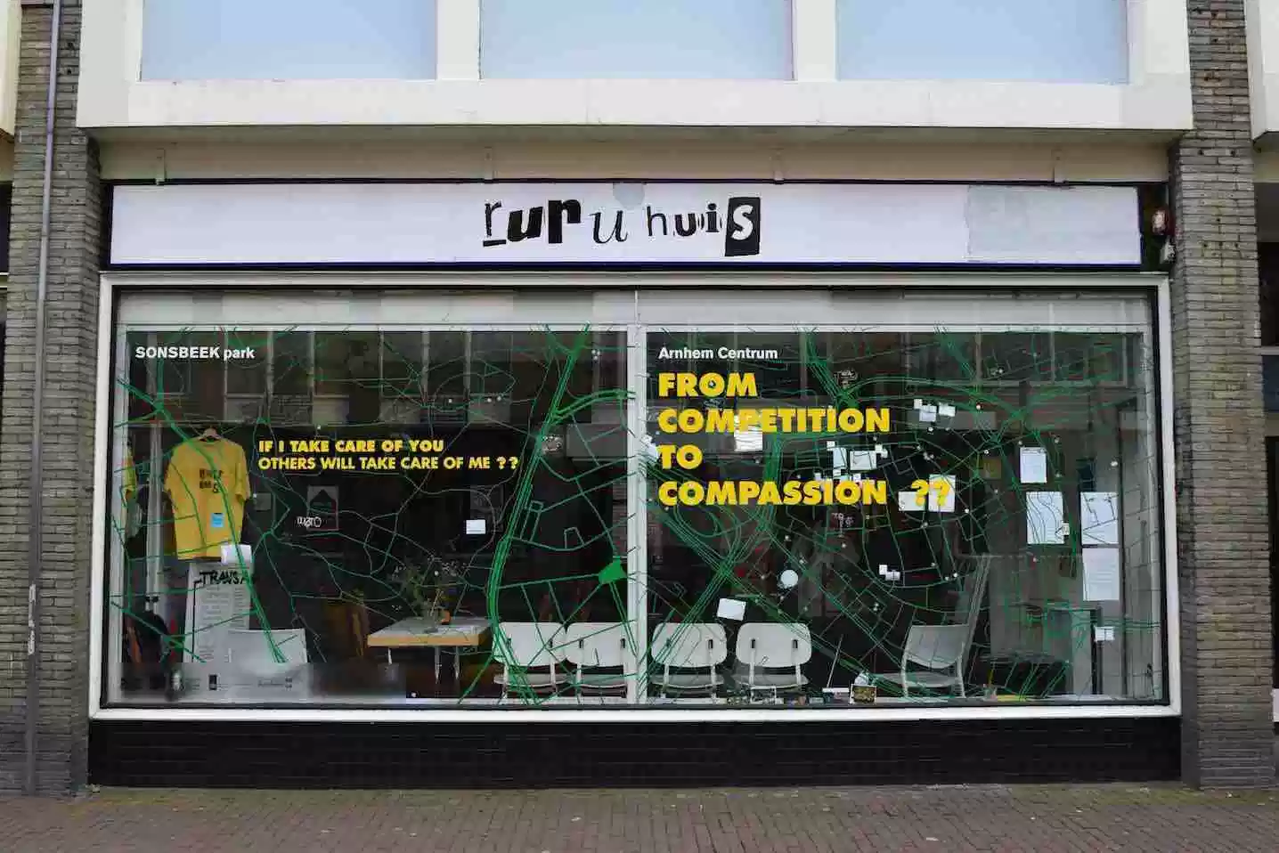

Slide 29
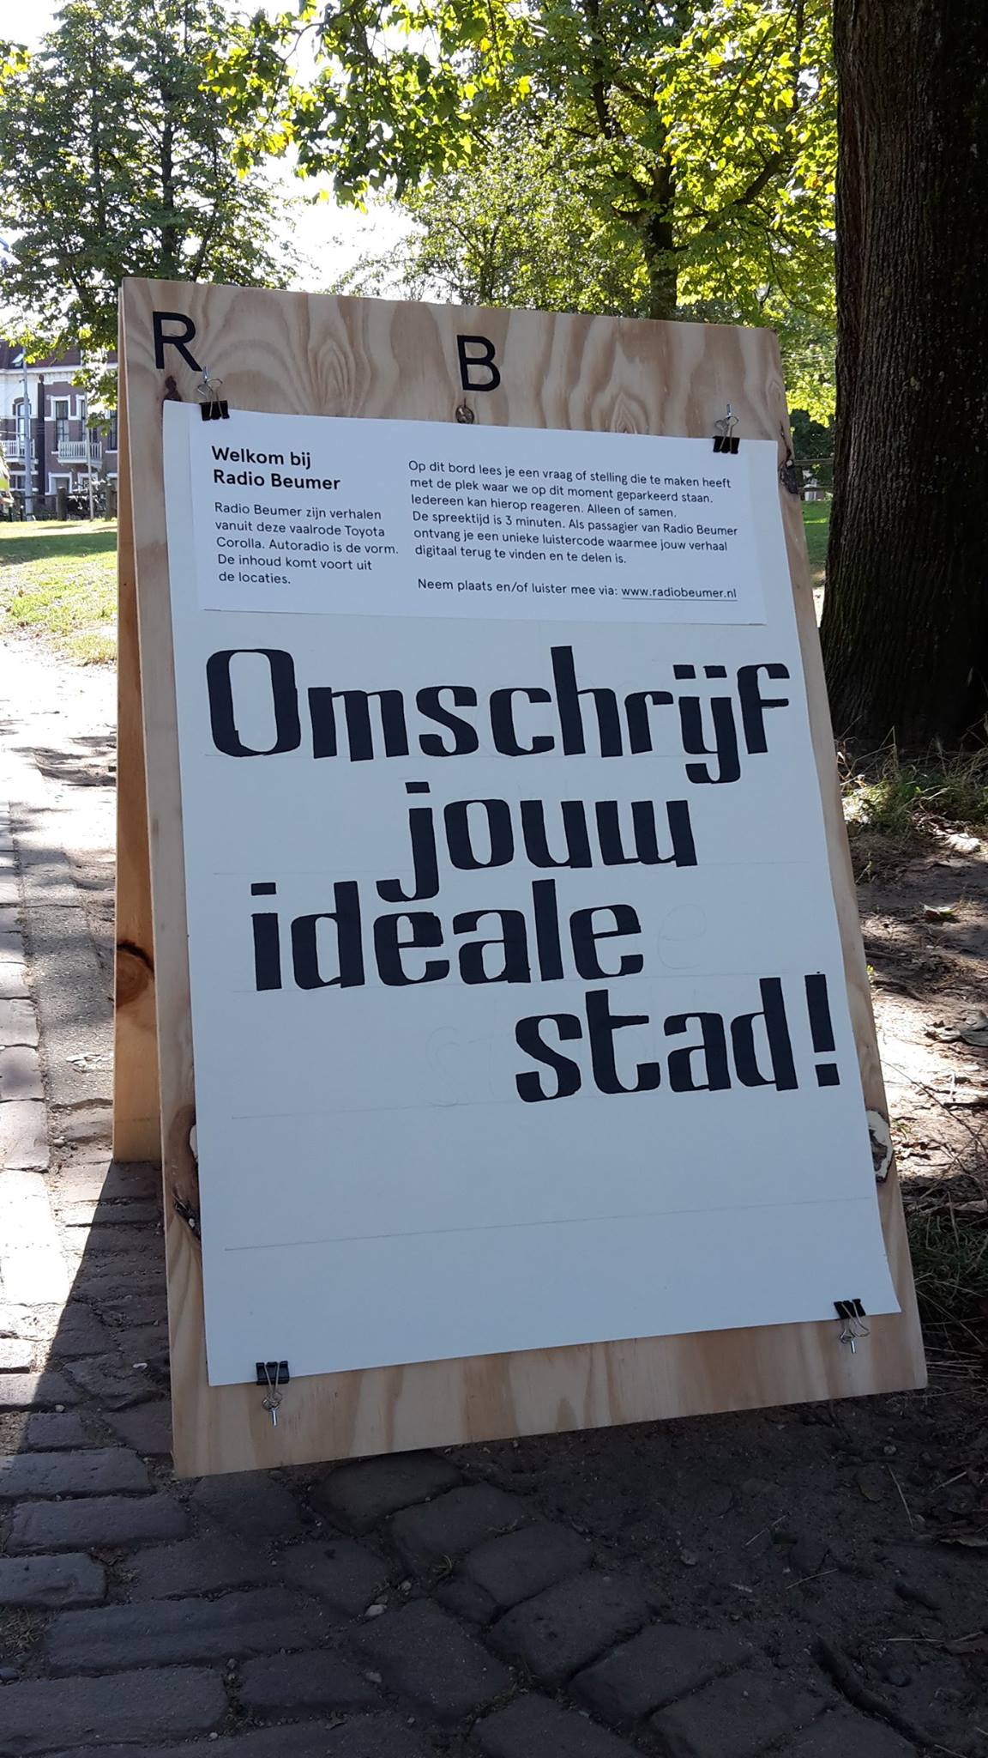
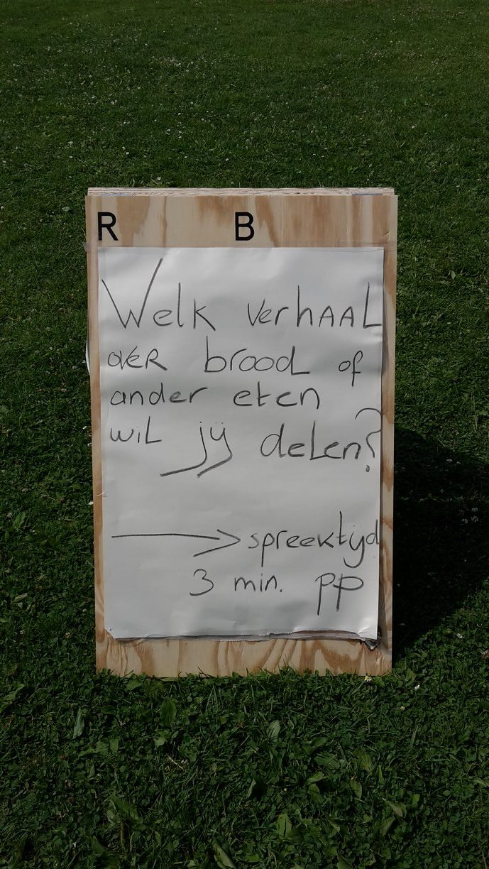
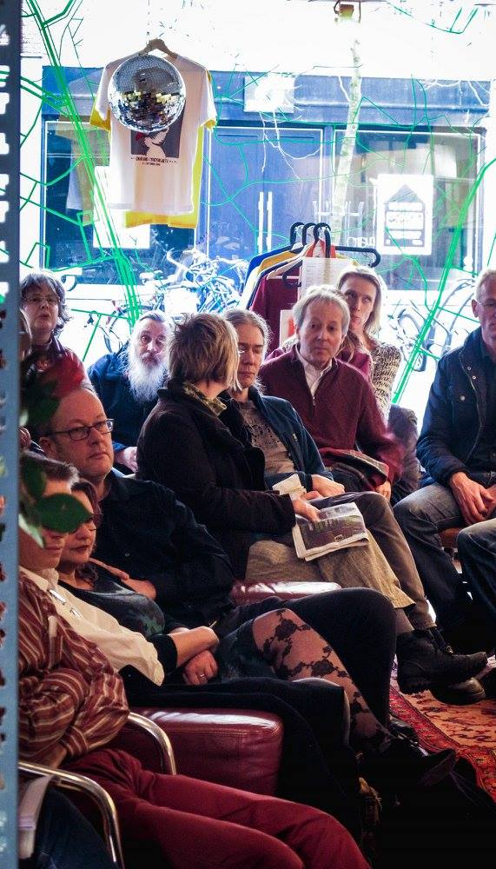

Slide 30
“Our curatorial approach aims at a different community-oriented model of resource usage—economical, but also taking ideas, knowledge, programs and innovations into account. If Documenta was launched in 1955 to heal war wounds, why shouldn’t we focus Documenta 15 on today’s injuries, especially ones rooted in colonialism, capitalism, or patriarchal structures, and contrast them with partnership-based models that enable people to have a different view of the world.”

Slide 31
Florian Cramer Willem de Kooning Academy Rotterdam J.J.F.Cramer@hr.nl

